Slide 1
What’s the Difference?
Stephen K. Roney
Jubail Industrial College

Slide 2
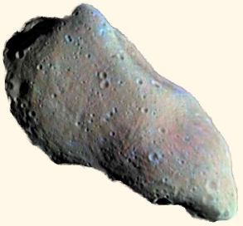
Asteroid

Slide 3
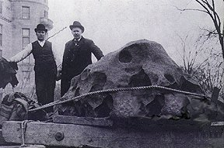
Meteorite

Slide 4
Comet

Slide 5
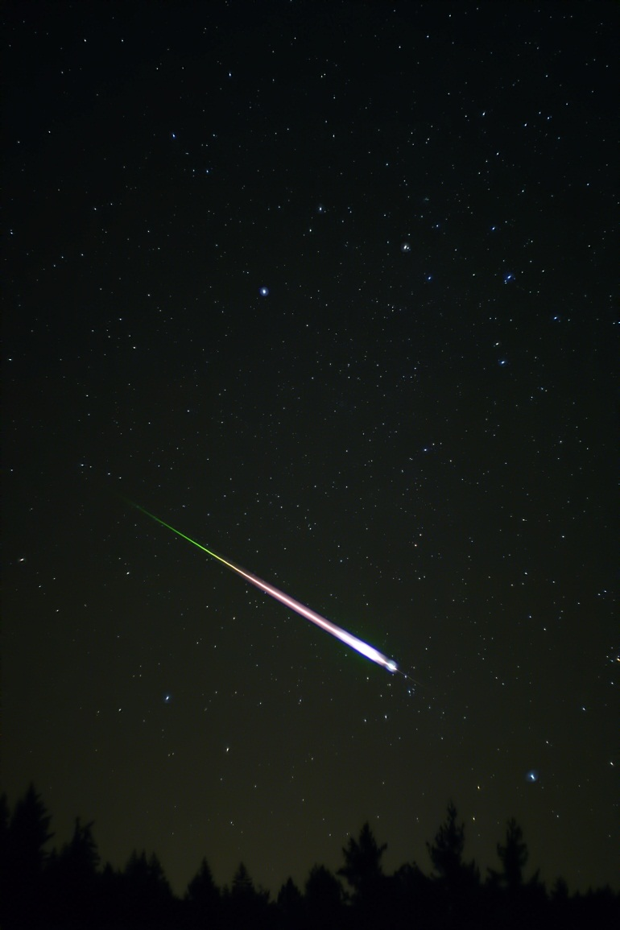
Meteor

