Slide 1
Which design decade?
Stephen Roney, Jic, november 2012

Slide 2
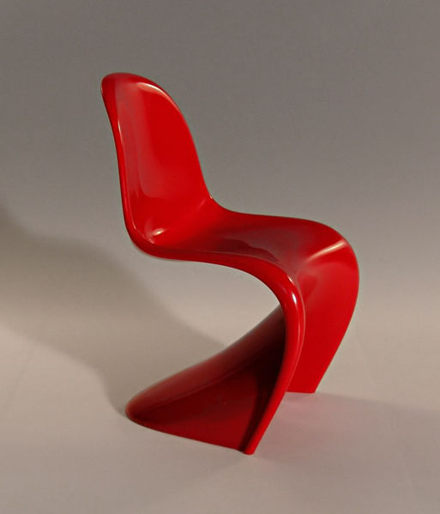
1960-69 panton s-chair

Slide 3
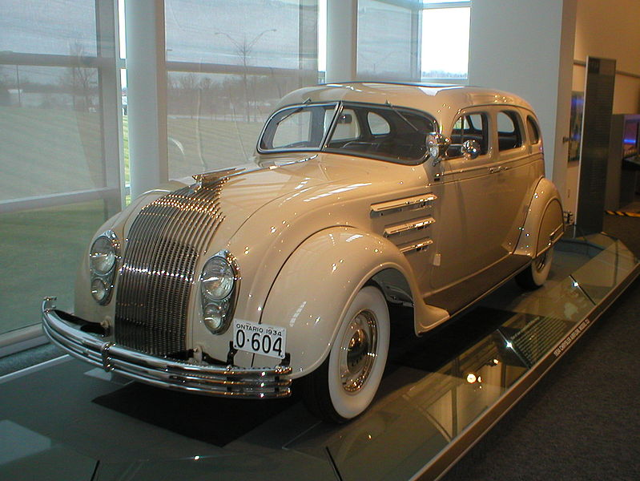
1930-39 Chrysler airflow

Slide 4
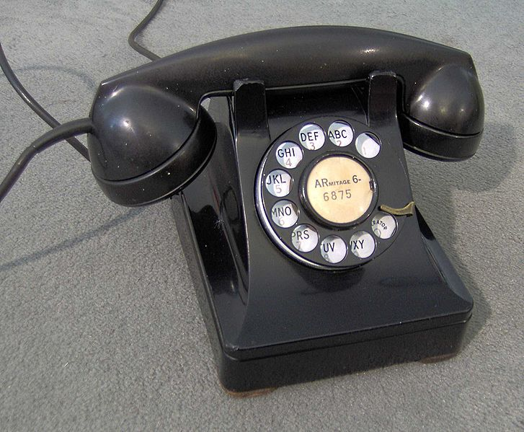
1930-39 Dreyfuss telephone

Slide 5
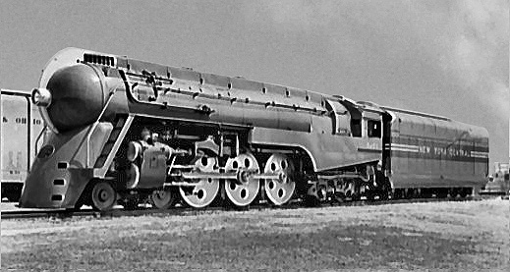
1930-39 dreyfuss locomotive

Slide 6
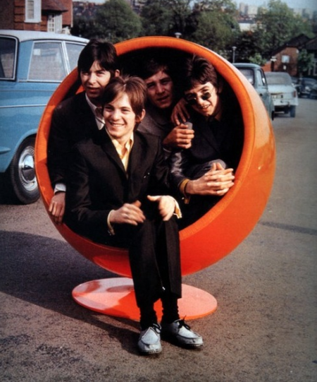
1960-69 ball chair

Slide 7
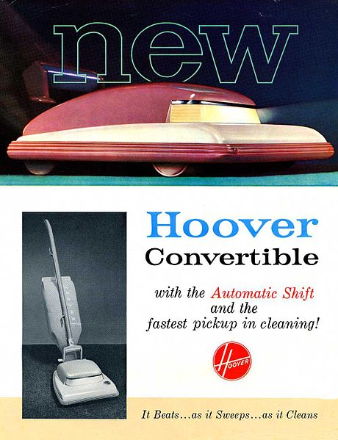
1830-39 dreyfuss hoover cleaner

Slide 8
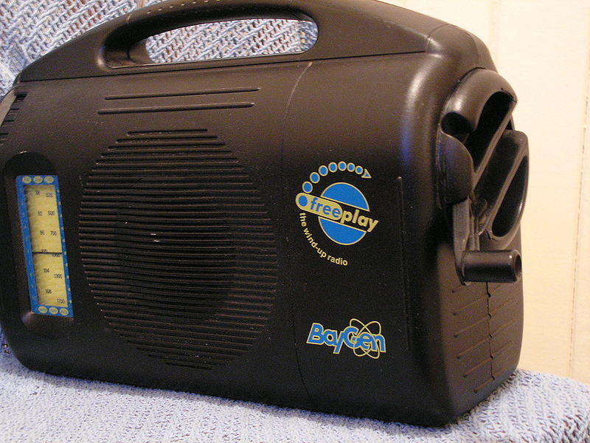
1990-99 Baylis radio

Slide 9
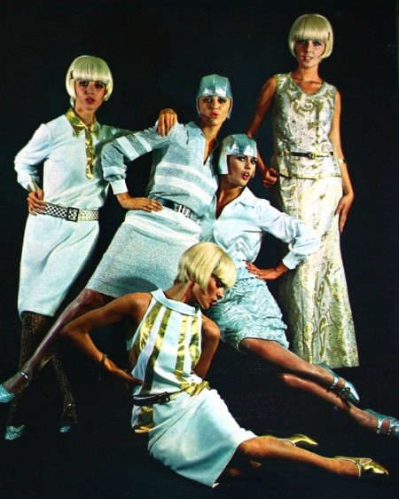
1960-69 courreges space age clothes

Slide 10
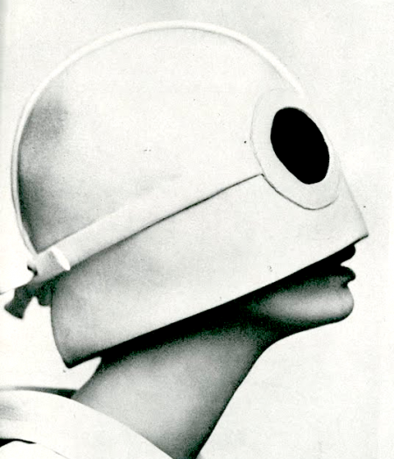
1960-69 courreges hat

