Slide 1
Weather Icons
Stephen Roney
JIC
March 2013

Slide 2
hurricane

Slide 3
foggy, fog

Slide 4
snowy, blizzard

Slide 5
rain, rainy

Slide 6
windy, wind

Slide 7
storm

Slide 8
sun, sunny, bright

Slide 9
ice

Slide 10
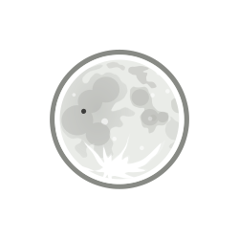
clear

Slide 11
cloudy

Slide 12
dark

Slide 13
cold, cool

Slide 14
hot

Slide 15
humid

