Slide 1
What is It?
Stephen Roney
JIC
2012

Slide 2
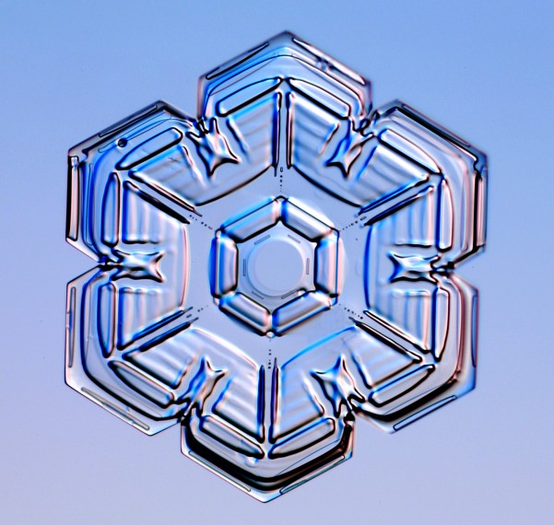
Clue 1

Slide 3
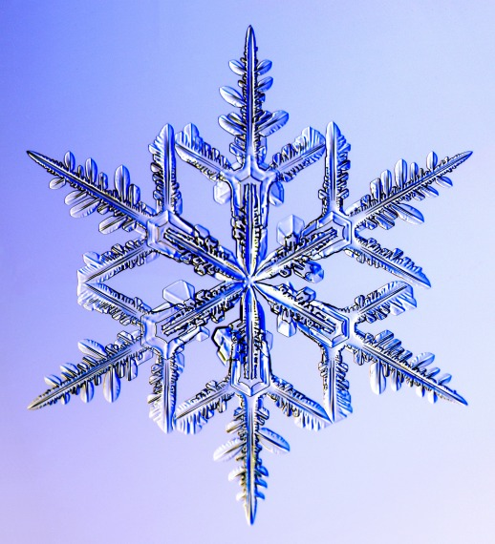
Clue 2

Slide 4
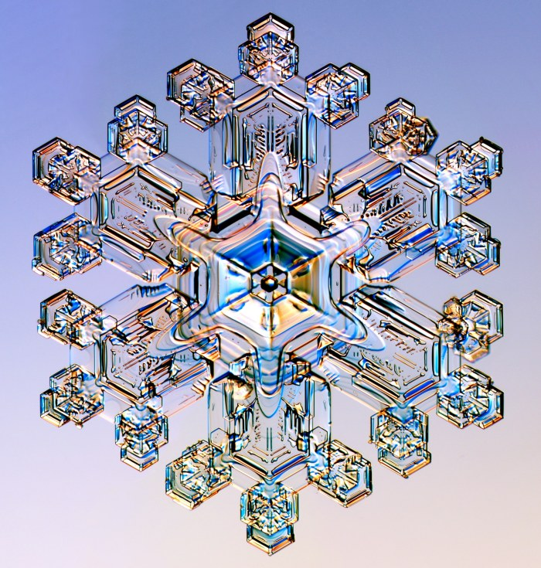
Clue 3

Slide 5
SNOW

Slide 6
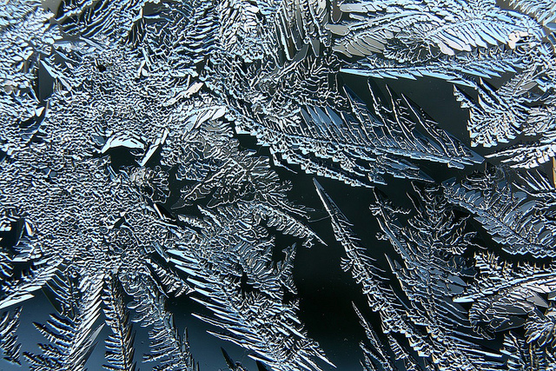
Clue 1

Slide 7
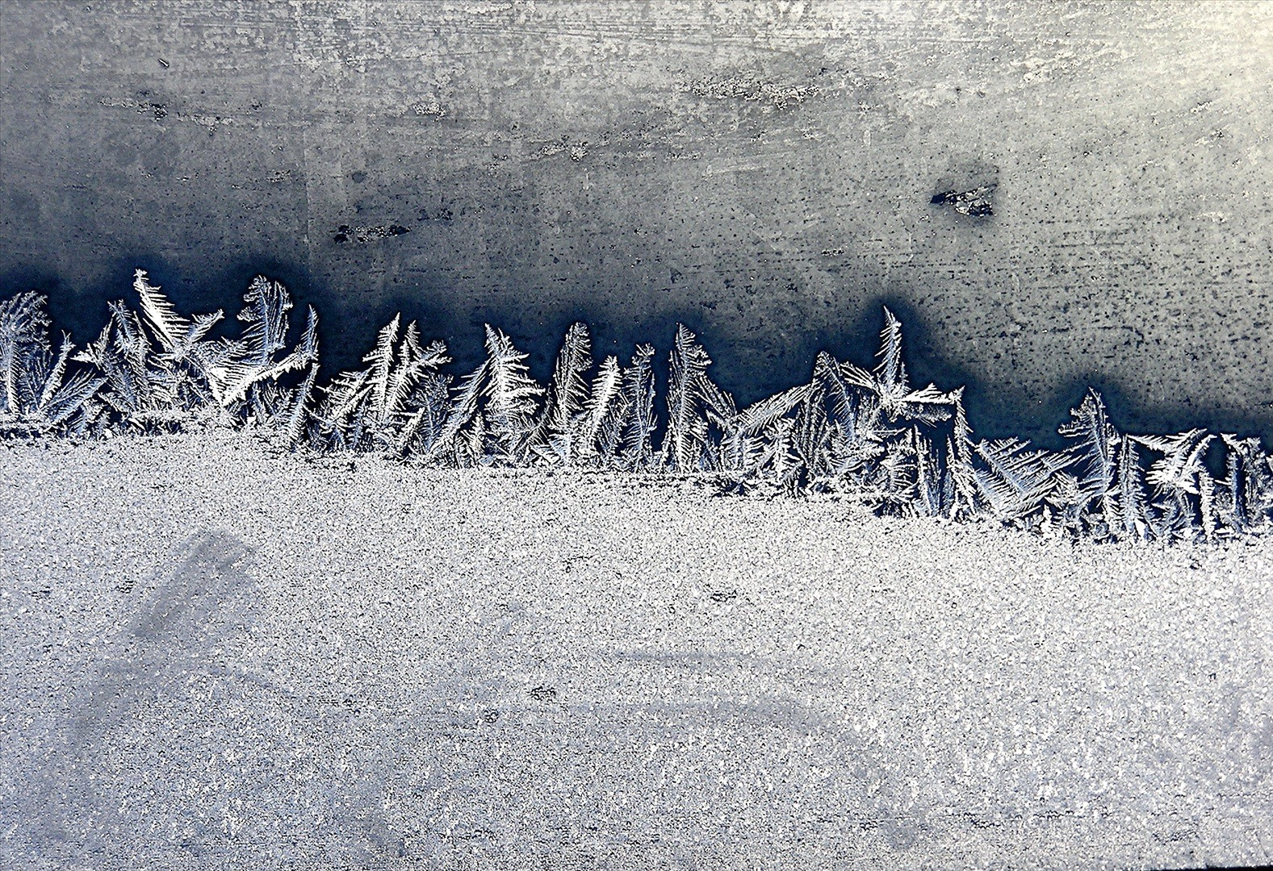
Clue 2

Slide 8
FROST (ice on a window)

Slide 9
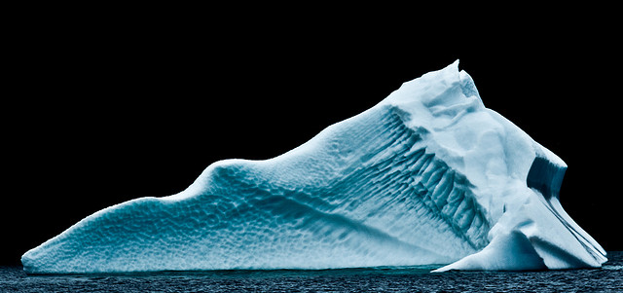
Clue 1

Slide 10
ICEBERG (ice at sea)

Slide 11
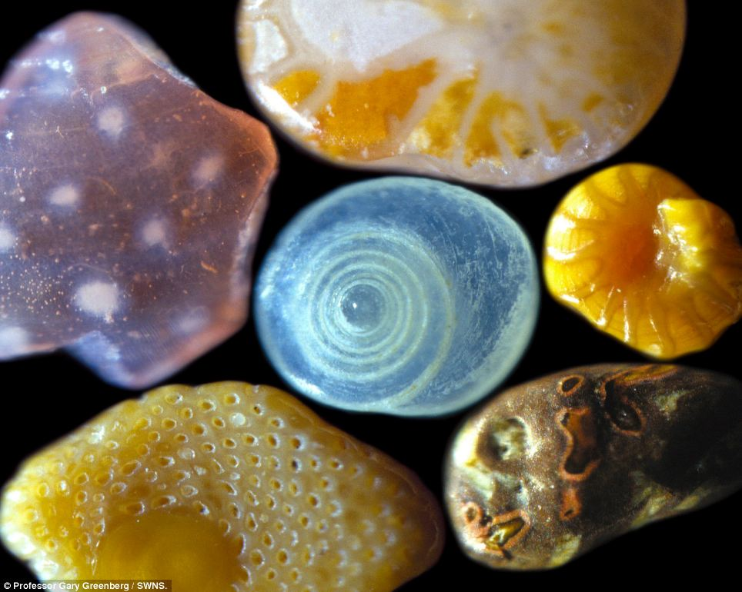
What is this?

Slide 12
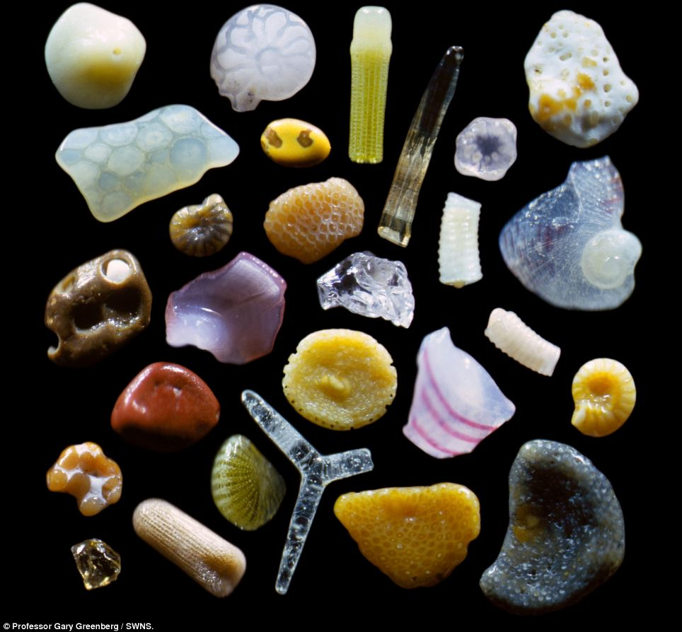
Clue 2

Slide 13
SAND

