Slide 1
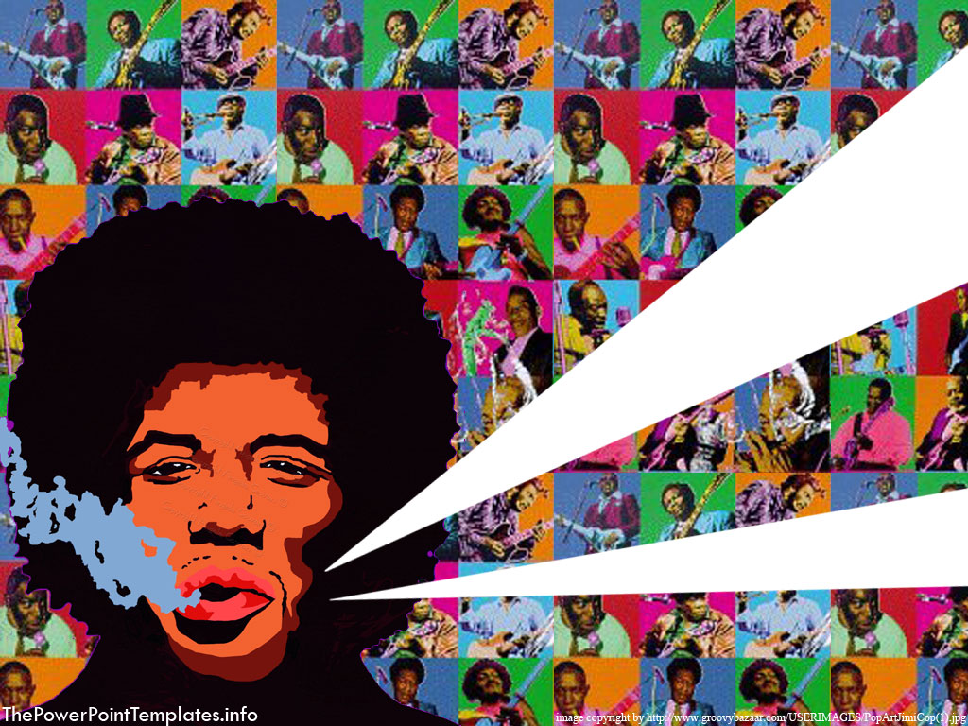
Unit 10 Verbs
Stephen Roney JIC 2014

Slide 2
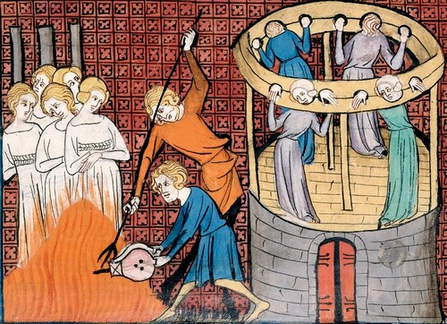
hurt

Slide 3
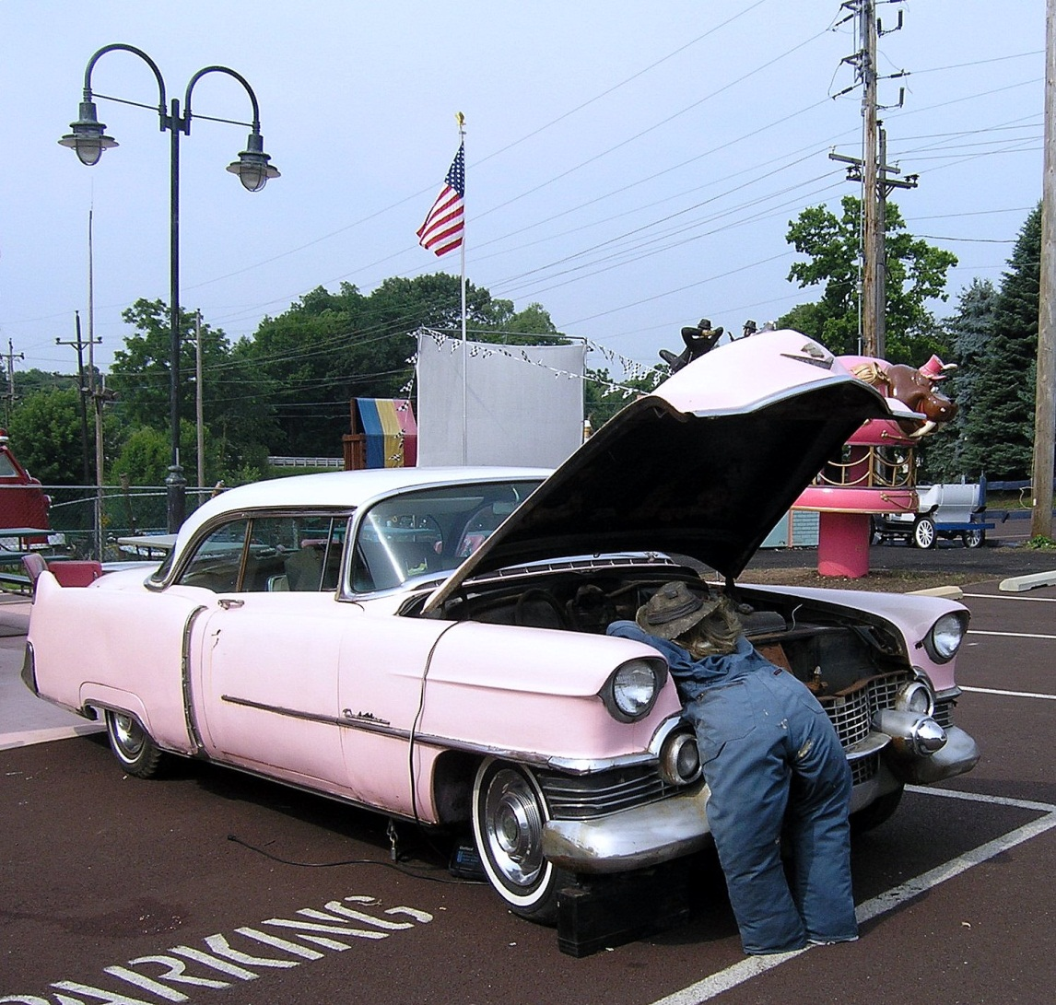
service

Slide 4
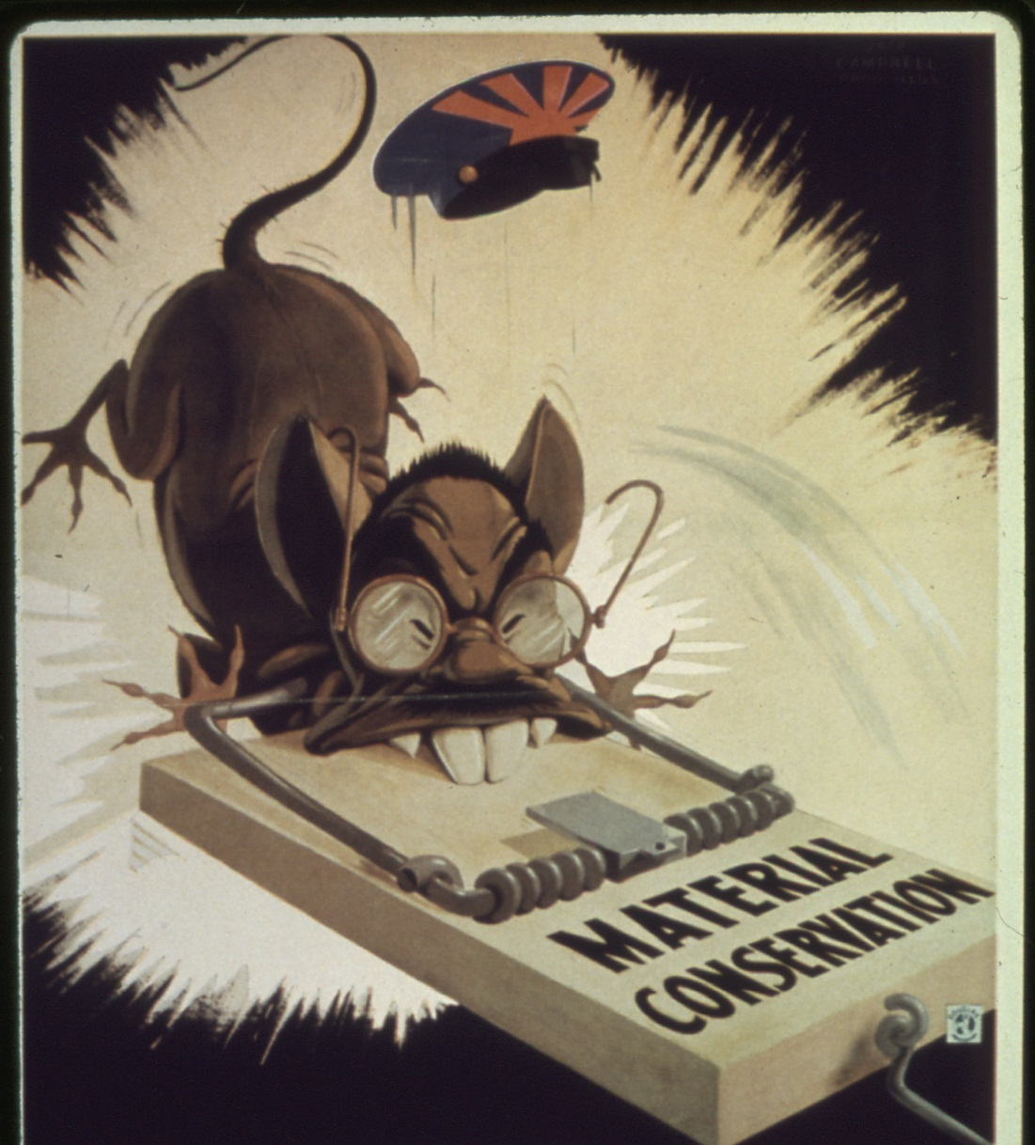
trap

Slide 5
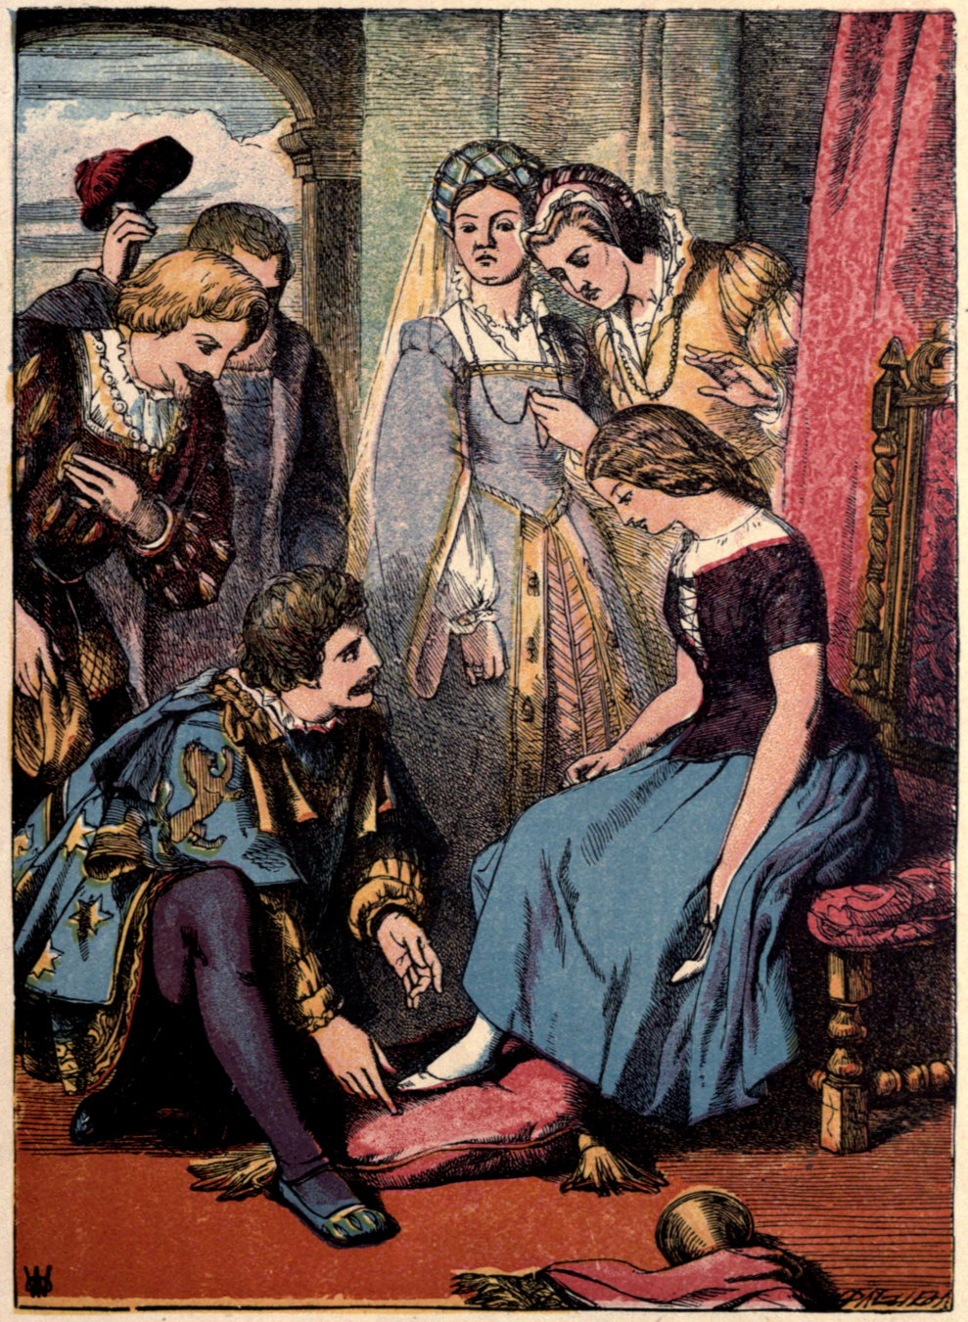
wear

Slide 6

trip

Slide 7

wash

Slide 8

slip

Slide 9
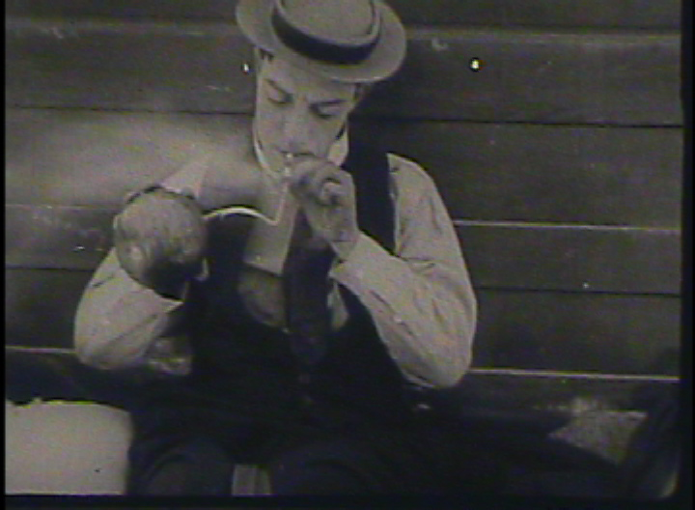
light

Slide 10

investigate

Slide 11
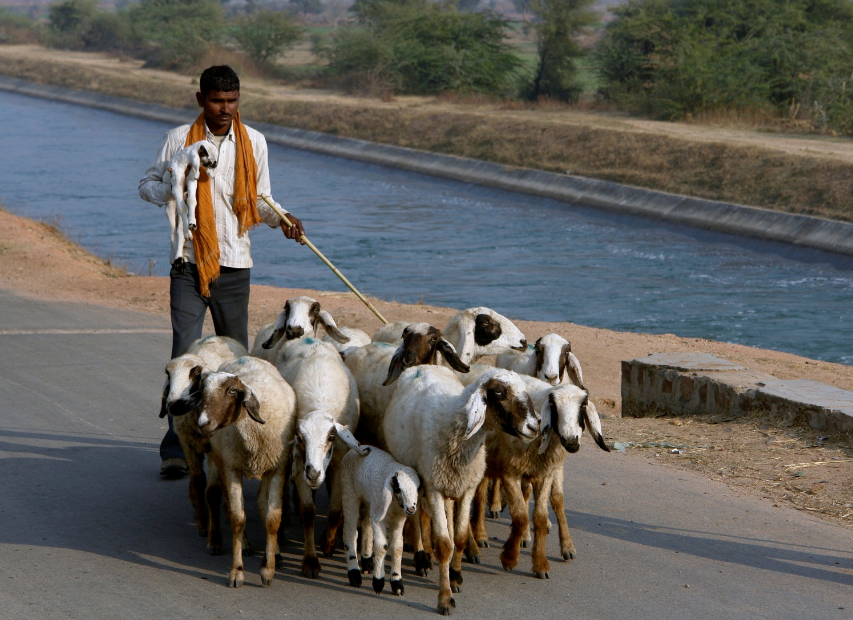
mind

Slide 12
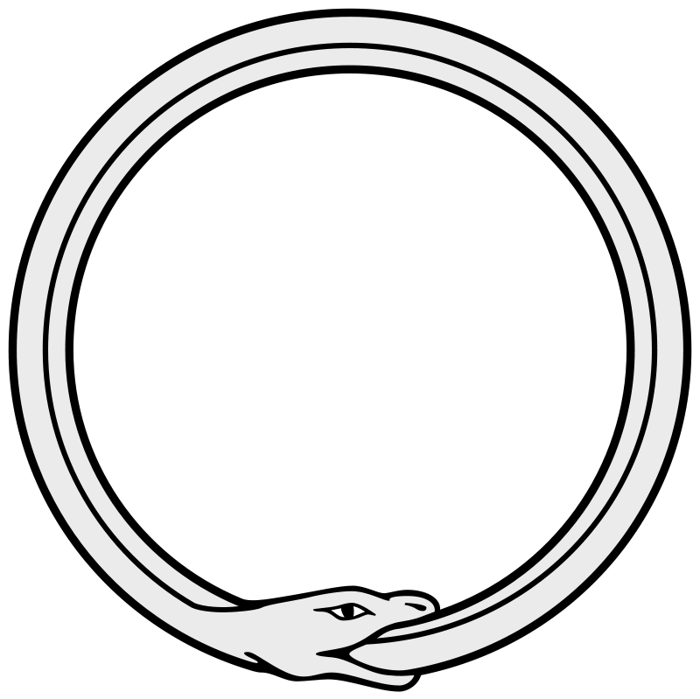
coil

Slide 13
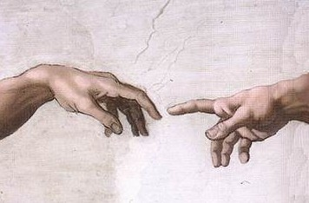
touch

Slide 14
The End
Stephen K. Roney
JIC
March, 2014

