Slide 1
Vacation Activities
Stephen Roney
JIC
March, 2013

Slide 2
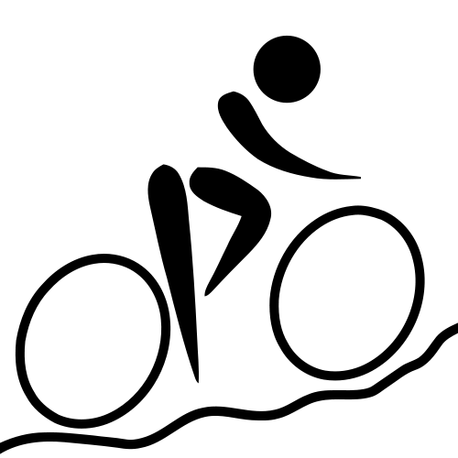
mountain biking

Slide 3
sea kayaking

Slide 4
snowboarding

Slide 5
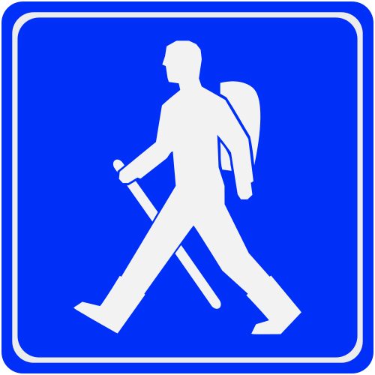
trekking

Slide 6
skiing

Slide 7
scuba diving

Slide 8
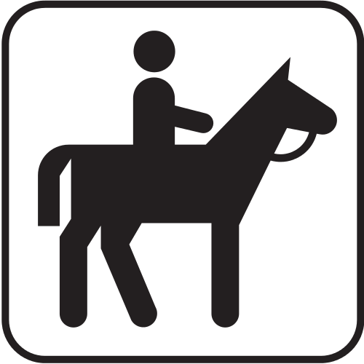
horse riding

