Slide 1
Unit 8 Vocabulary
Stephen Roney
JIC
February 2014

Slide 2
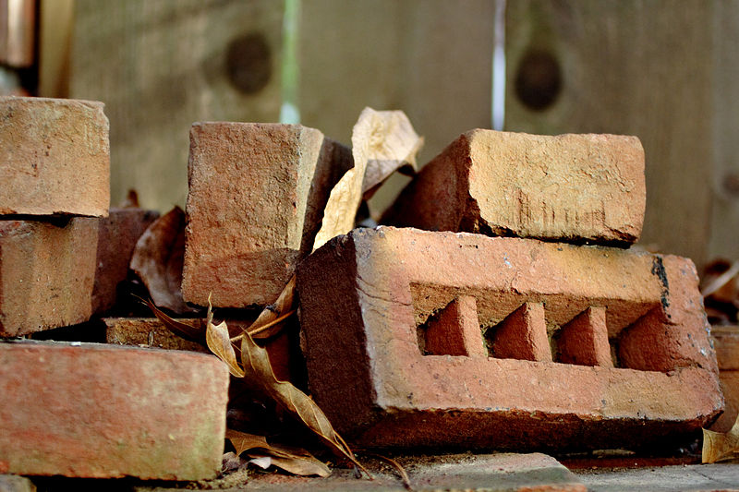
bricks

Slide 3
digger

Slide 4
hard hat

Slide 5
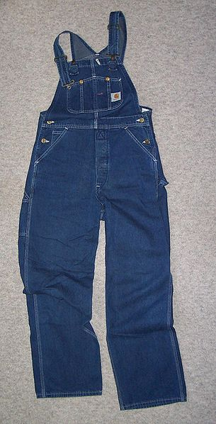
overalls

Slide 6
space shuttle

Slide 7
telescope

Slide 8
spark plug

Slide 9
space walk

Slide 10
space station

Slide 11
satellite

Slide 12
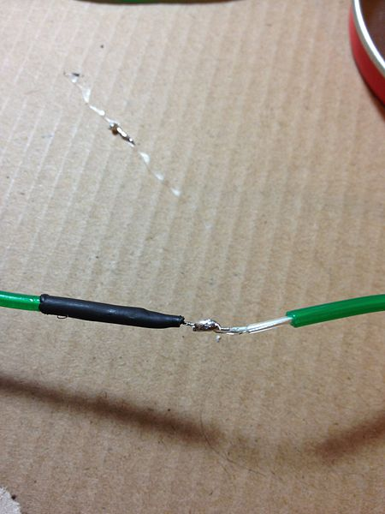
insulation

Slide 13
display screen

Slide 14
bucket

Slide 15
accident

Slide 16
ambulance

Slide 17
beam

Slide 18
damage

Slide 19
goggles

Slide 20
moon

Slide 21
sledgehammer

Slide 22
scaffolding

Slide 23
lens

Slide 24
fuse

Slide 25
crane

Slide 26
The End
Stephen Roney
JIC
February, 2014

