Slide 1
Unit 6 Nouns 2
Stephen Roney
JIC
May, 2014

Slide 2
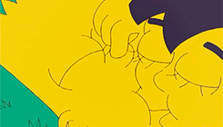
artificial respiration

Slide 3
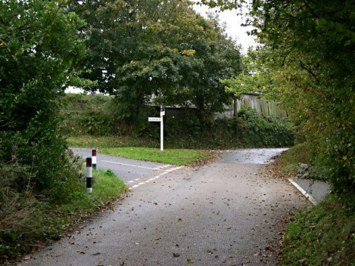
crossroads

Slide 4
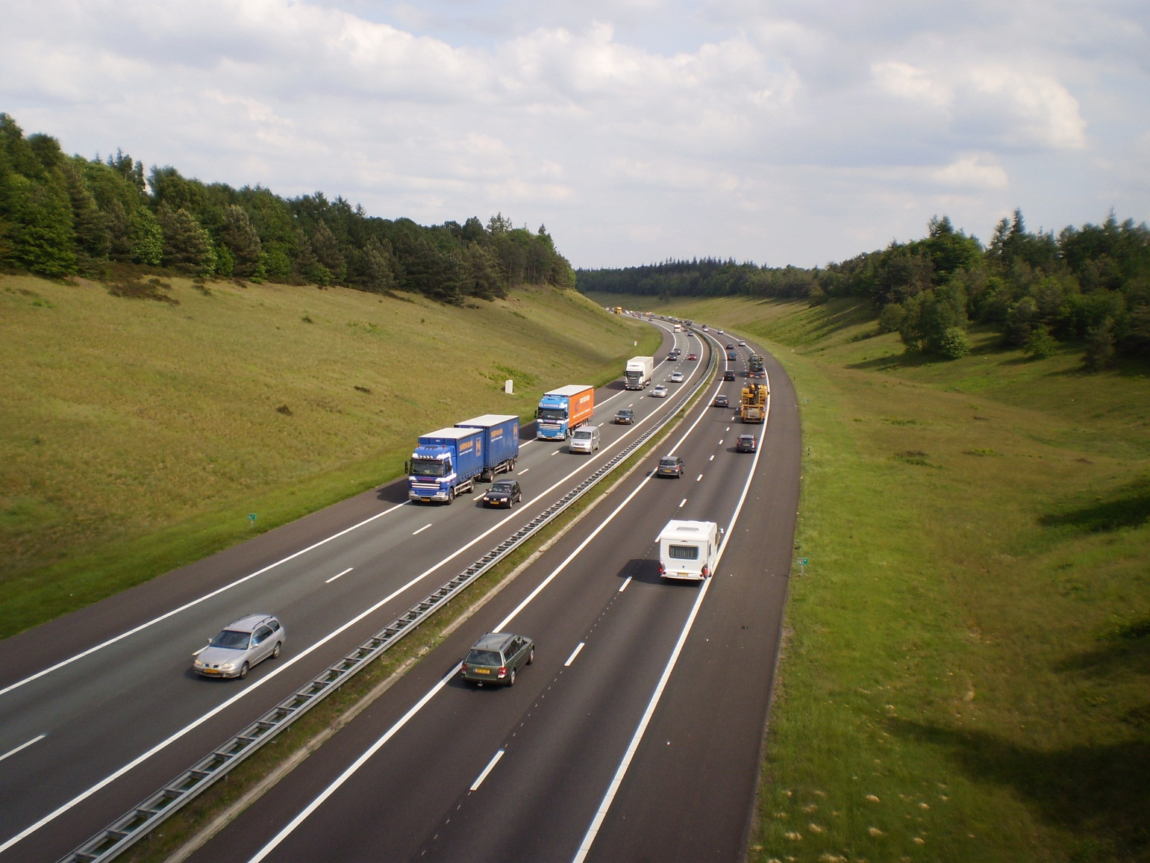
motorway

Slide 5
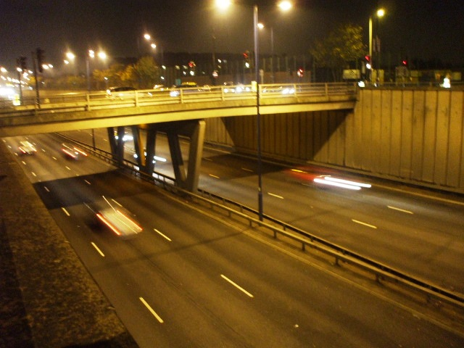
underpass

Slide 6
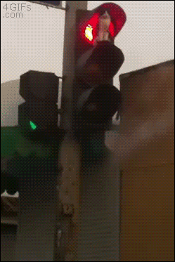
traffic lights

Slide 7
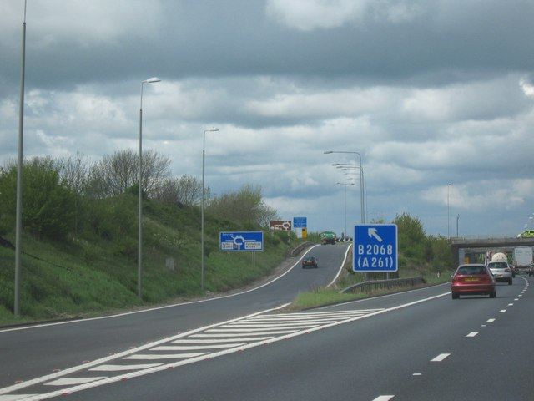
slip road

Slide 8
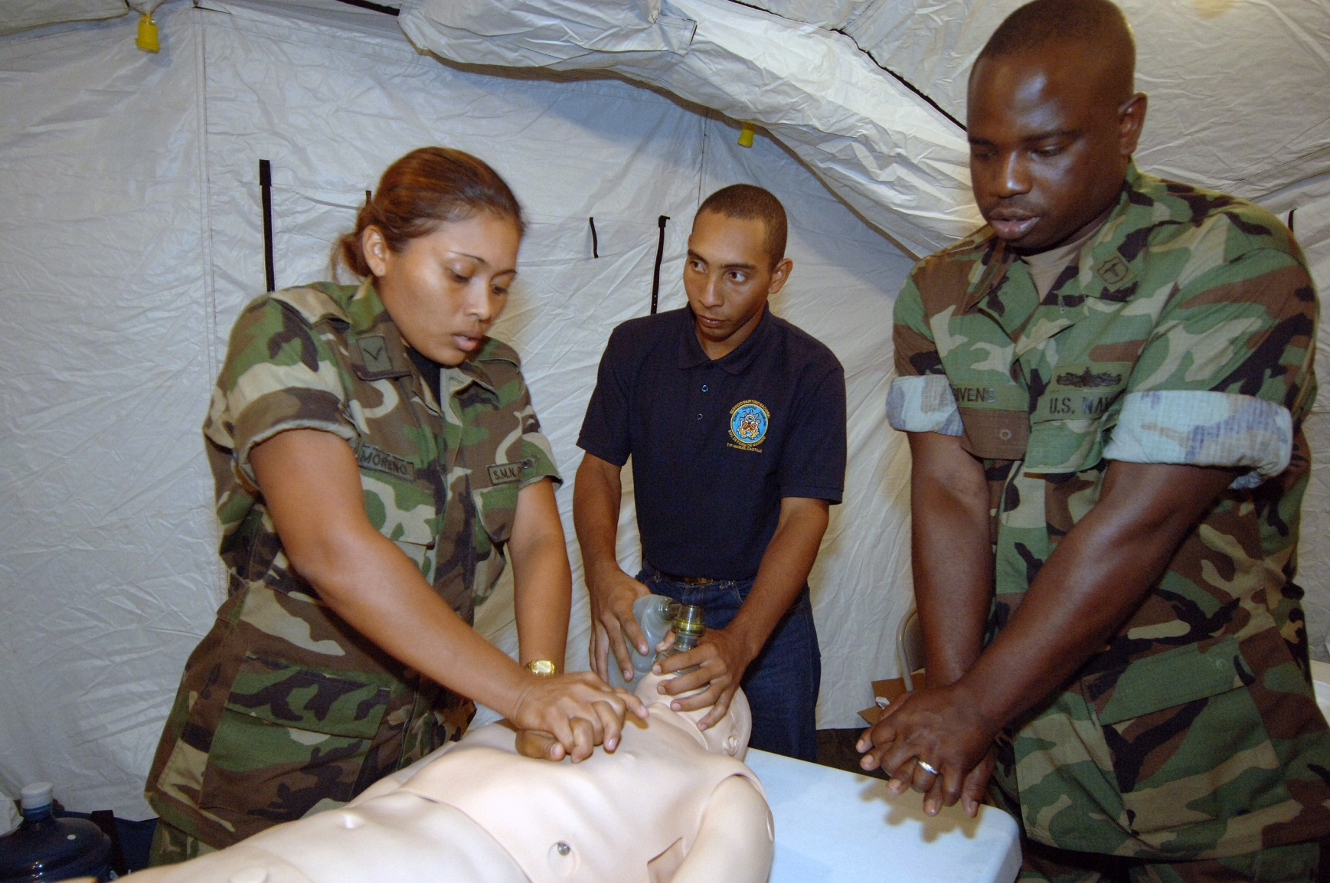
cardio-pulmonary resuscitation

Slide 9
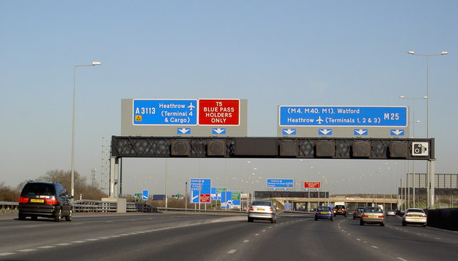
gantry

Slide 10
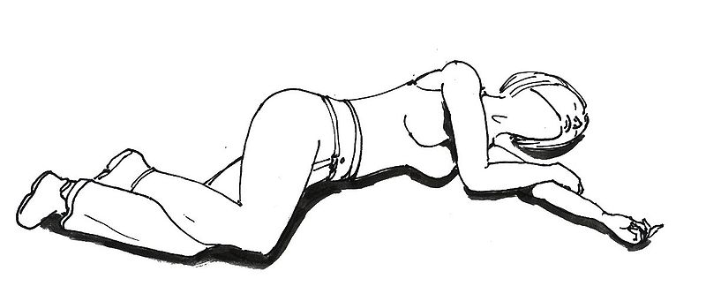
recovery position

Slide 11
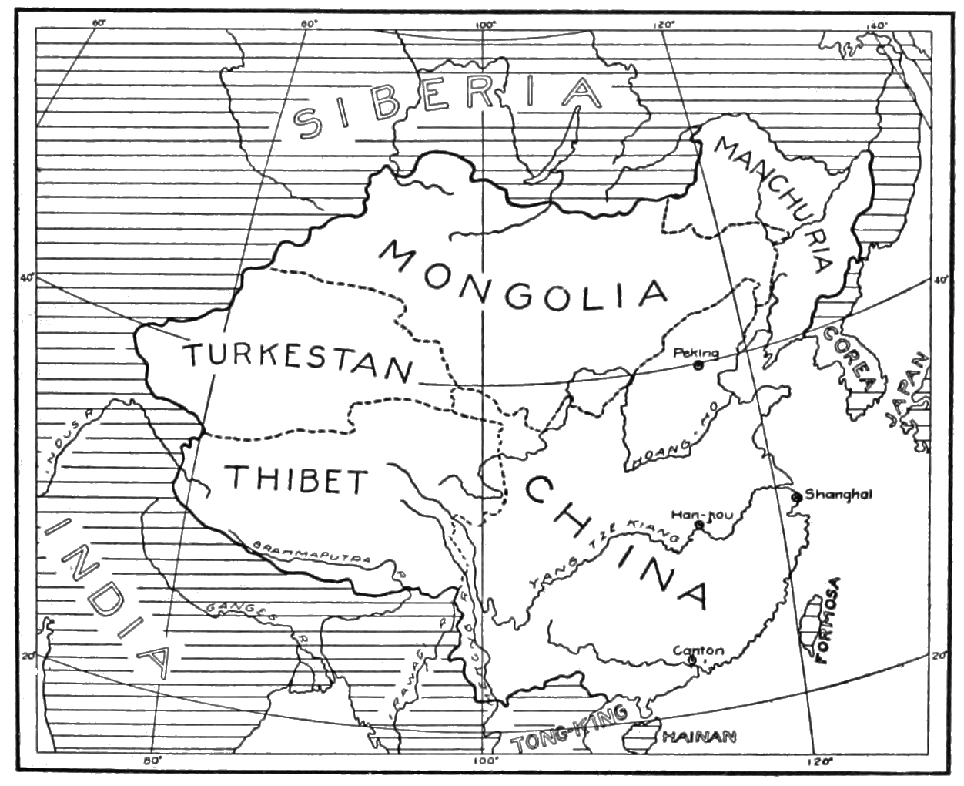
sketch map

Slide 12
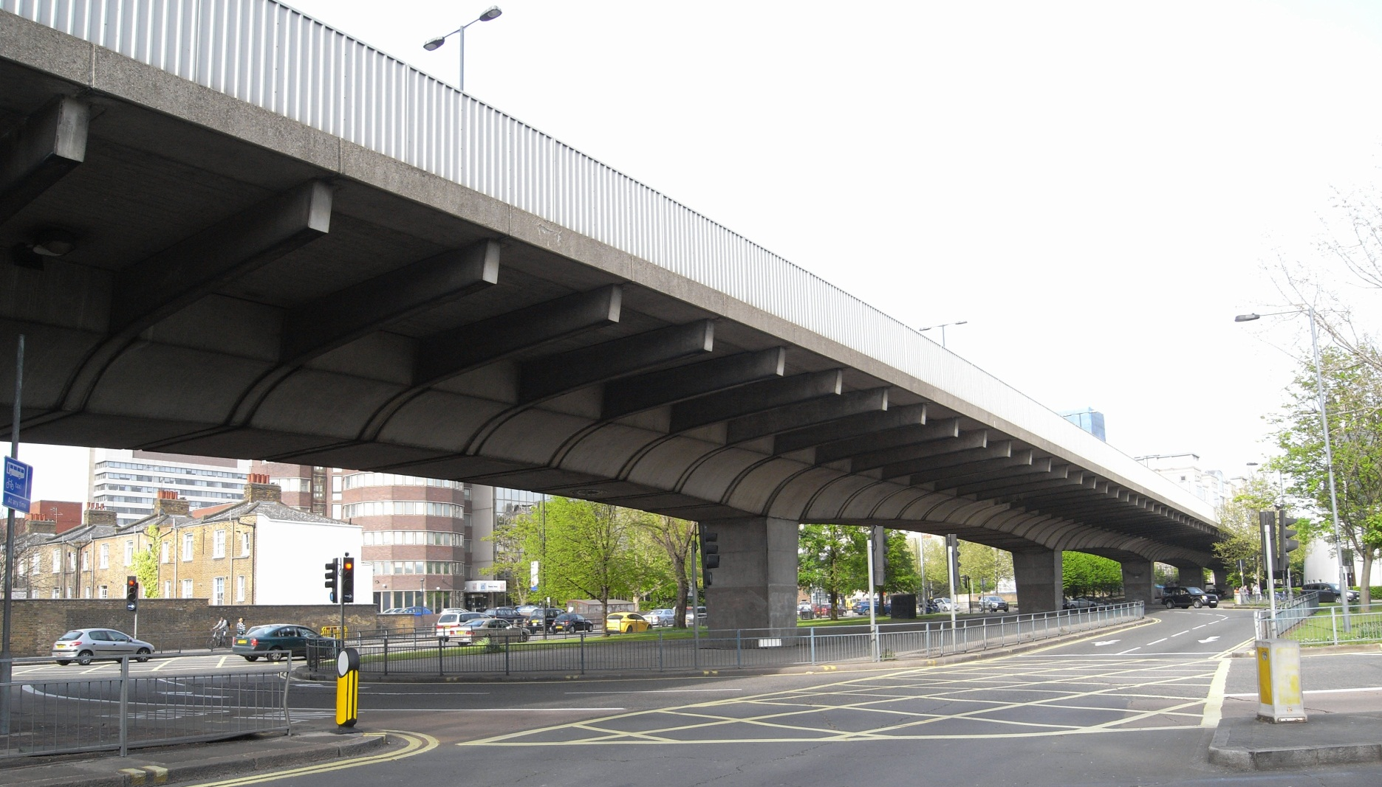
flyover

Slide 13
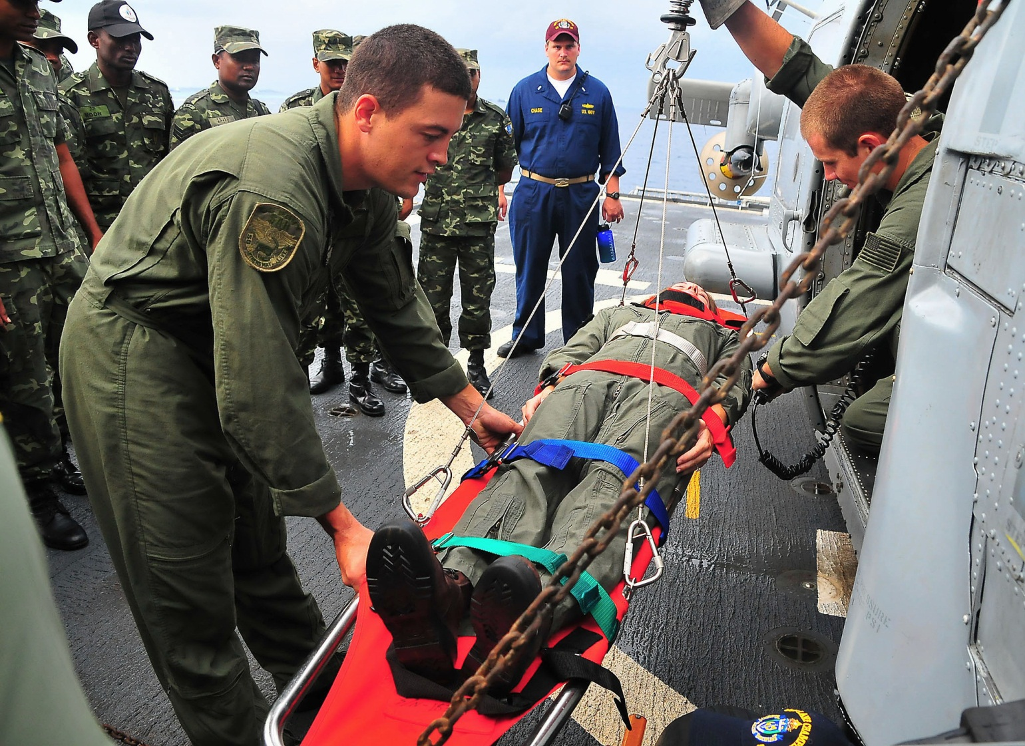
casualty

Slide 14
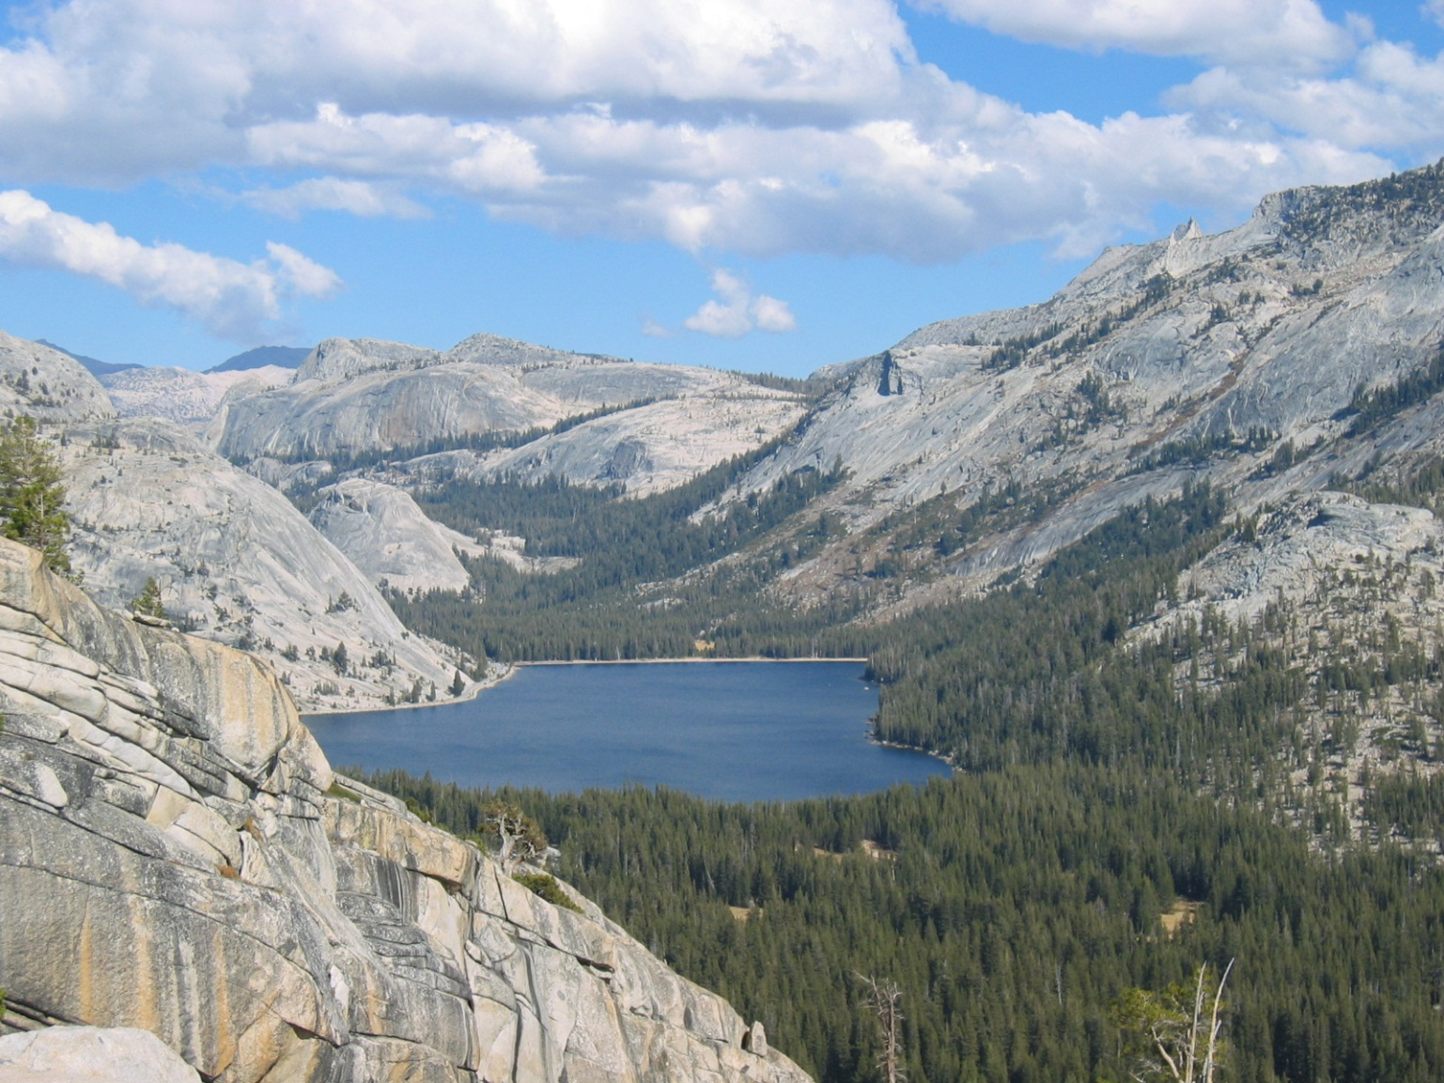
lake

Slide 15
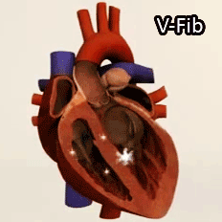
pulse

Slide 16
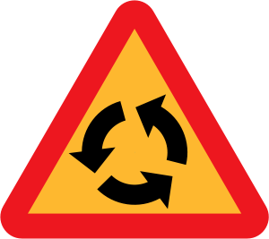
roundabout

Slide 17
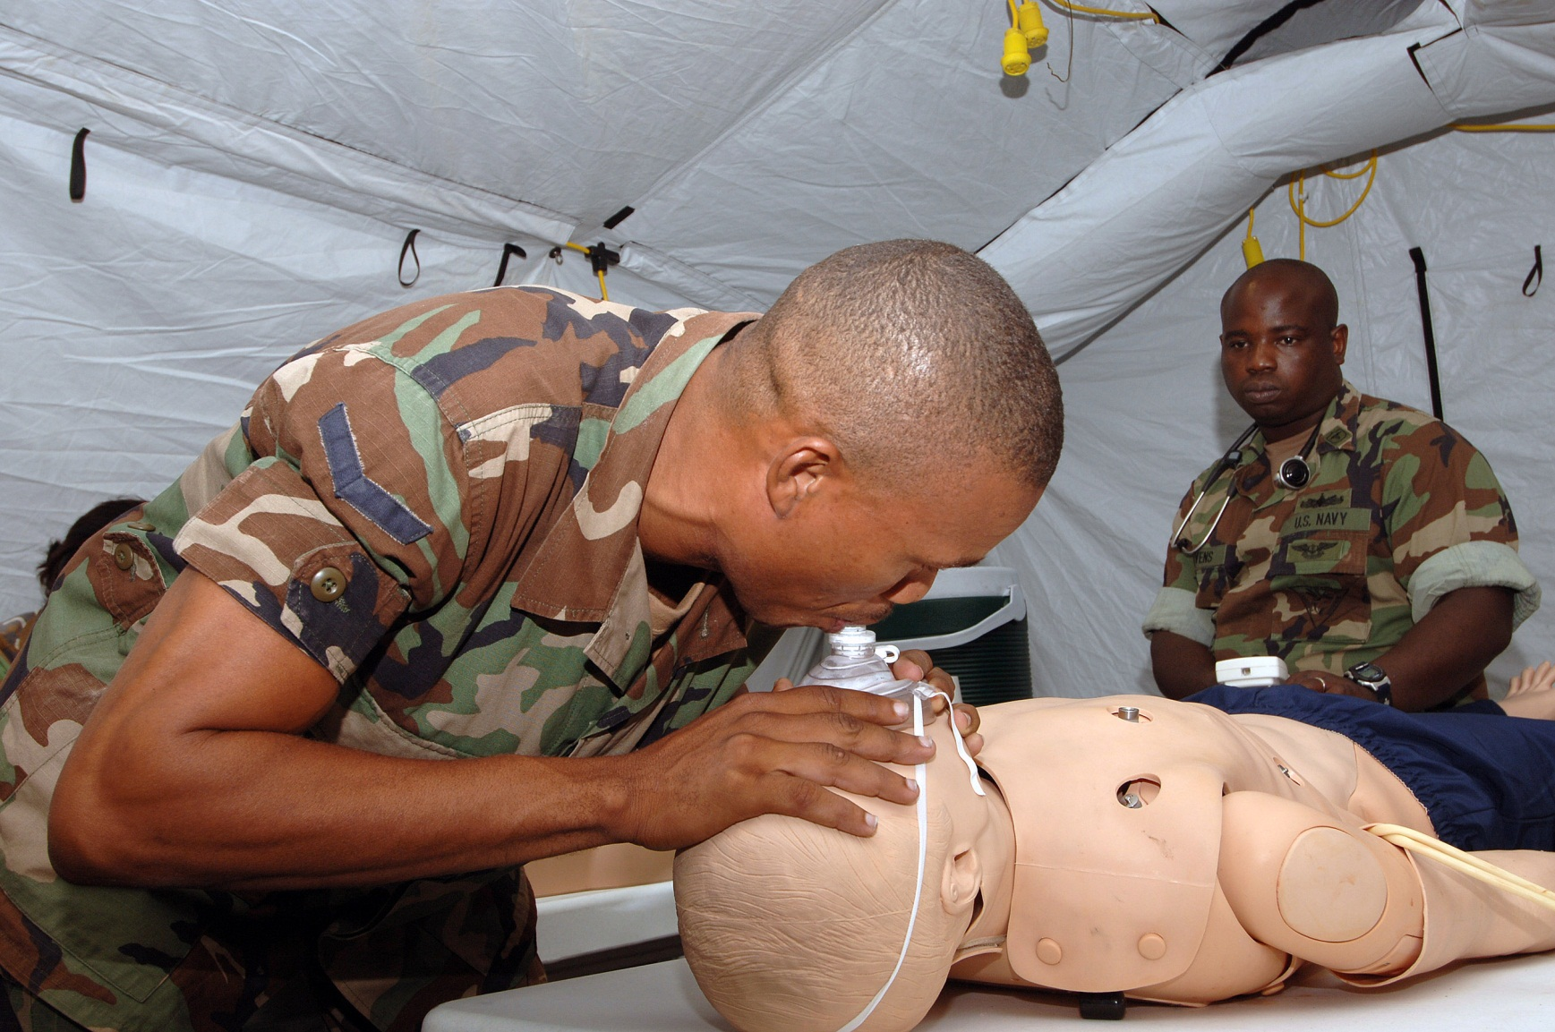
artificial respiration

Slide 18
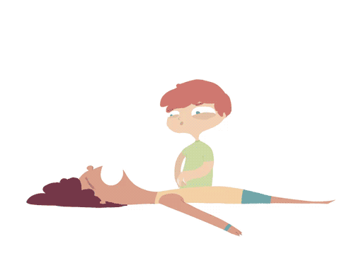
cardio-pulmonary resuscitation

Slide 19
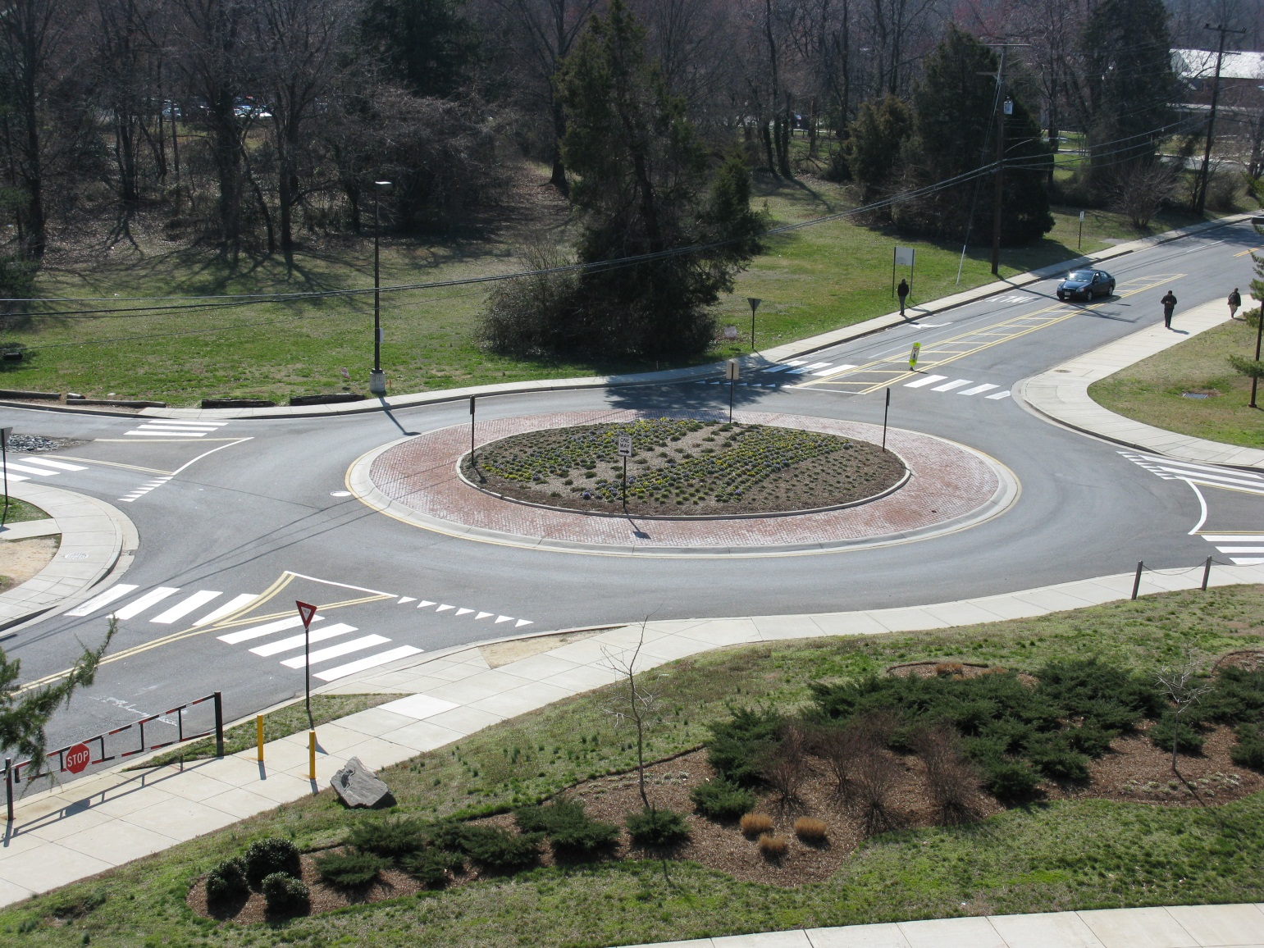
roundabout

Slide 20
Khalas. Shukran.
Stephen Roney JIC May, 2014

