Slide 1
Unit 4 Nouns
Stephen Roney
JIC
April, 2014

Slide 2
drill

Slide 3
communications satellite

Slide 4
cutter face

Slide 5
hydraulic cylinder

Slide 6
satellite dish

Slide 7
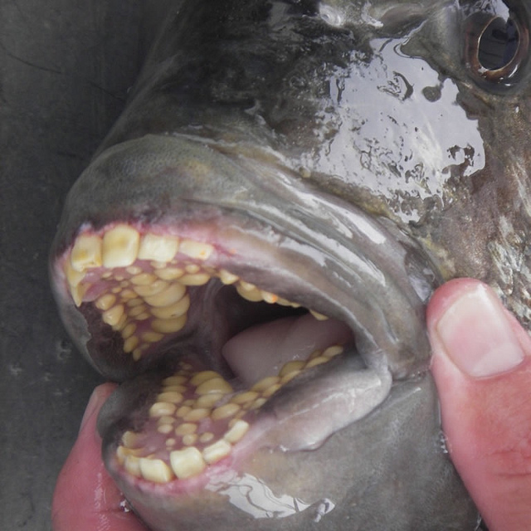
teeth

Slide 8
TV station

Slide 9
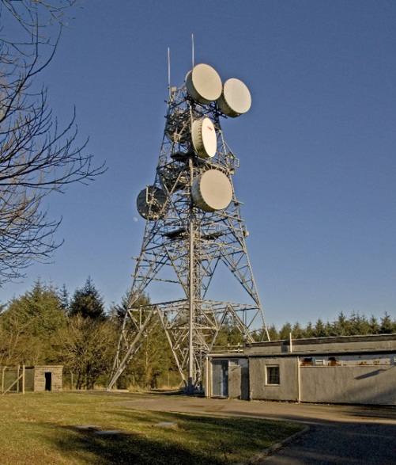
transmitter

Slide 10
scoop

Slide 11
monitor

Slide 12
drill

Slide 13
cutter

Slide 14
conveyor belt

Slide 15
propeller

Slide 16
orbit

Slide 17
feed horn

Slide 18
frequency

Slide 19
low frequency

Slide 20
high frequency

Slide 21
digital TV card

Slide 22
conveyor belt

Slide 23
chute

Slide 24
belt

Slide 25
Khalas. Shukran.
Stephen Roney JIC April 2014

