Slide 1
Unit 4 Car Nouns
Stephen Roney
JIC
April, 2014

Slide 2
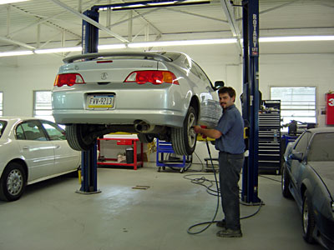
body shop

Slide 3
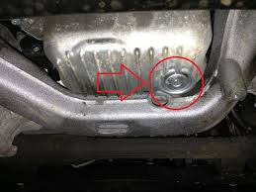
oil drain plug

Slide 4
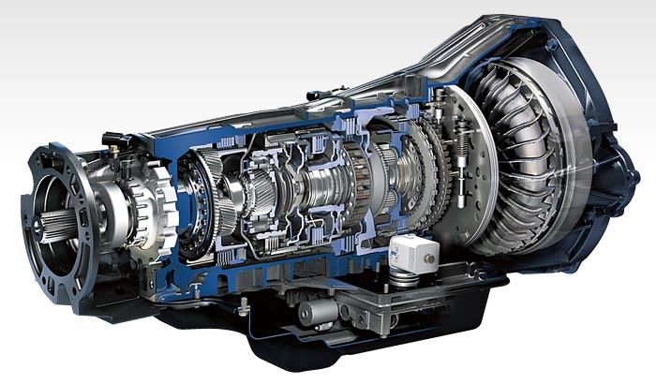
transmission

Slide 5
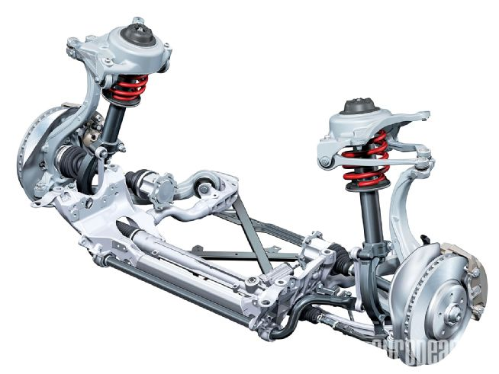
suspension

Slide 6
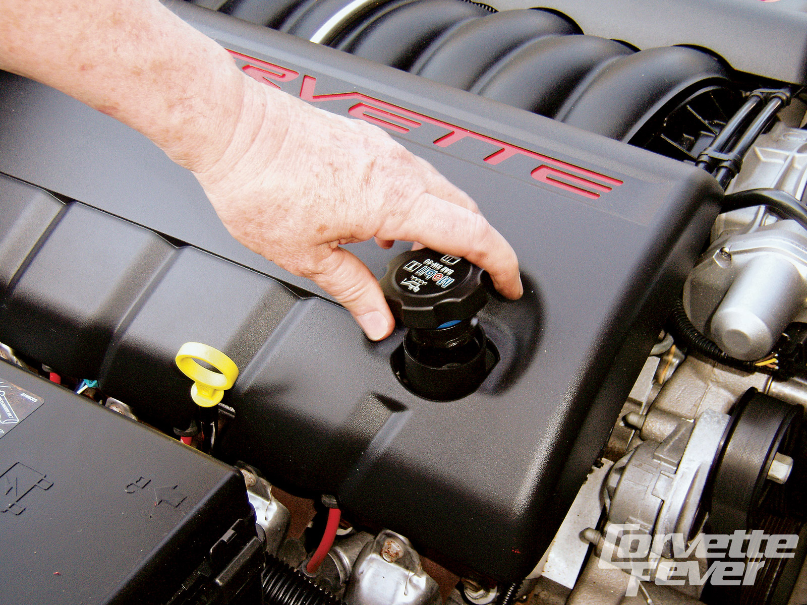
oil filler cap

Slide 7
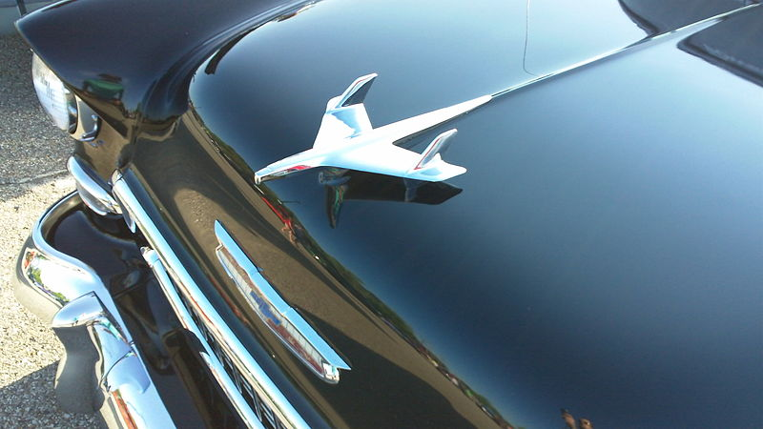
bonnet

Slide 8
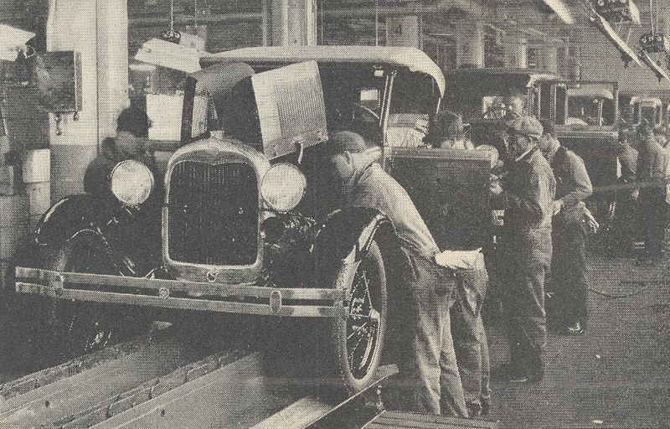
assembly line

Slide 9
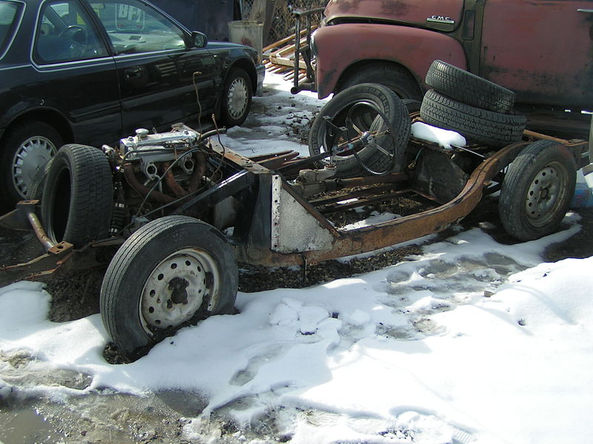
chassis

Slide 10
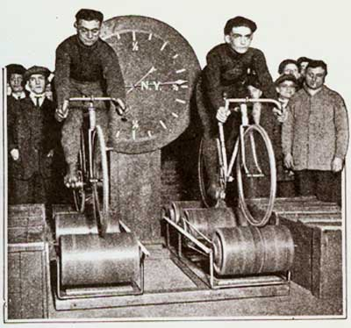
rollers

Slide 11
rust

Slide 12
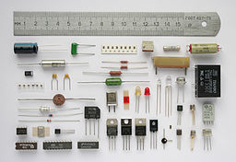
components

Slide 13
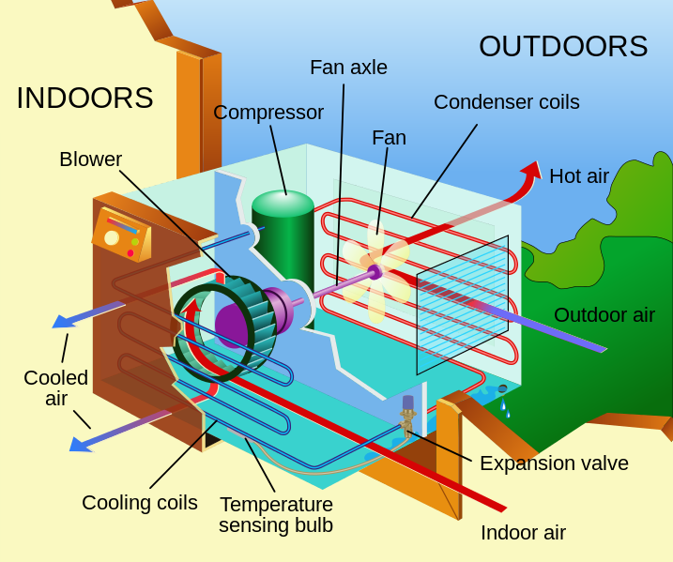
air conditioning

Slide 14
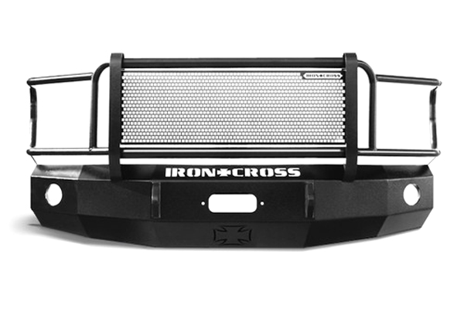
bumper

Slide 15
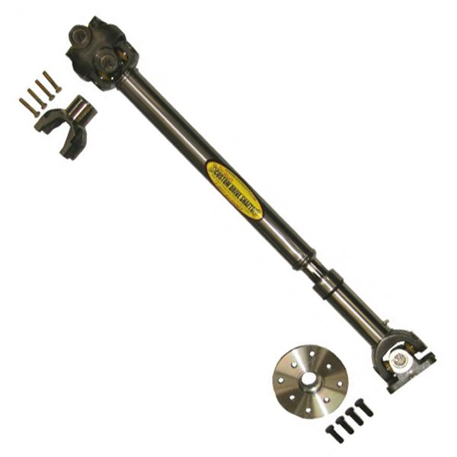
drive shaft

Slide 16
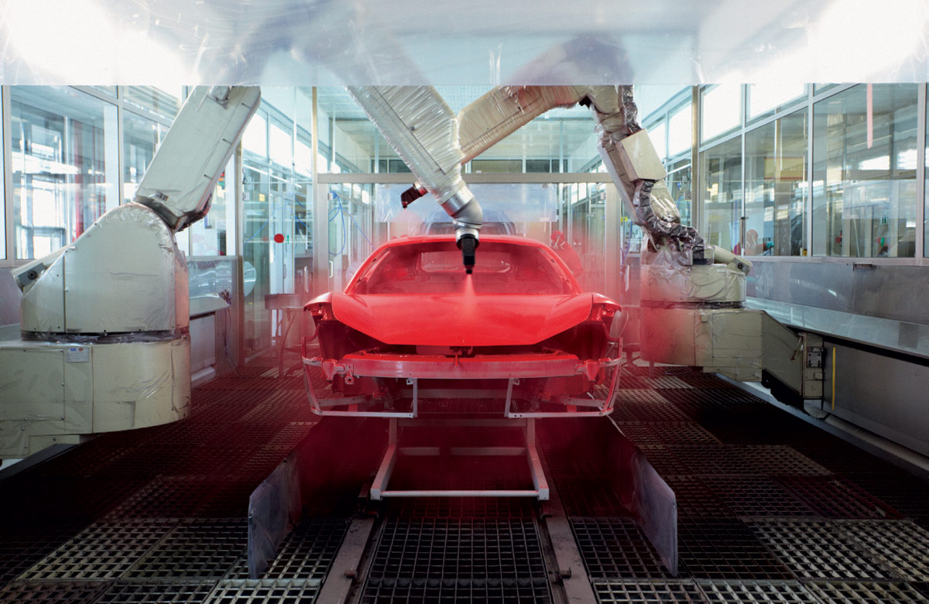
paint shop

Slide 17
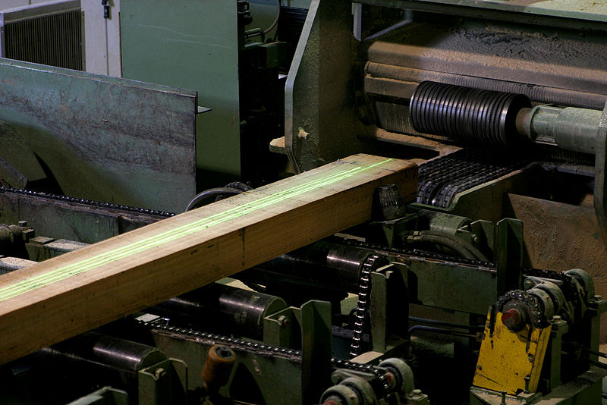
laser guide

Slide 18
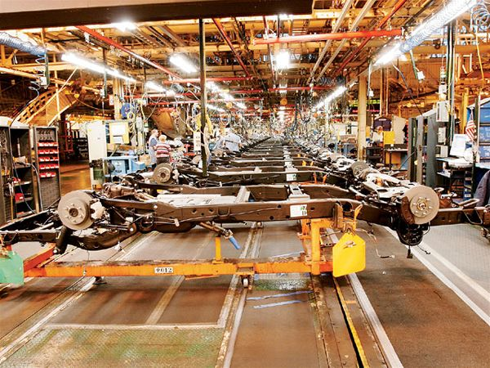
chassis line

Slide 19
Khalas.
Shukran!
Stephen Roney
JIC
April, 2014

