Slide 1
Unit 3 Nouns and Verbs
Stephen Roney
JIC
April 2014

Slide 2
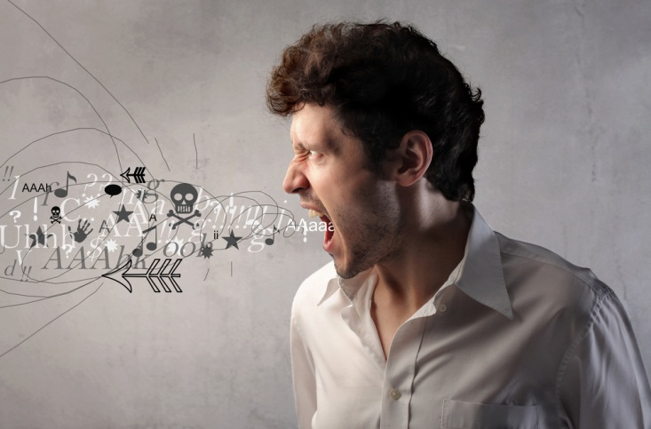
complain

Slide 3
nanotube

Slide 4
recommendation

Slide 5
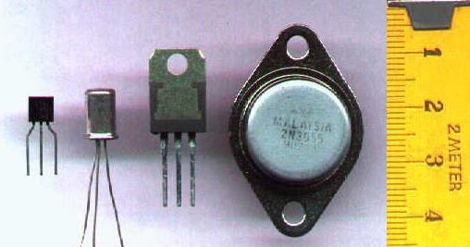
transistors

Slide 6
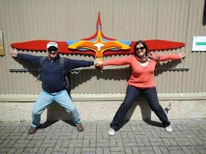
wingspan

Slide 7
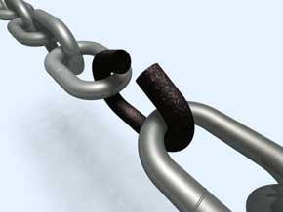
weakness

Slide 8
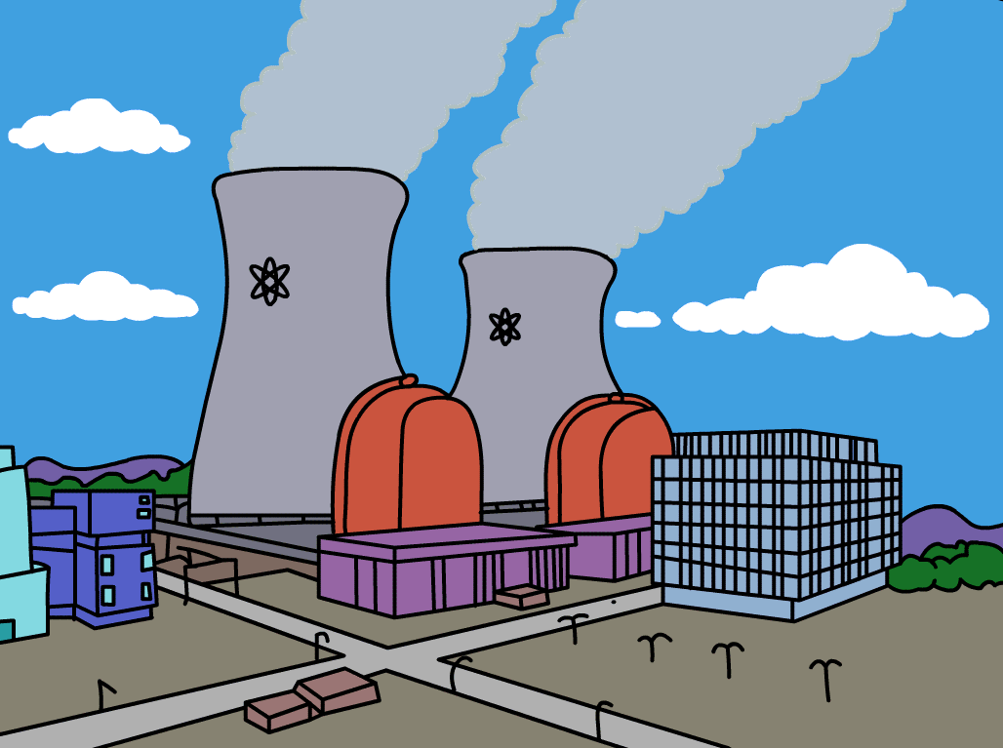
nuclear power

Slide 9
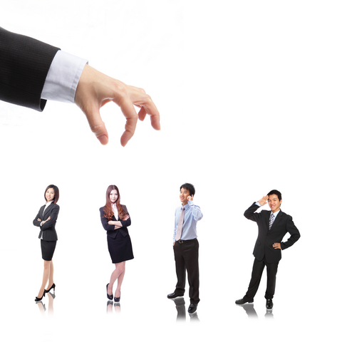
hire

Slide 10
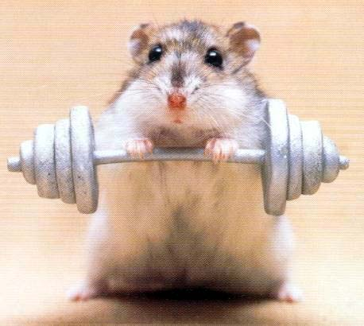
strength

Slide 11
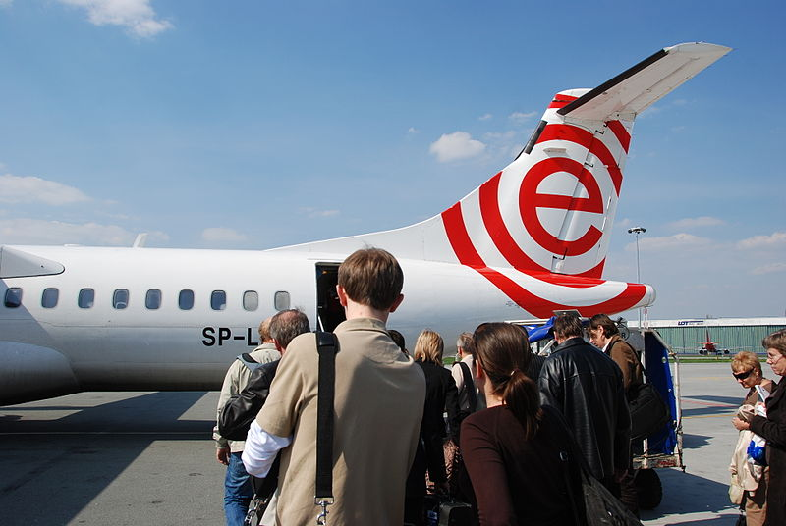
board

Slide 12
cancel

Slide 13
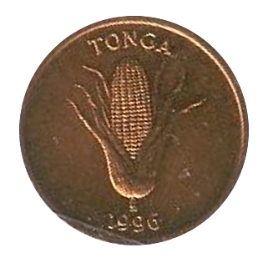
coin

Slide 14
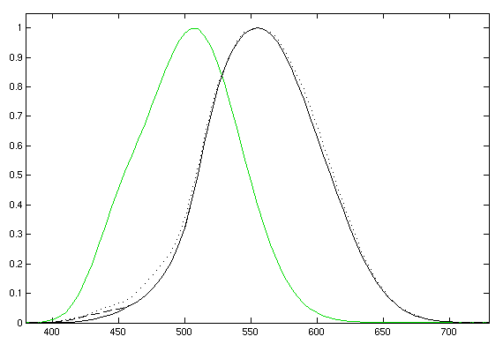
nanometres

Slide 15
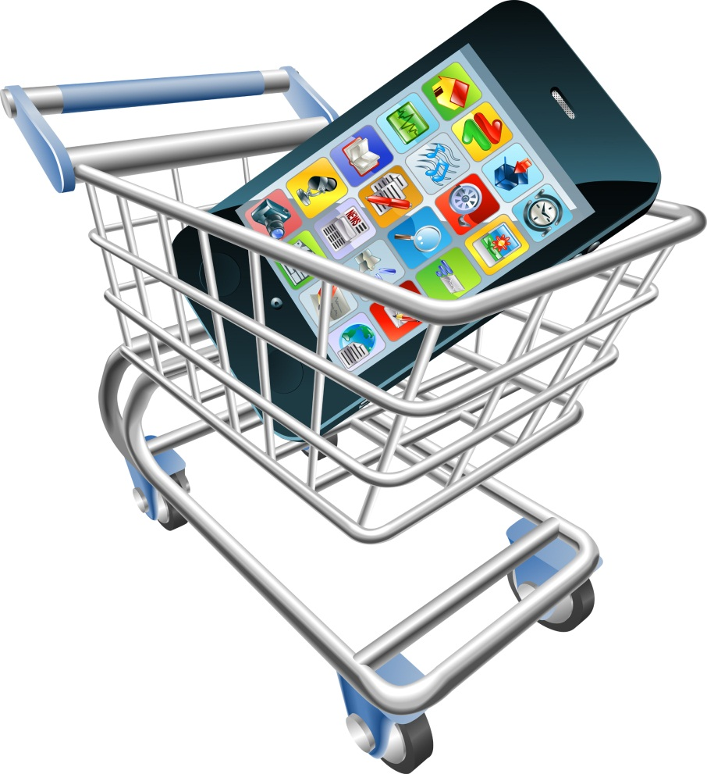
purchase

Slide 16
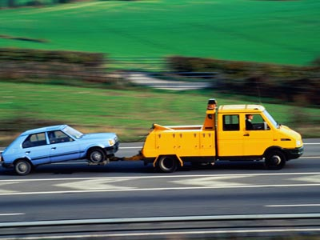
tow

Slide 17
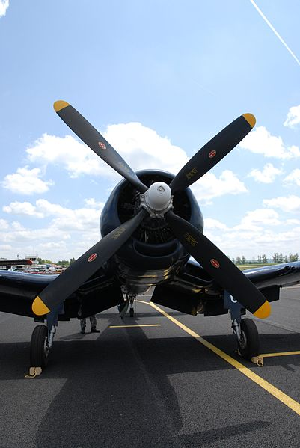
propeller

Slide 18
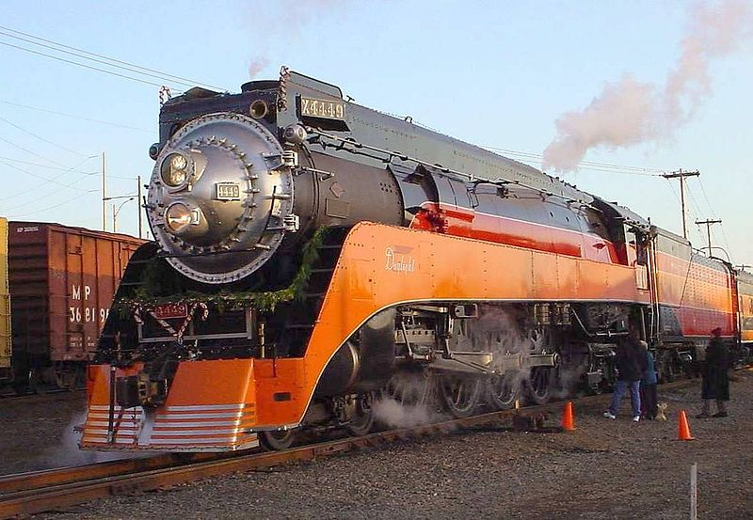
idle

Slide 19
Khalas. Shukran.
Stephen Roney
JIC
April, 2014

