Slide 1
Unit 2 Book 2 Adverbs and Adjectives
Stephen Roney
JIC
April, 2014

Slide 2
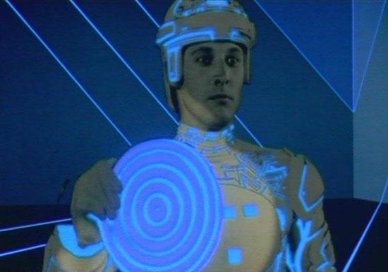
electronic

Slide 3
mechanical

Slide 4
onshore

Slide 5
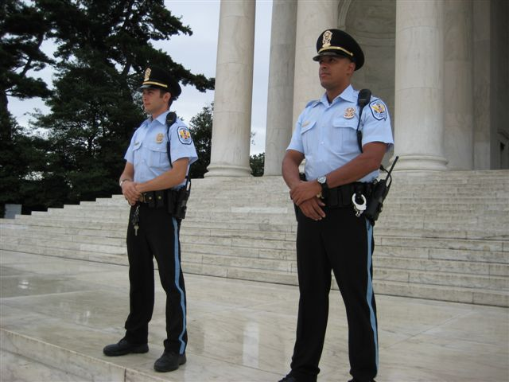
on duty

Slide 6
underwater

Slide 7
available

Slide 8
fantastic

Slide 9
off duty

Slide 10
grateful

Slide 11
heat-resistant

Slide 12
on leave

Slide 13
offshore

Slide 14
aware

Slide 15
Khalas. Shukran.
Stephen Roney
JIC
April 2014

