Slide 1
Unit 1 Nouns
Stephen Roney JIC March, 2014

Slide 2
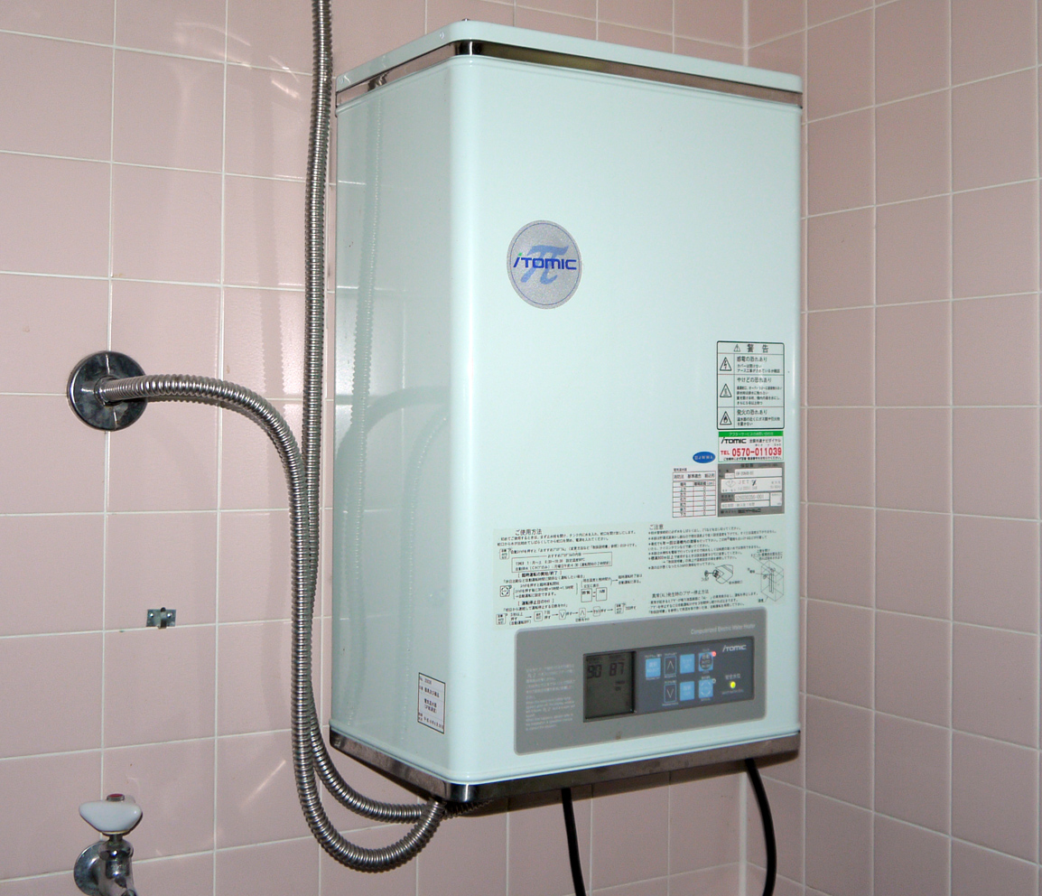
water heater

Slide 3
iPods

Slide 4
cord

Slide 5
chest

Slide 6
dial

Slide 7
handset

Slide 8
water valves

Slide 9
outboard motor

Slide 10
ticket machine

Slide 11
sensor

Slide 12
receiver

Slide 13
wireless

Slide 14
THE END
Stephen Roney JIC March 2014

