Slide 1
Unit 12 nouns
Stephen Roney
JIC
March, 2014

Slide 2
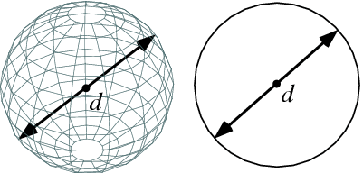
diameter

Slide 3
instruments

Slide 4
million

Slide 5
powder

Slide 6
rover

Slide 7
waste

Slide 8
surface

Slide 9
simulation

Slide 10
progress

Slide 11
obstacle

Slide 12
laser beam

Slide 13
distance

Slide 14
astronaut

Slide 15
camera

Slide 16
control centre

Slide 17
equipment

Slide 18
mast

Slide 19
photograph

Slide 20
robot

Slide 21
range

Slide 22
oxygen

Slide 23
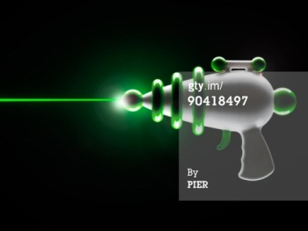
laser gun

Slide 24
mass

Slide 25
The End
Stephen K. Roney
JIC
March, 2014

