Slide 1
Unit 11 Nouns
Stephen Roney JIC March, 2014

Slide 2
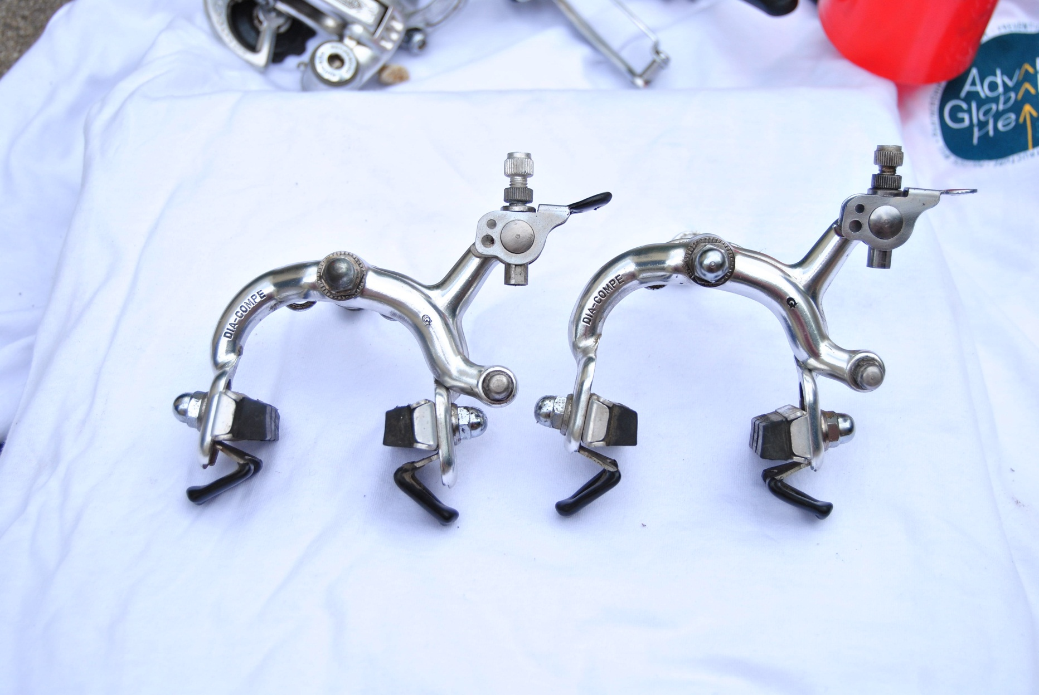
brakes

Slide 3
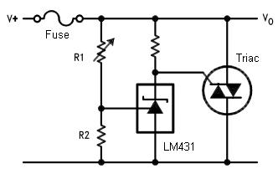
circuit

Slide 4

high pressure

Slide 5
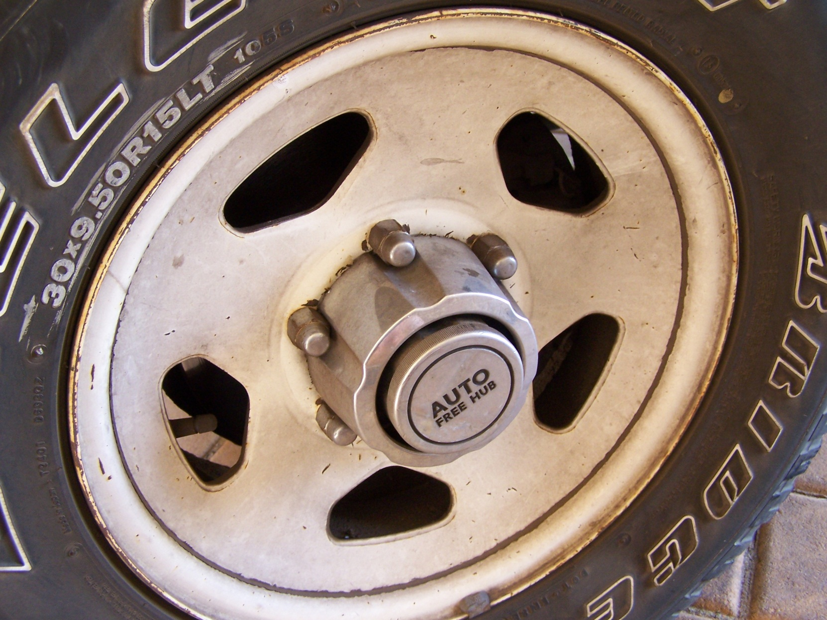
hub

Slide 6
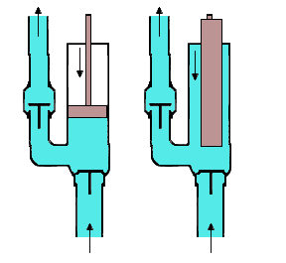
piston pump

Slide 7
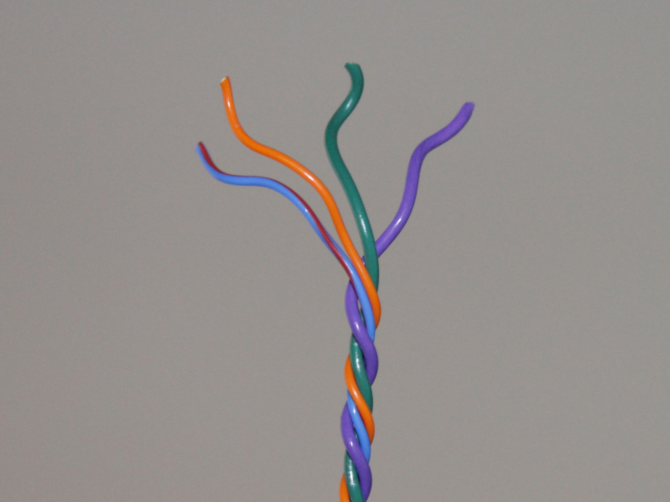
wire

Slide 8
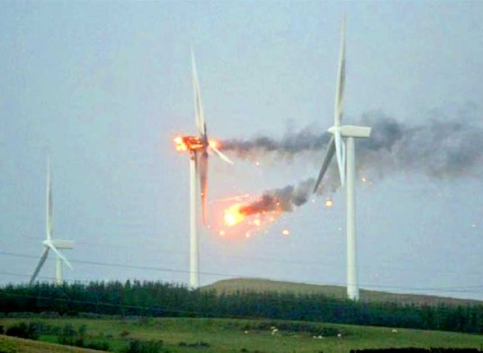
wind turbines

Slide 9
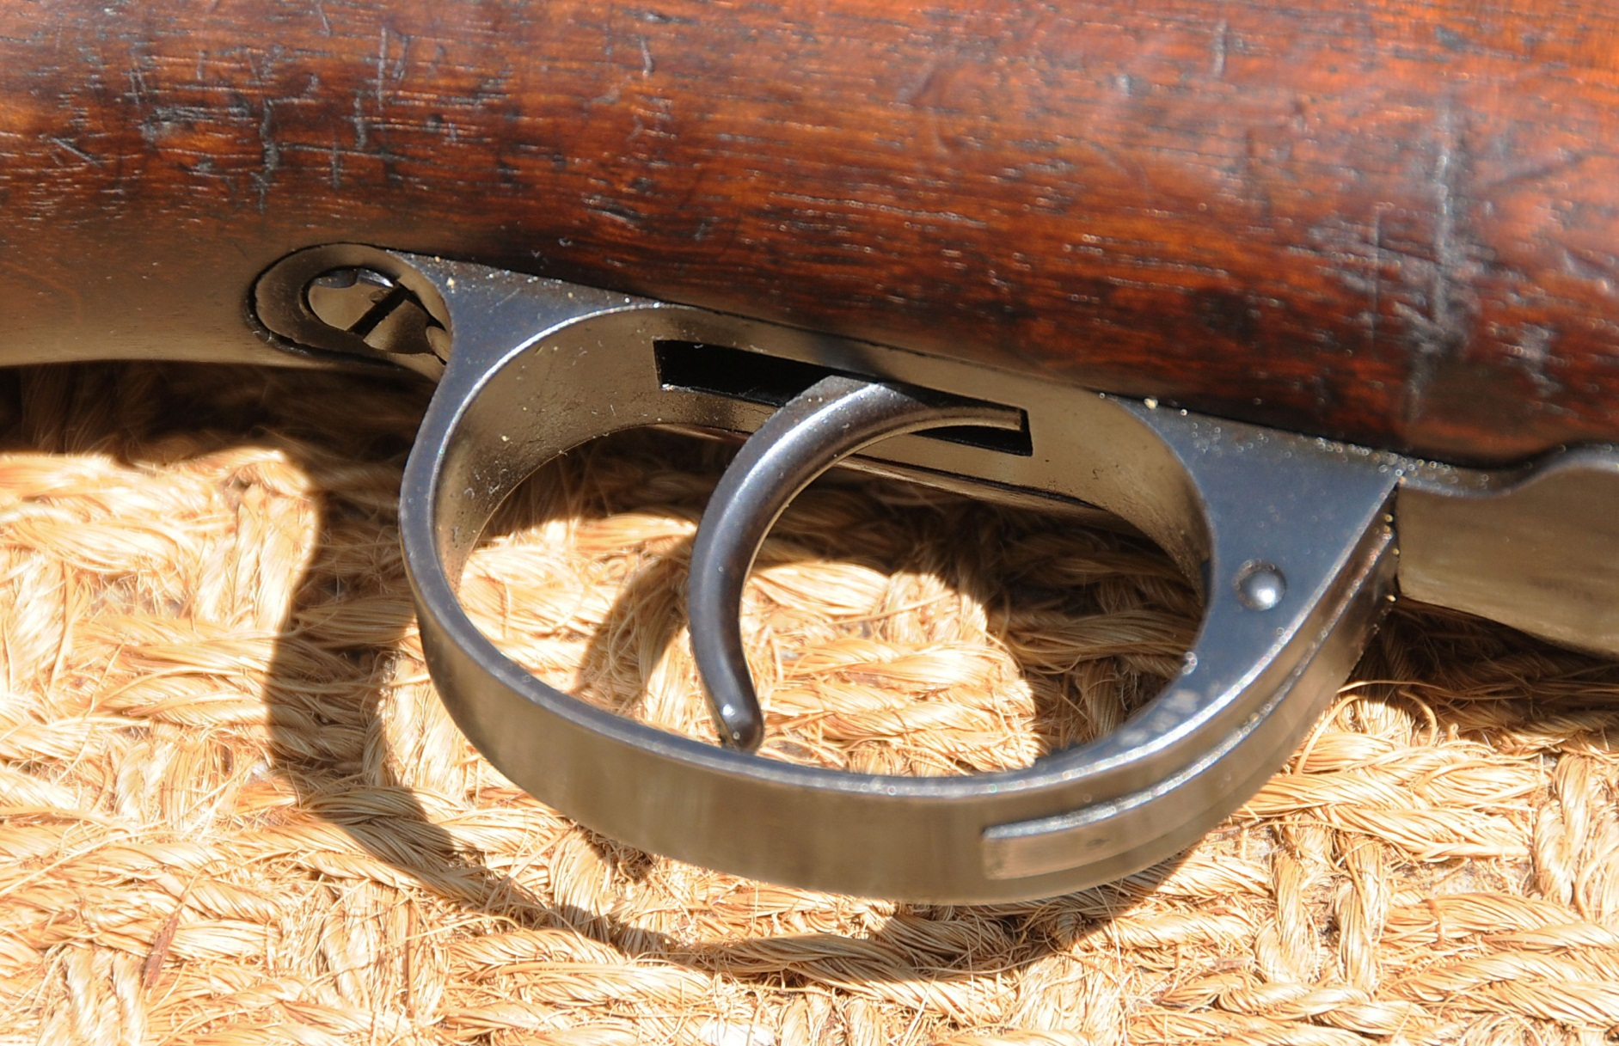
trigger

Slide 10

switch

Slide 11
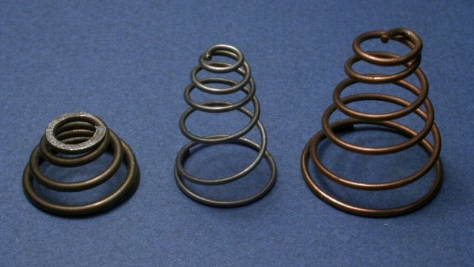
springs

Slide 12
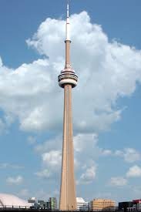
tower

Slide 13
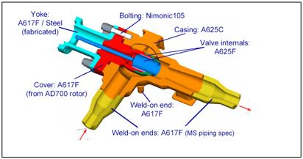
inlet valve

Slide 14
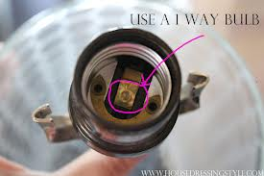
contact

Slide 15

bell

Slide 16
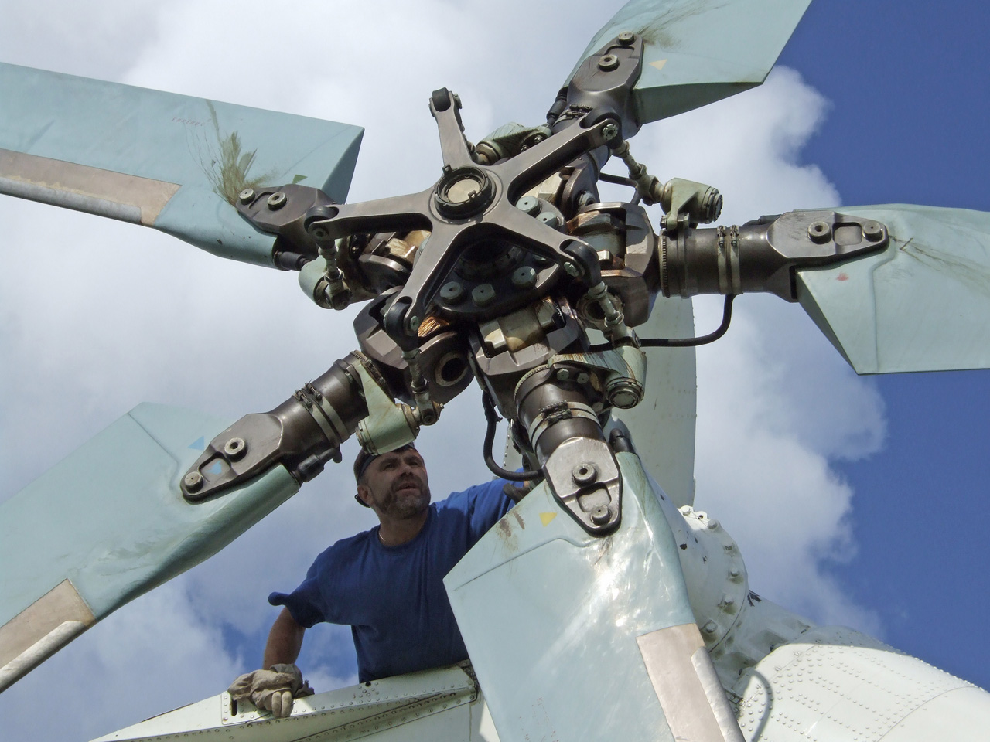
rotor

Slide 17
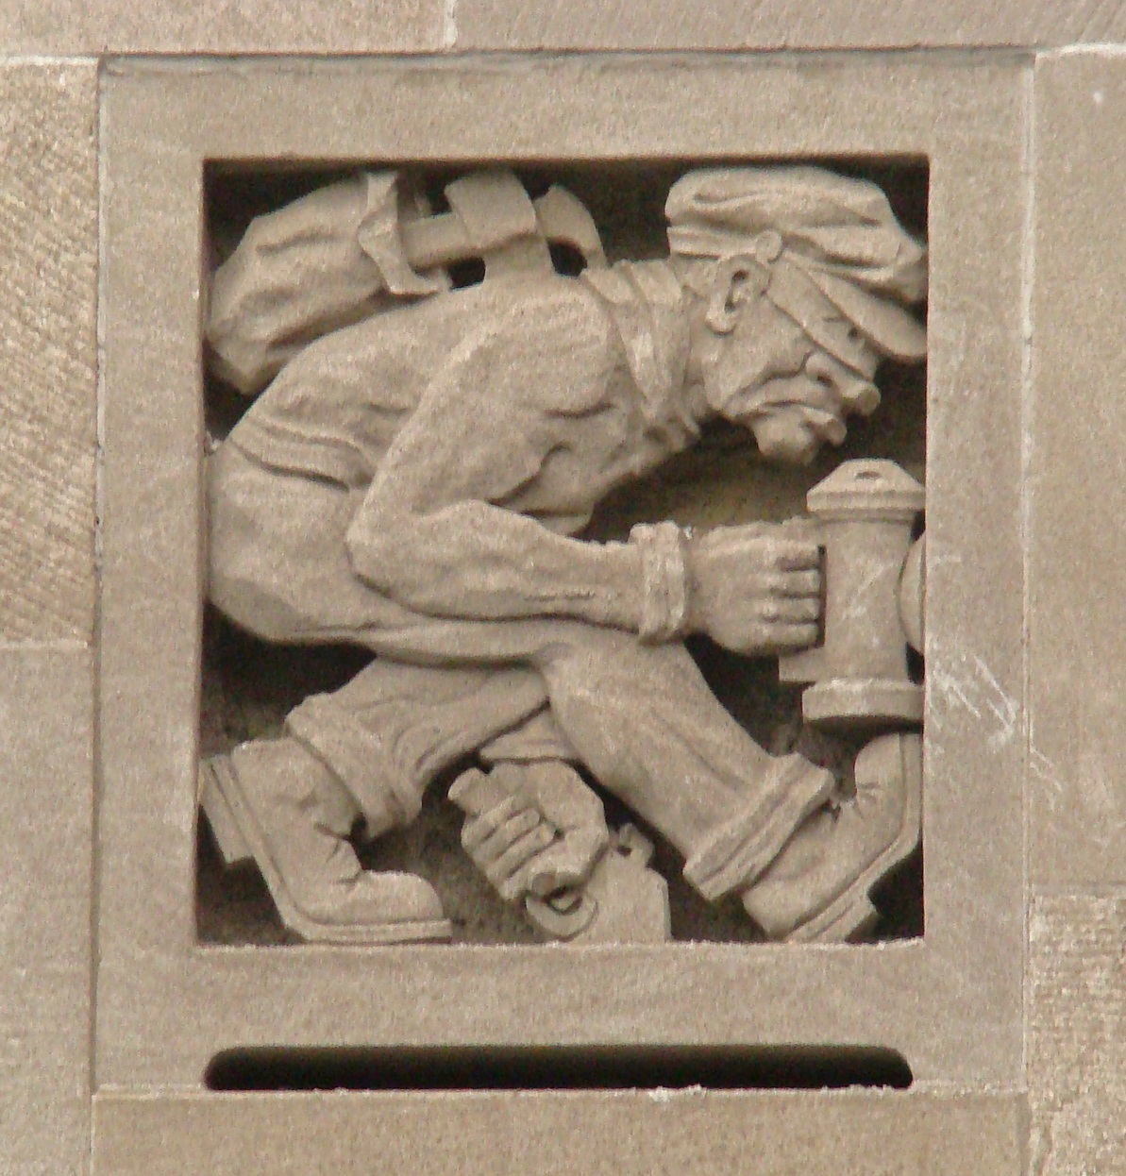
burglar

Slide 18
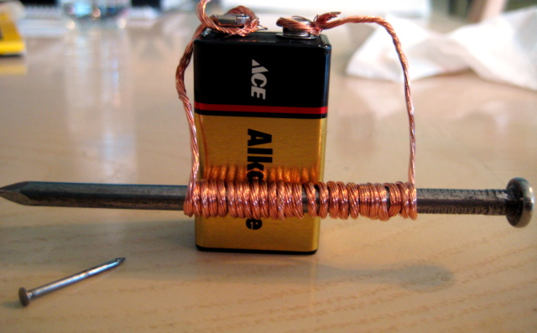
electromagnet

Slide 19

gear

Slide 20
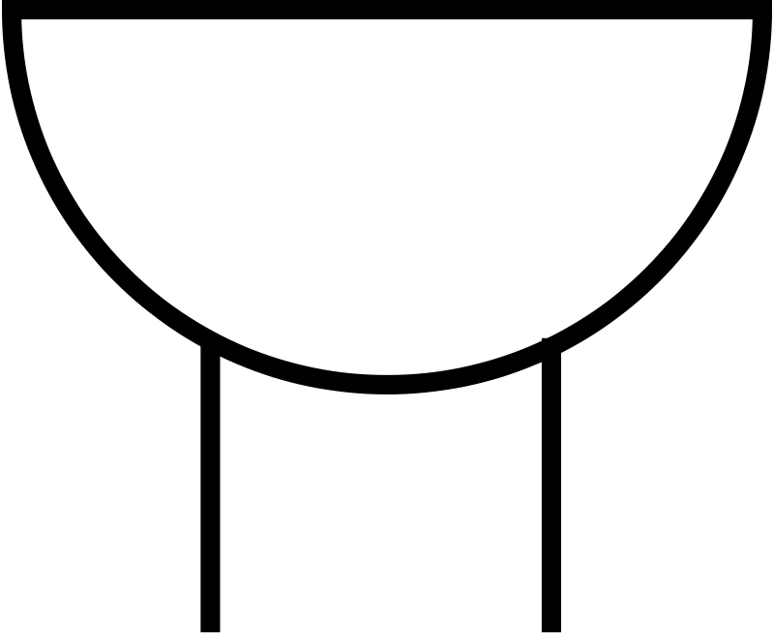
buzzer

Slide 21
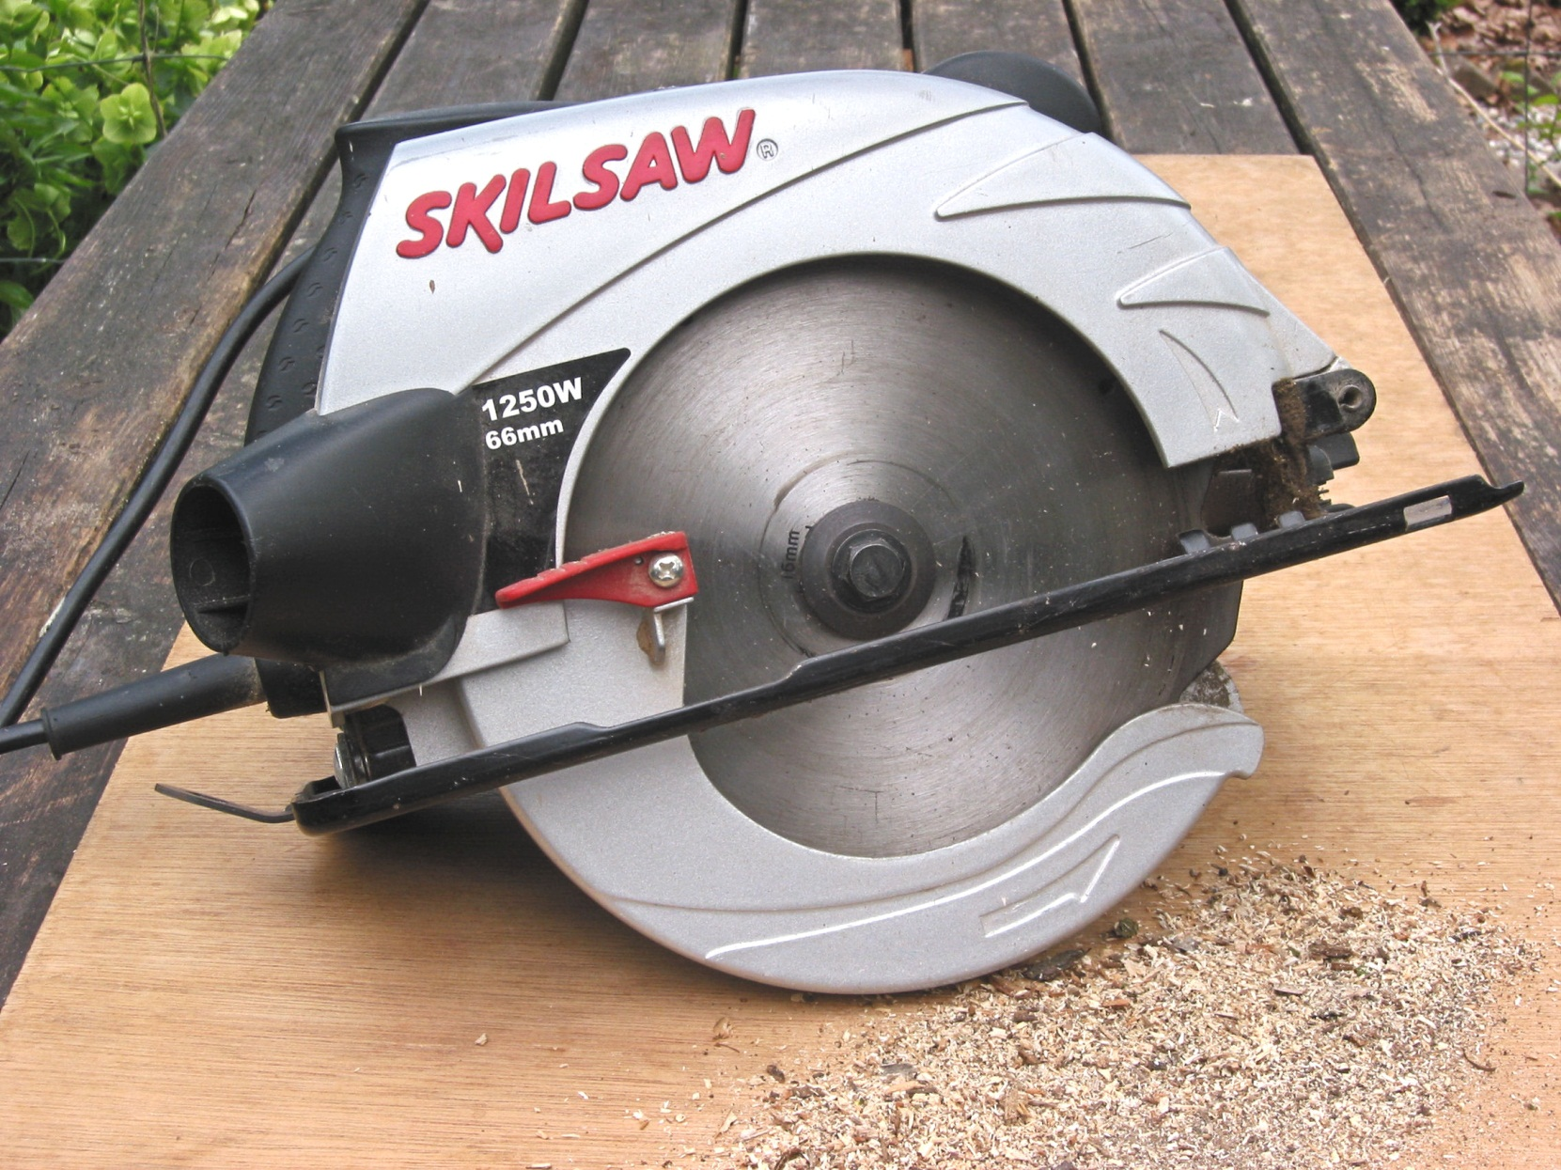
guard

Slide 22
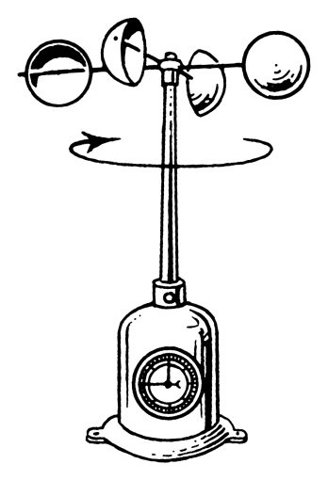
anemometer

Slide 23
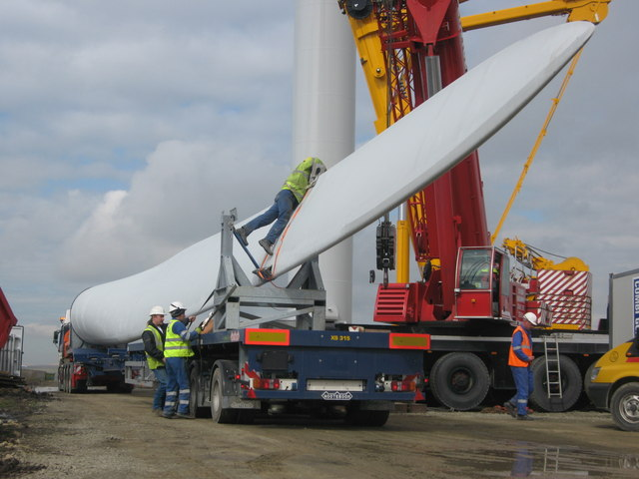
blade

Slide 24
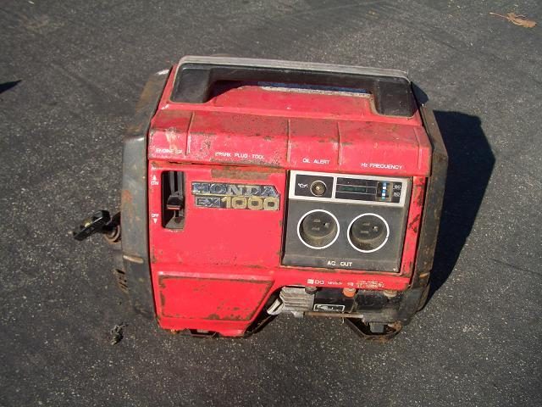
generator

Slide 25
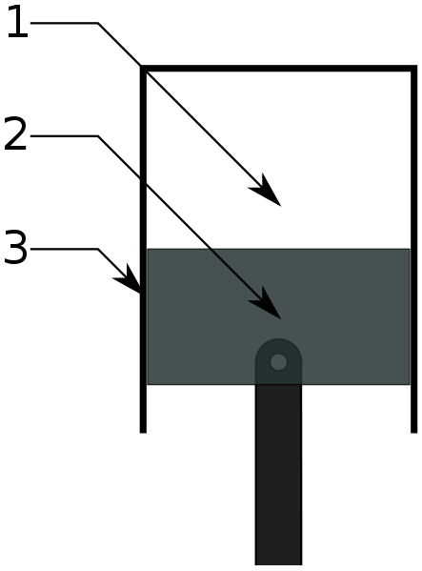
piston

Slide 26

magnet

Slide 27
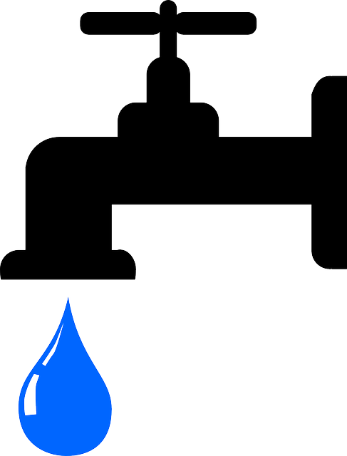
outlet valve

Slide 28
The End
Stephen K. Roney
JIC
March, 2014

