Slide 1
Types of TV show
Stephen Roney JIC April 2013

Slide 2
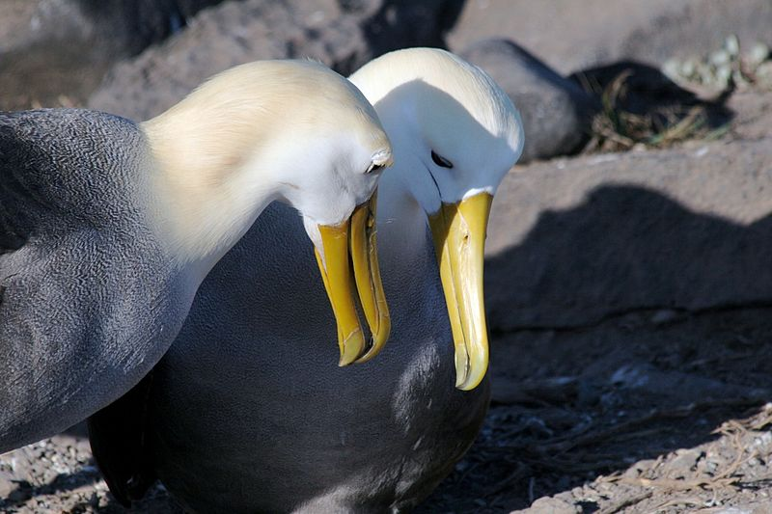
Nature programme

Slide 3
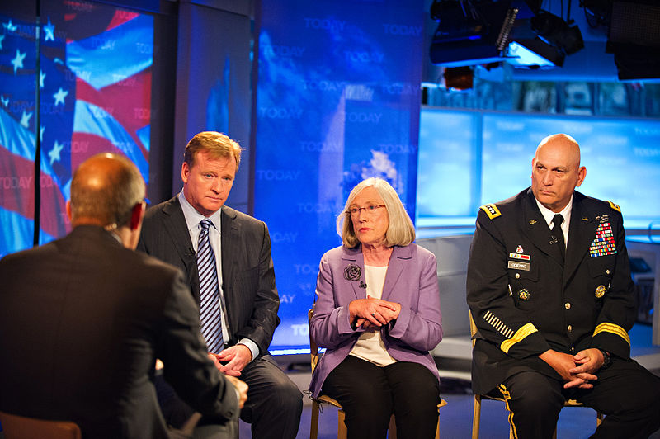
Current affairs

Slide 4
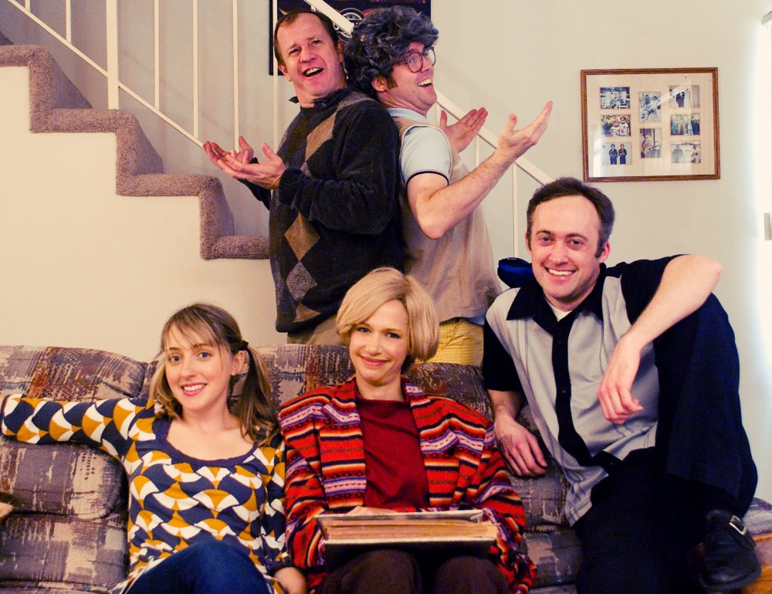
sitcom

Slide 5
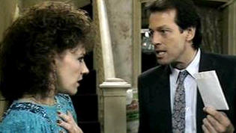
Soap opera

Slide 6
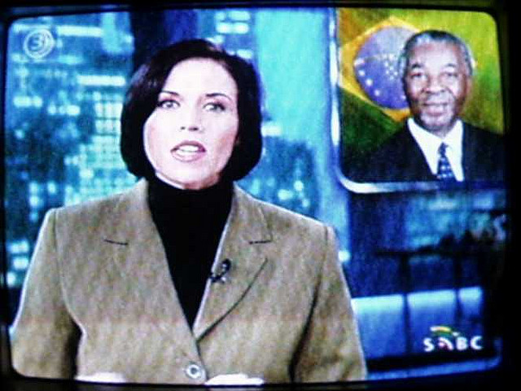
news

Slide 7
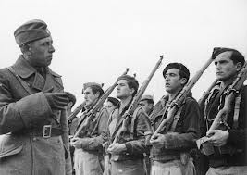
documentary

Slide 8

comedy

Slide 9

Game show

Slide 10
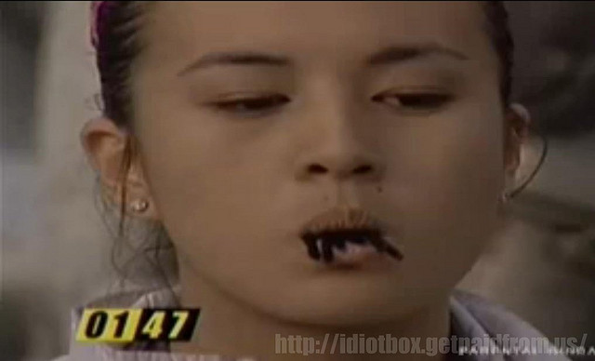
Reality TV

Slide 11
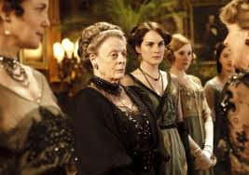
drama

Slide 12
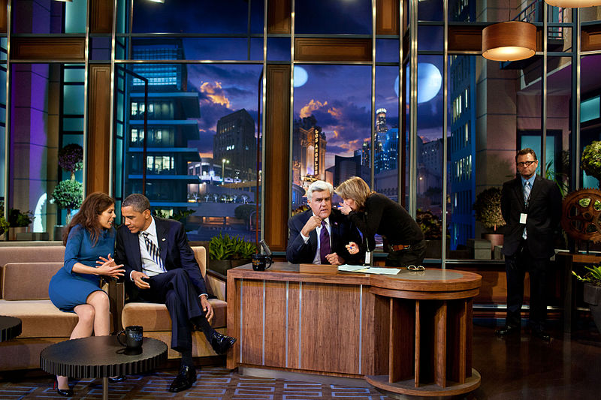
Chat show

Slide 13
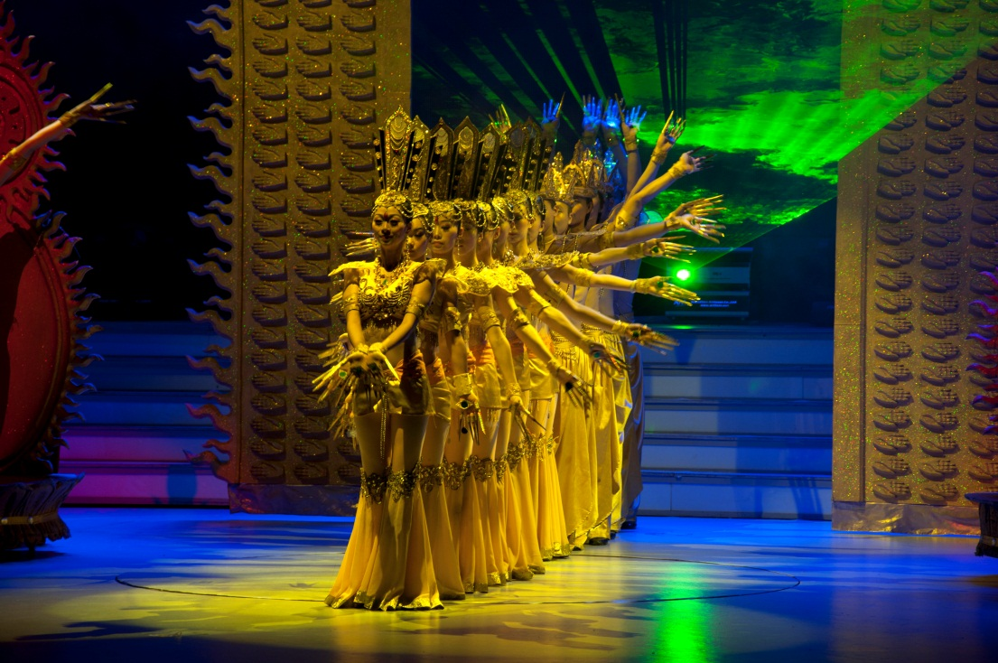
Variety show

