Slide 1
Telephone Vocabulary 1
Stephen K. Roney
JIC
February 3, 2014

Slide 2
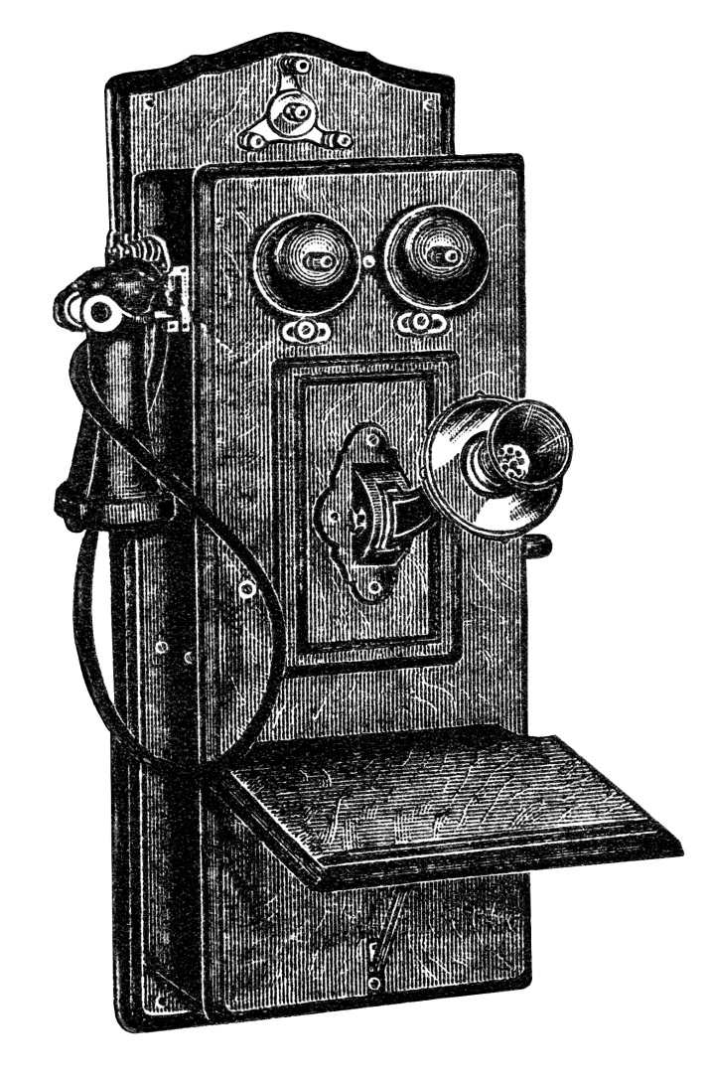
telephone

Slide 3
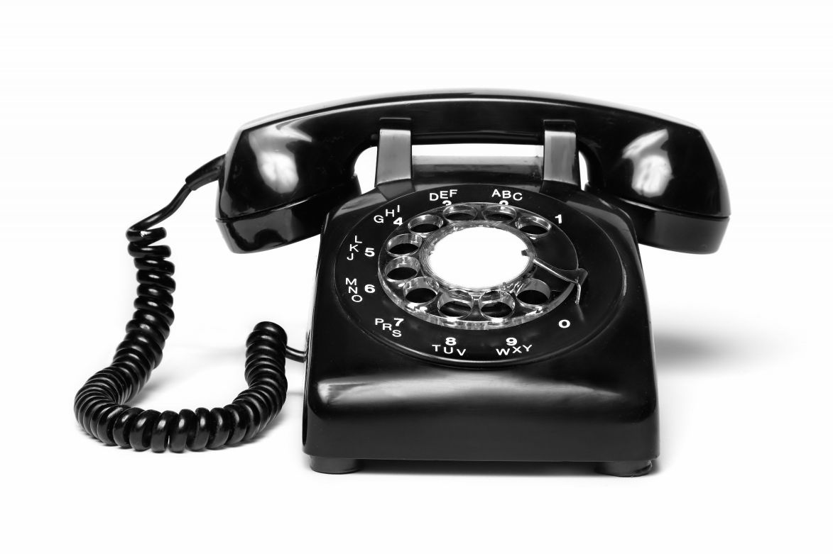
telephone

Slide 4
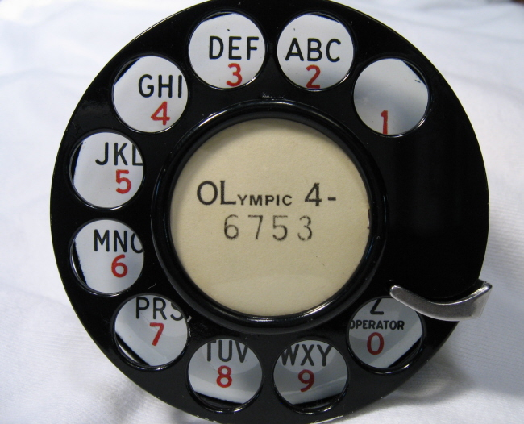
rotary dial

Slide 5
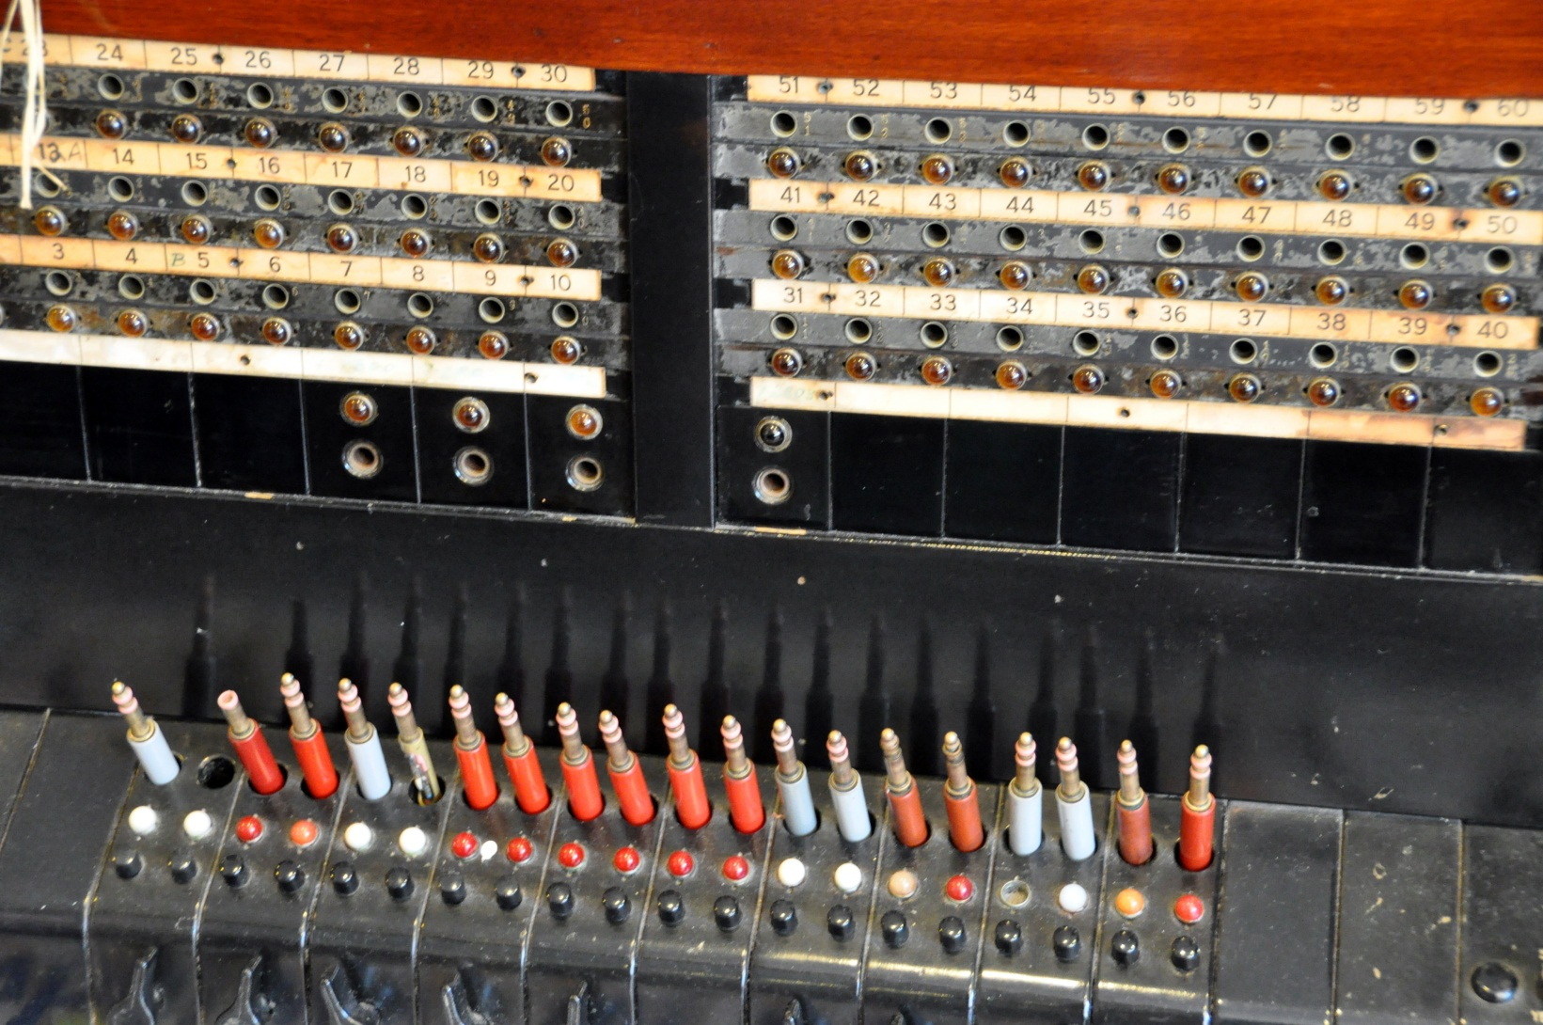
switchboard

Slide 6
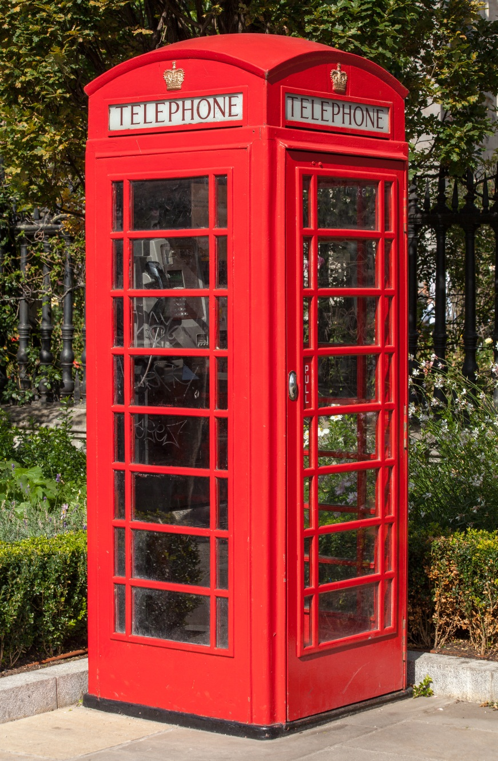
phone booth

Slide 7
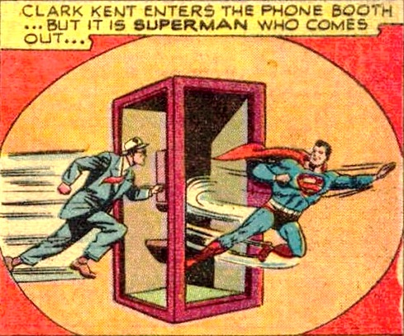

Slide 8
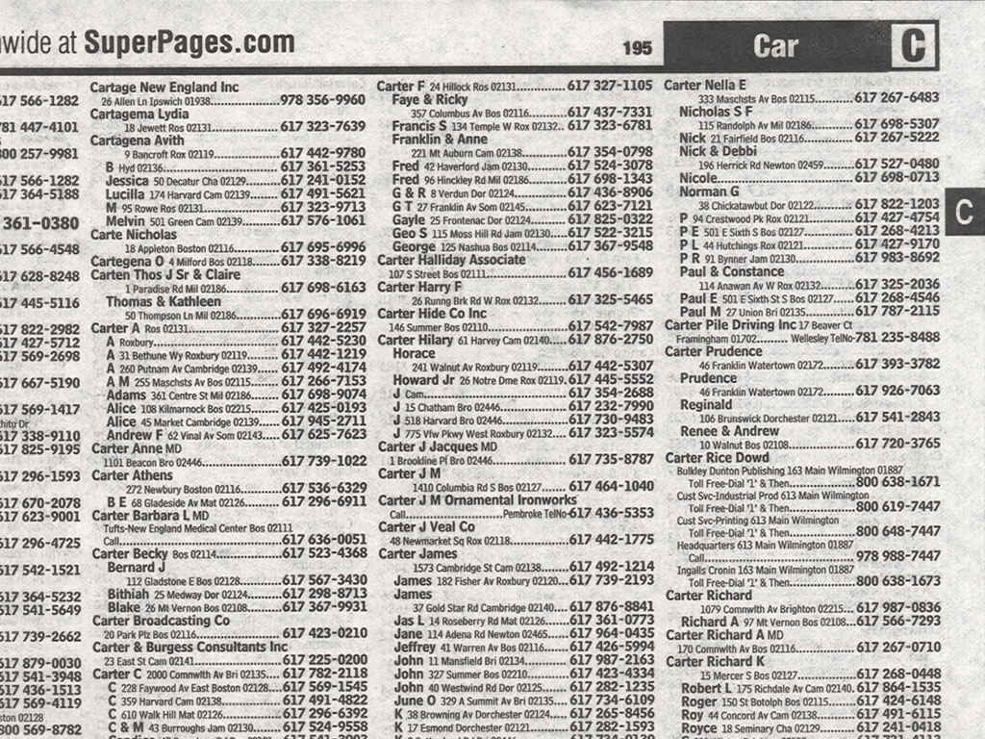
phone book; directory

Slide 9
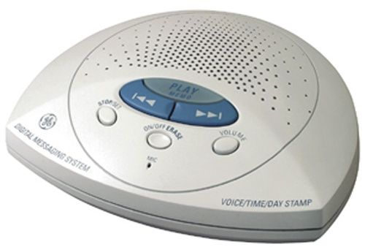
answering machine

