Slide 1
Still Life
Can you name the foods in these famous paintings?

Slide 2
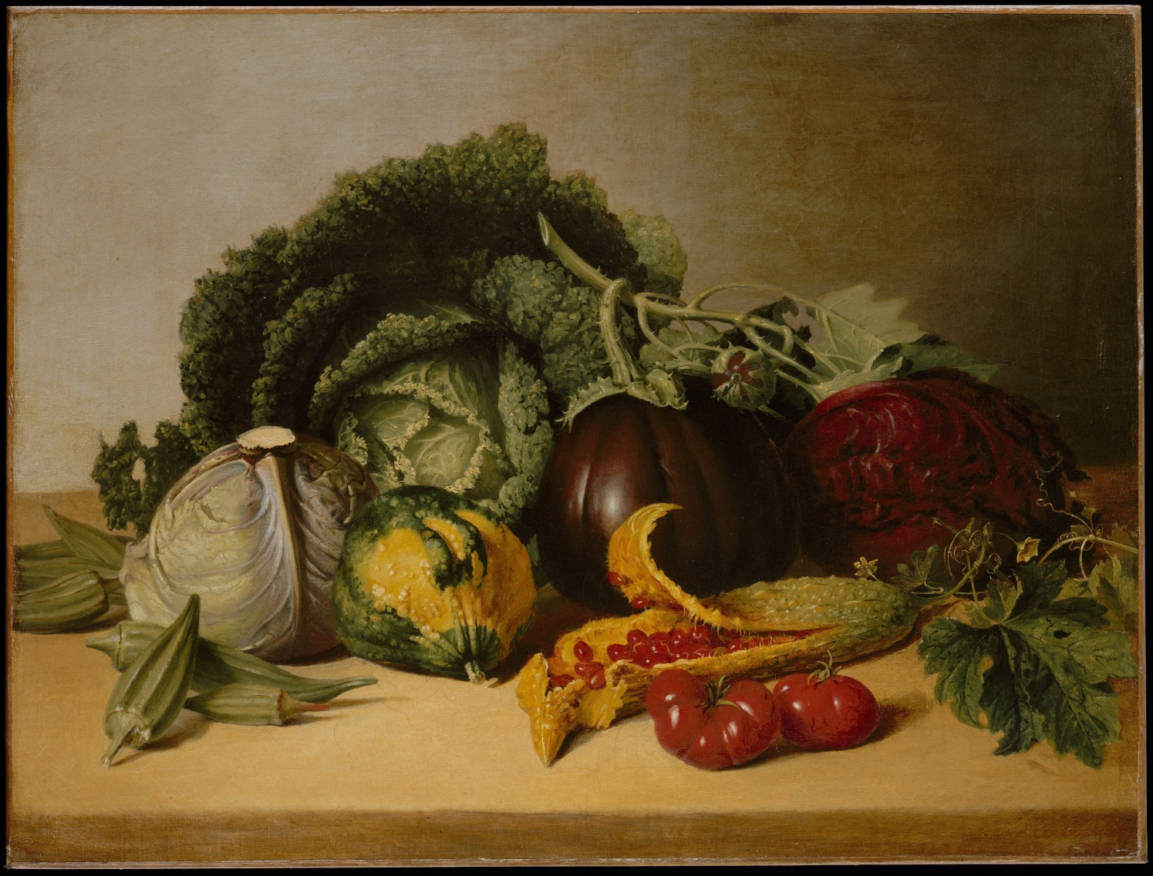

Slide 3
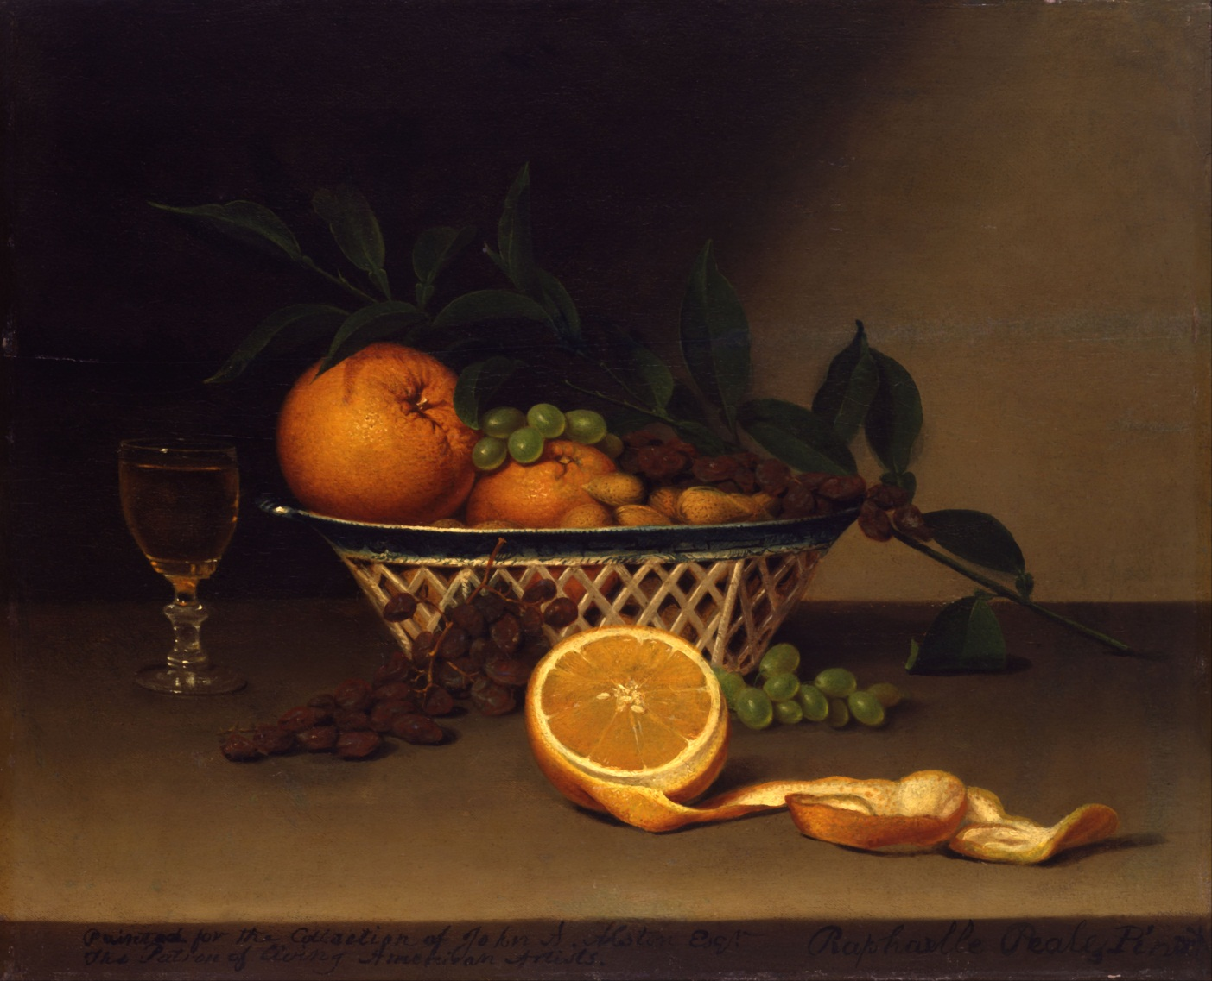

Slide 4
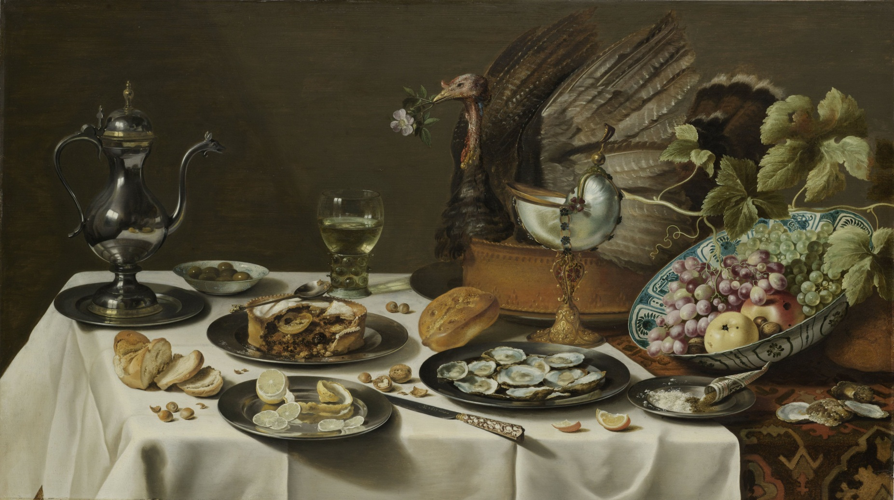

Slide 5
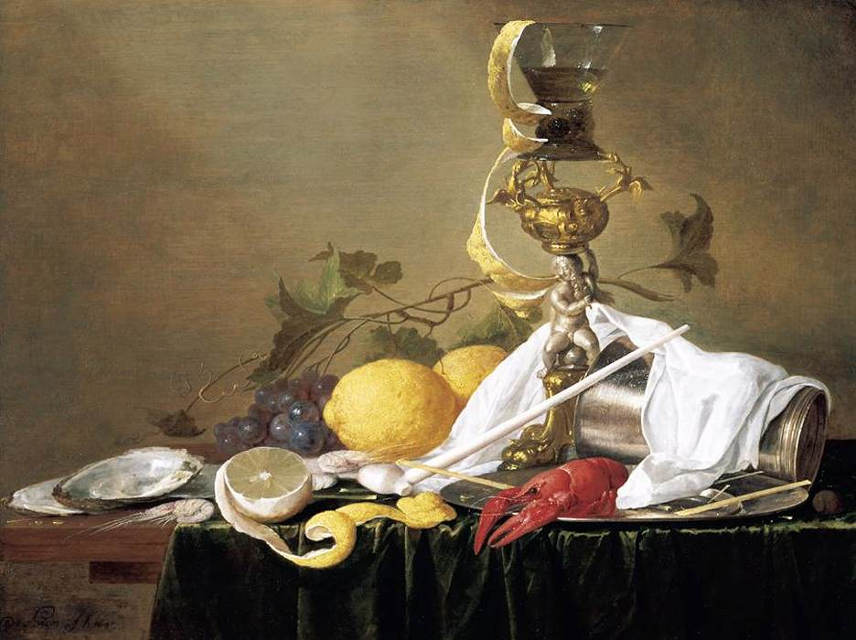

Slide 6
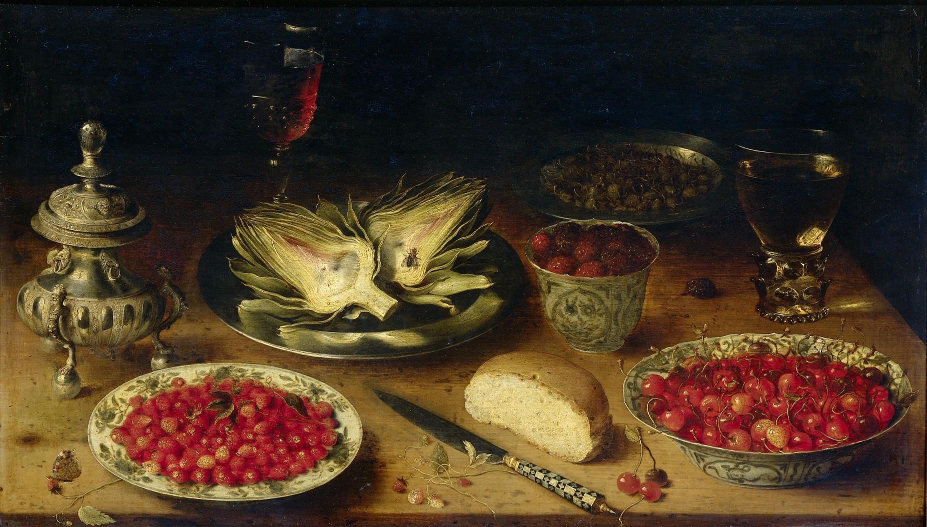

Slide 7
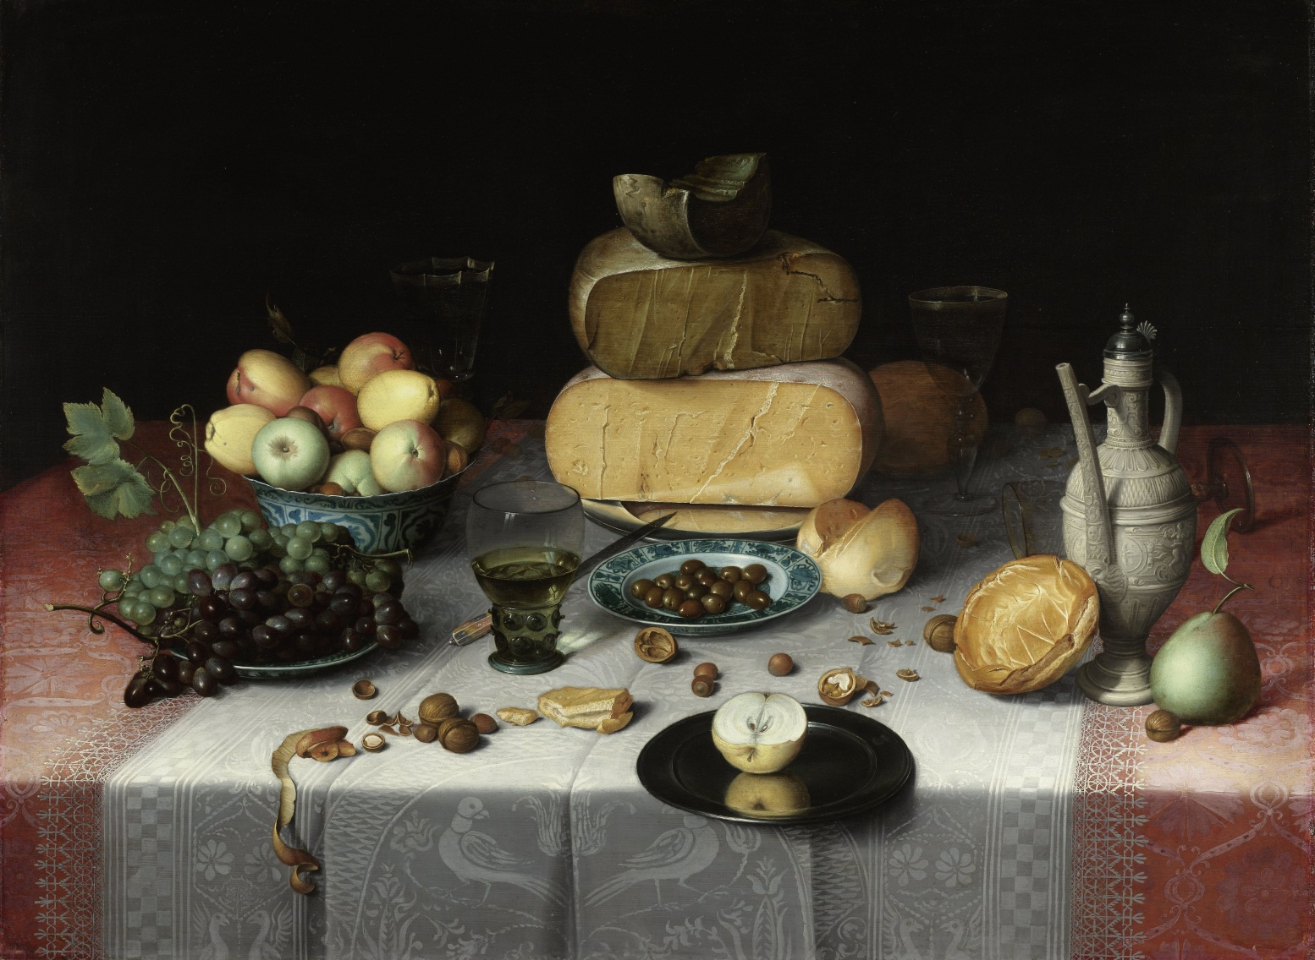

Slide 8
The End
Stephen Roney
JIC
September, 2014

