Slide 1
Sports and Pastimes Vocabulary
Stephen Roney
JIC
February, 2013
Notes:
This template can be used as a starter file for presenting training materials in a group setting.
Sections
Right-click on a slide to add sections. Sections can help to organize your slides or facilitate collaboration between multiple authors.
Notes
Use the Notes section for delivery notes or to provide additional details for the audience. View these notes in Presentation View during your presentation.
Keep in mind the font size (important for accessibility, visibility, videotaping, and online production)
Coordinated colors
Pay particular attention to the graphs, charts, and text boxes.
Consider that attendees will print in black and white or grayscale. Run a test print to make sure your colors work when printed in pure black and white and grayscale.
Graphics, tables, and graphs
Keep it simple: If possible, use consistent, non-distracting styles and colors.
Label all graphs and tables.

Slide 2
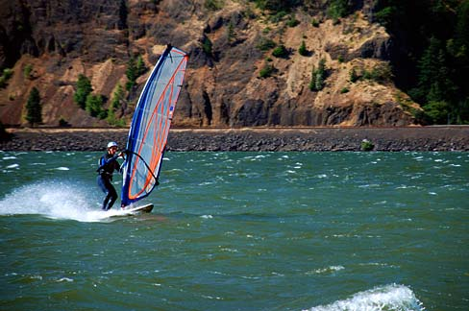
windsurfing
Notes:
Give a brief overview of the presentation. Describe the major focus of the presentation and why it is important.
Introduce each of the major topics.
To provide a road map for the audience, you can repeat this Overview slide throughout the presentation, highlighting the particular topic you will discuss next.

Slide 3
swimming

Slide 4
scuba diving

Slide 5
mountain biking

Slide 6
gym, gymnasium
NOUN

Slide 7
dance

Slide 8
basketball

Slide 9
aerobics

Slide 10
cycling, riding a bike

Slide 11
football

Slide 12
hiking

Slide 13
running

Slide 14
skiing, ski

Slide 15
tennis

Slide 16
yoga

