Slide 1
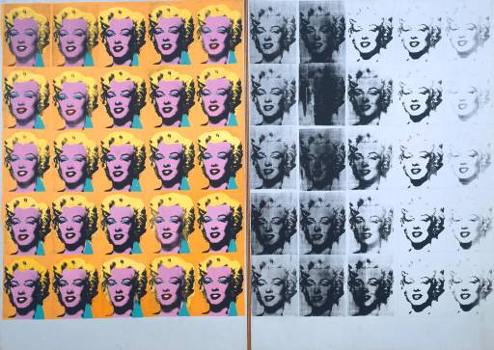
Using Vintage Pop Media in EFL
Stephen K. Roney
Jubail Industrial College
2014

Slide 2
Sources
Internet Archive
Library of Congress
National Library of Australia

Slide 5
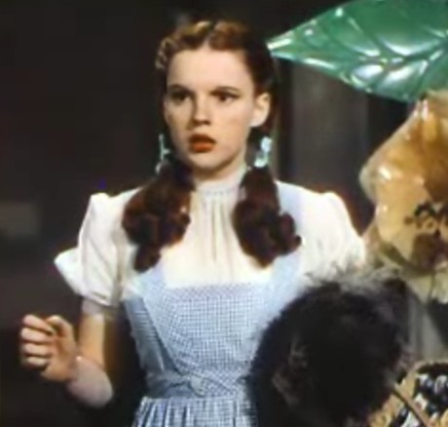
cinema
MovieClips
Classic Cinema
Open Culture

Slide 7
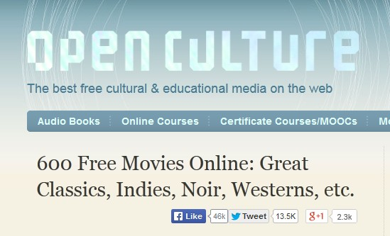

Slide 8
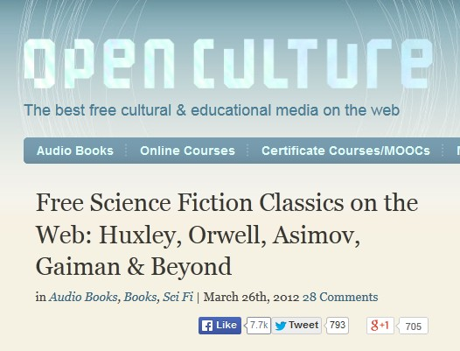

Slide 9
Simply scripts

Slide 10
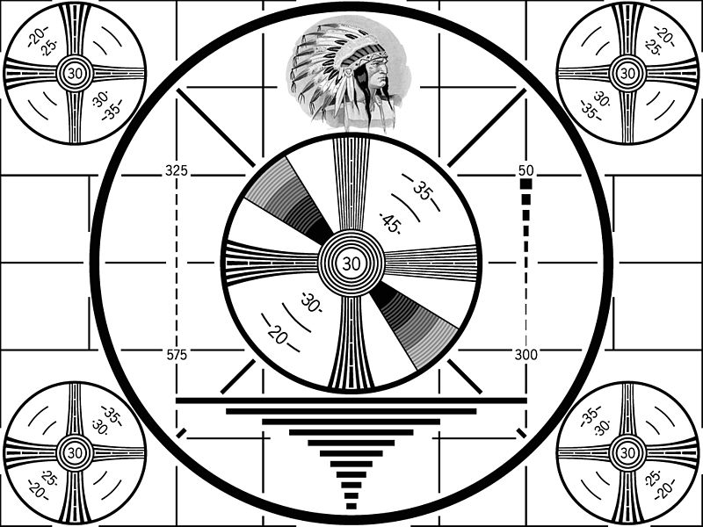
Television
YouTube
BBC Archives
CBC Archives

Slide 11
advertising
Duke University
TellyAds
Vintage Ad Browser
Vintascope

Slide 12
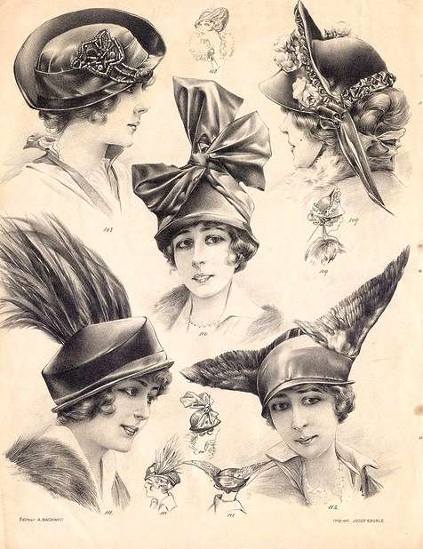
catalogues
Cdn. Museum of History
Radio Shack
Wishbook
Kingston Public Library

Slide 13
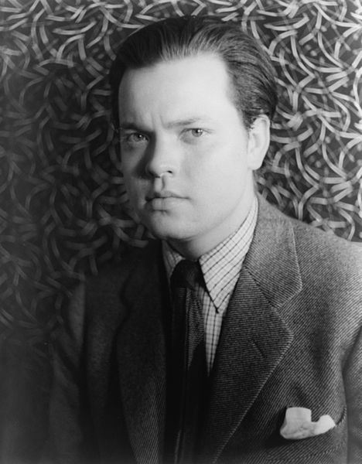
radio
Old Time Radio Network
Dumb
Mercury Theatre on the Air

Slide 14
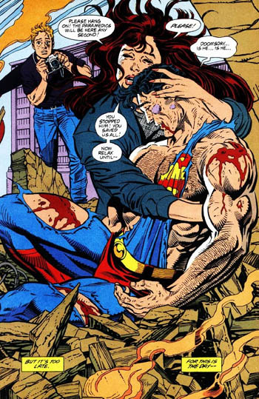
comics
Comic Book Plus
Digital Comics Museum
Catspaw

Slide 15
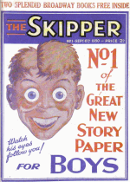
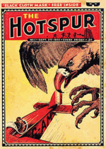
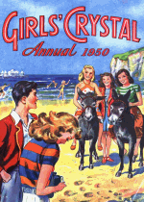

Slide 16
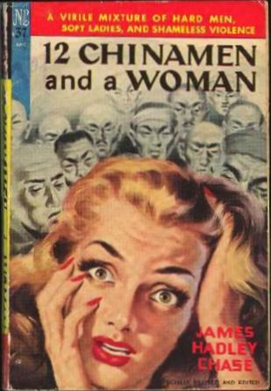
print
Munsey’s
Google Magazines
Gutenberg

Slide 17
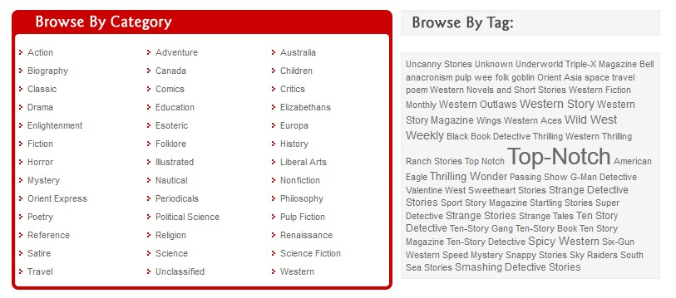

Slide 18
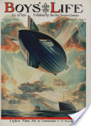
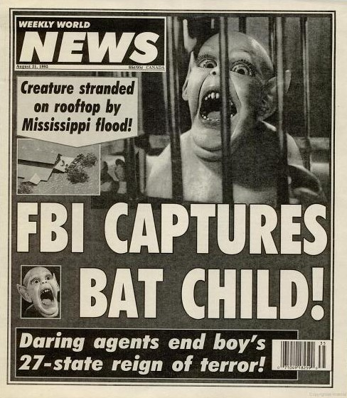
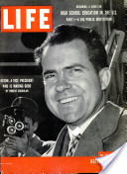

Slide 19
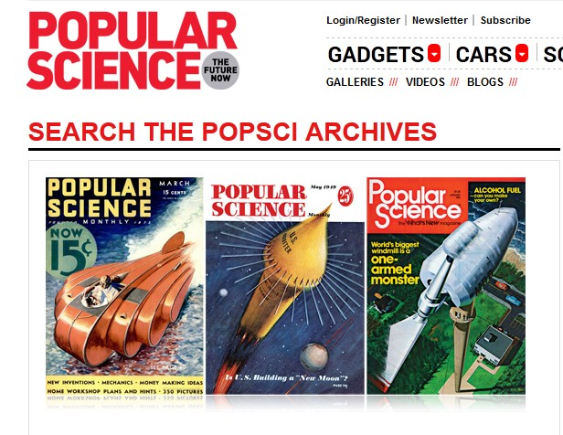

Slide 20
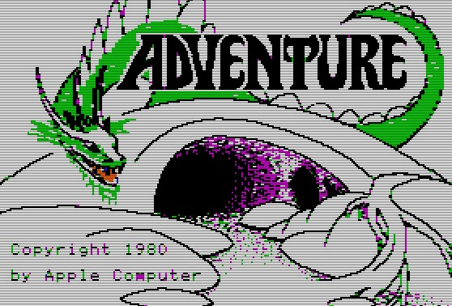
Computer games
RGB Classic Games
Virtual Apple
The People’s Republic of IF

Slide 21
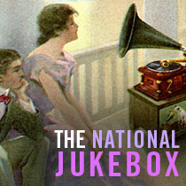
music
Open Music Archive
Library and Archives Canada
Mudcat Café
Cultural Equity Organization

Slide 22
karaoke
YouTube Karaoke Channel

Slide 23
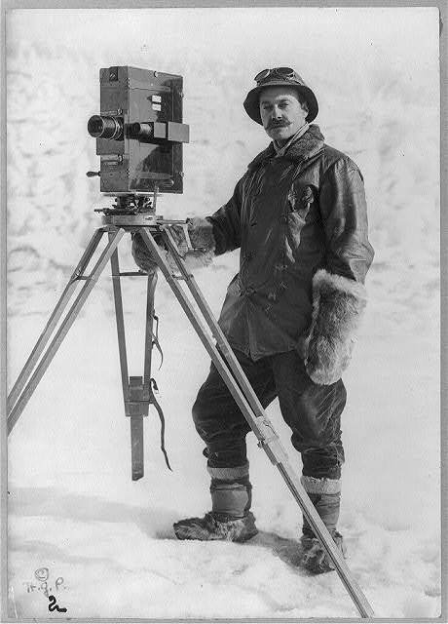
images
Cover Browser
LIFE Magazine
Shorpy
Internet Archive Flickr

Slide 24
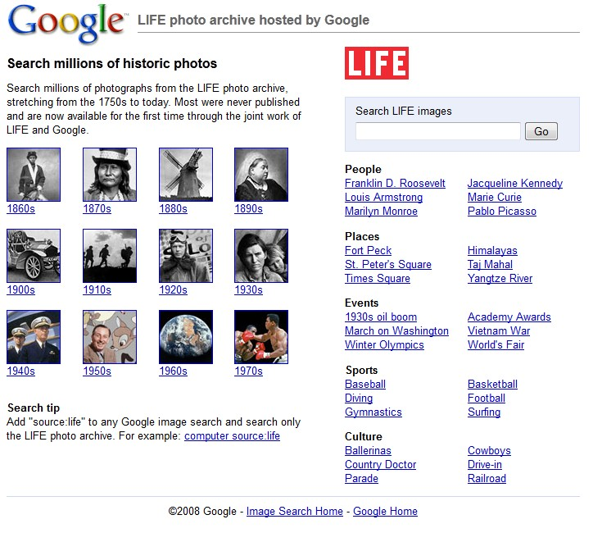

Slide 25
Tools
ESL Video
Lessonwriter
ImageQuiz
EduCanon
VoiceThread $
PowerPoint
Glogster $

Slide 26
imagequiz

Slide 27
