Slide 1
Some Muslim inventions
Stephen Roney JIC February 2013

Slide 2
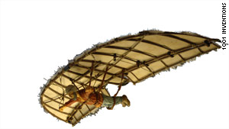
Glider – Ibn Firnas, 9th C

Slide 3
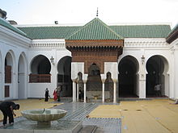
University – fez, 9th C.

Slide 4
Algebra – al-kwarizmi, 9th c.

Slide 5
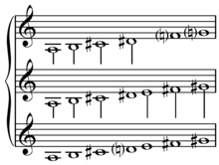
Musical scale – origin unclear

Slide 6
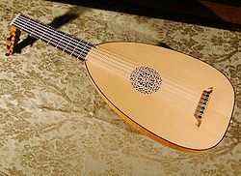
Lute – middle east, origin unclear

Slide 7
Coffee – yemen- 9th c.

Slide 8
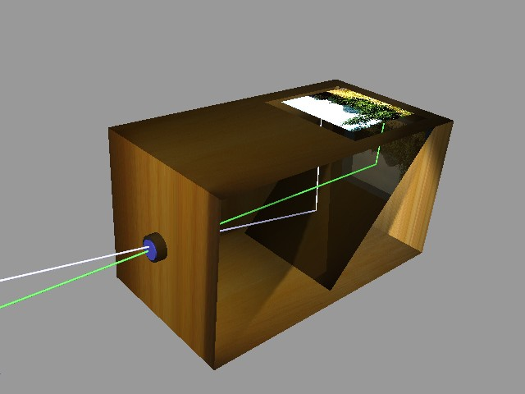
Camera obscura – al-haitam, 11th c.

Slide 9
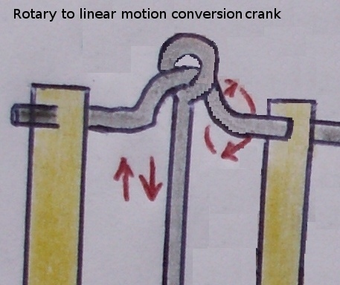
Mechanical crank – al-jazari, 12th c

