Slide 1
Social Activities
Stephen Roney
JIC
April, 2013

Slide 2
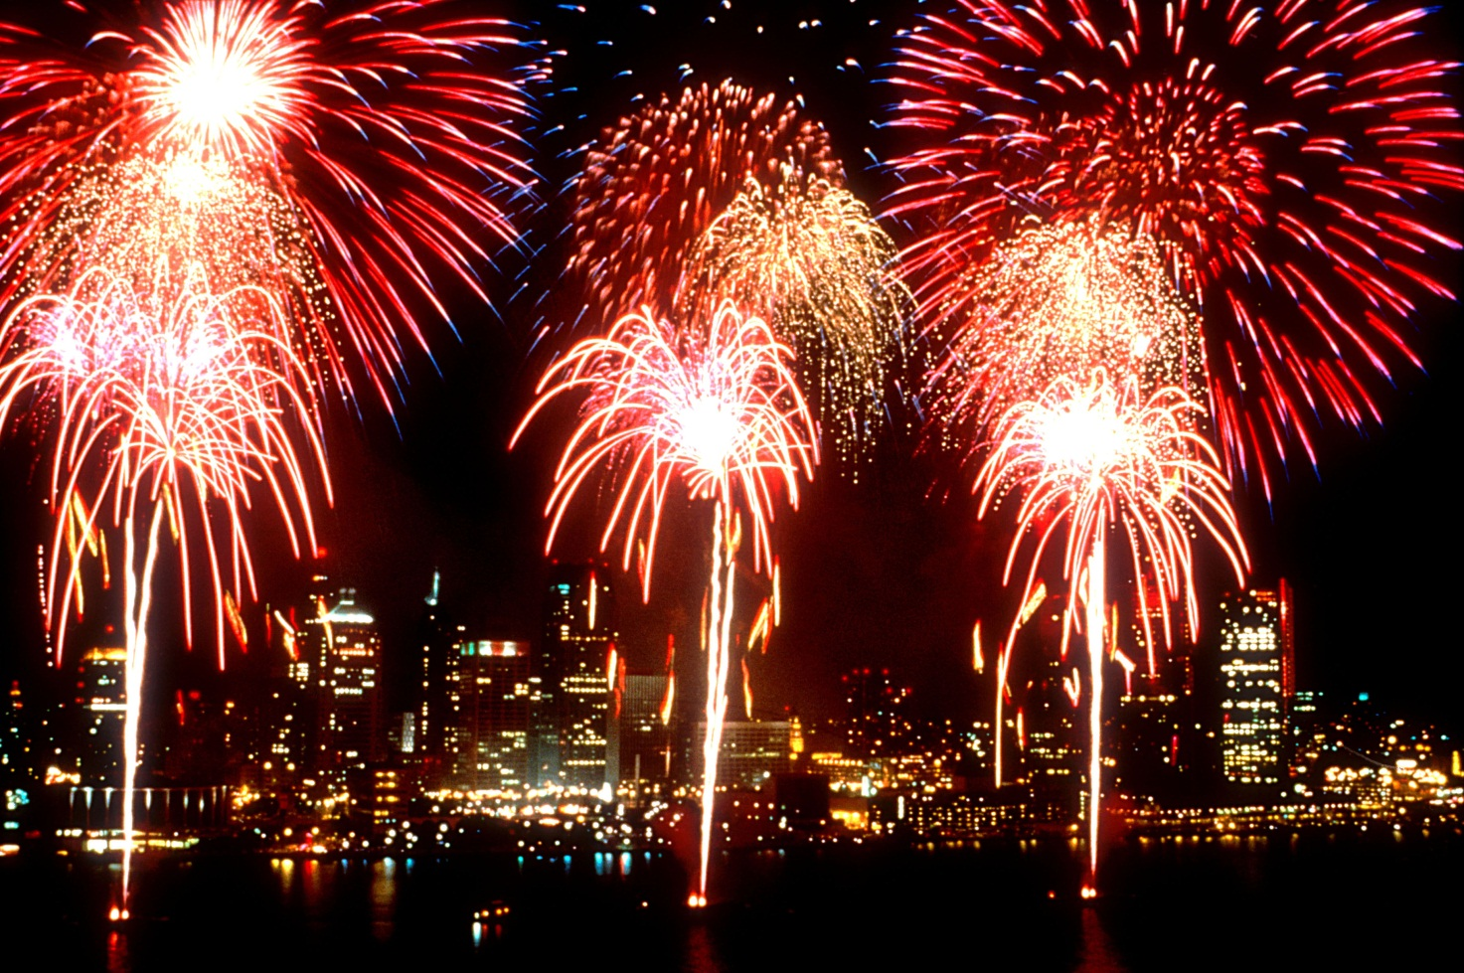
firework display

Slide 3
cinema

Slide 4
dinner

Slide 5
theatre

Slide 6
sports event

Slide 7
dancing

Slide 8
boat trip

Slide 9
concert

Slide 10
museum

