Slide 1
Unit 5 shapes
Stephen Roney
JIC
May, 2014
Notes:
This template can be used as a starter file for a photo album.

Slide 2
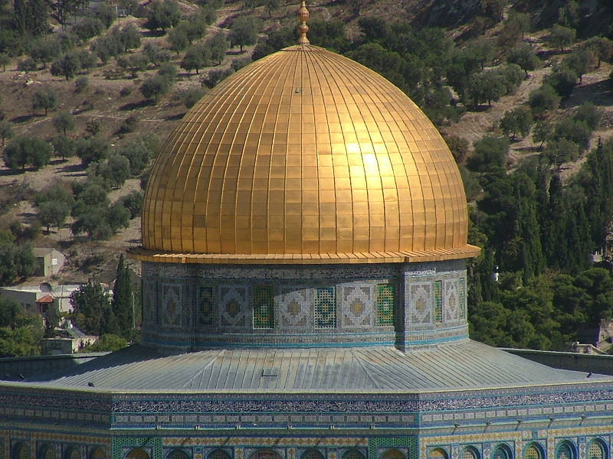
Dome

Slide 3
cylinder
cylindrical

Slide 4
square
square

Slide 5
triangle
triangular

Slide 6
rectangle
rectangular

Slide 7
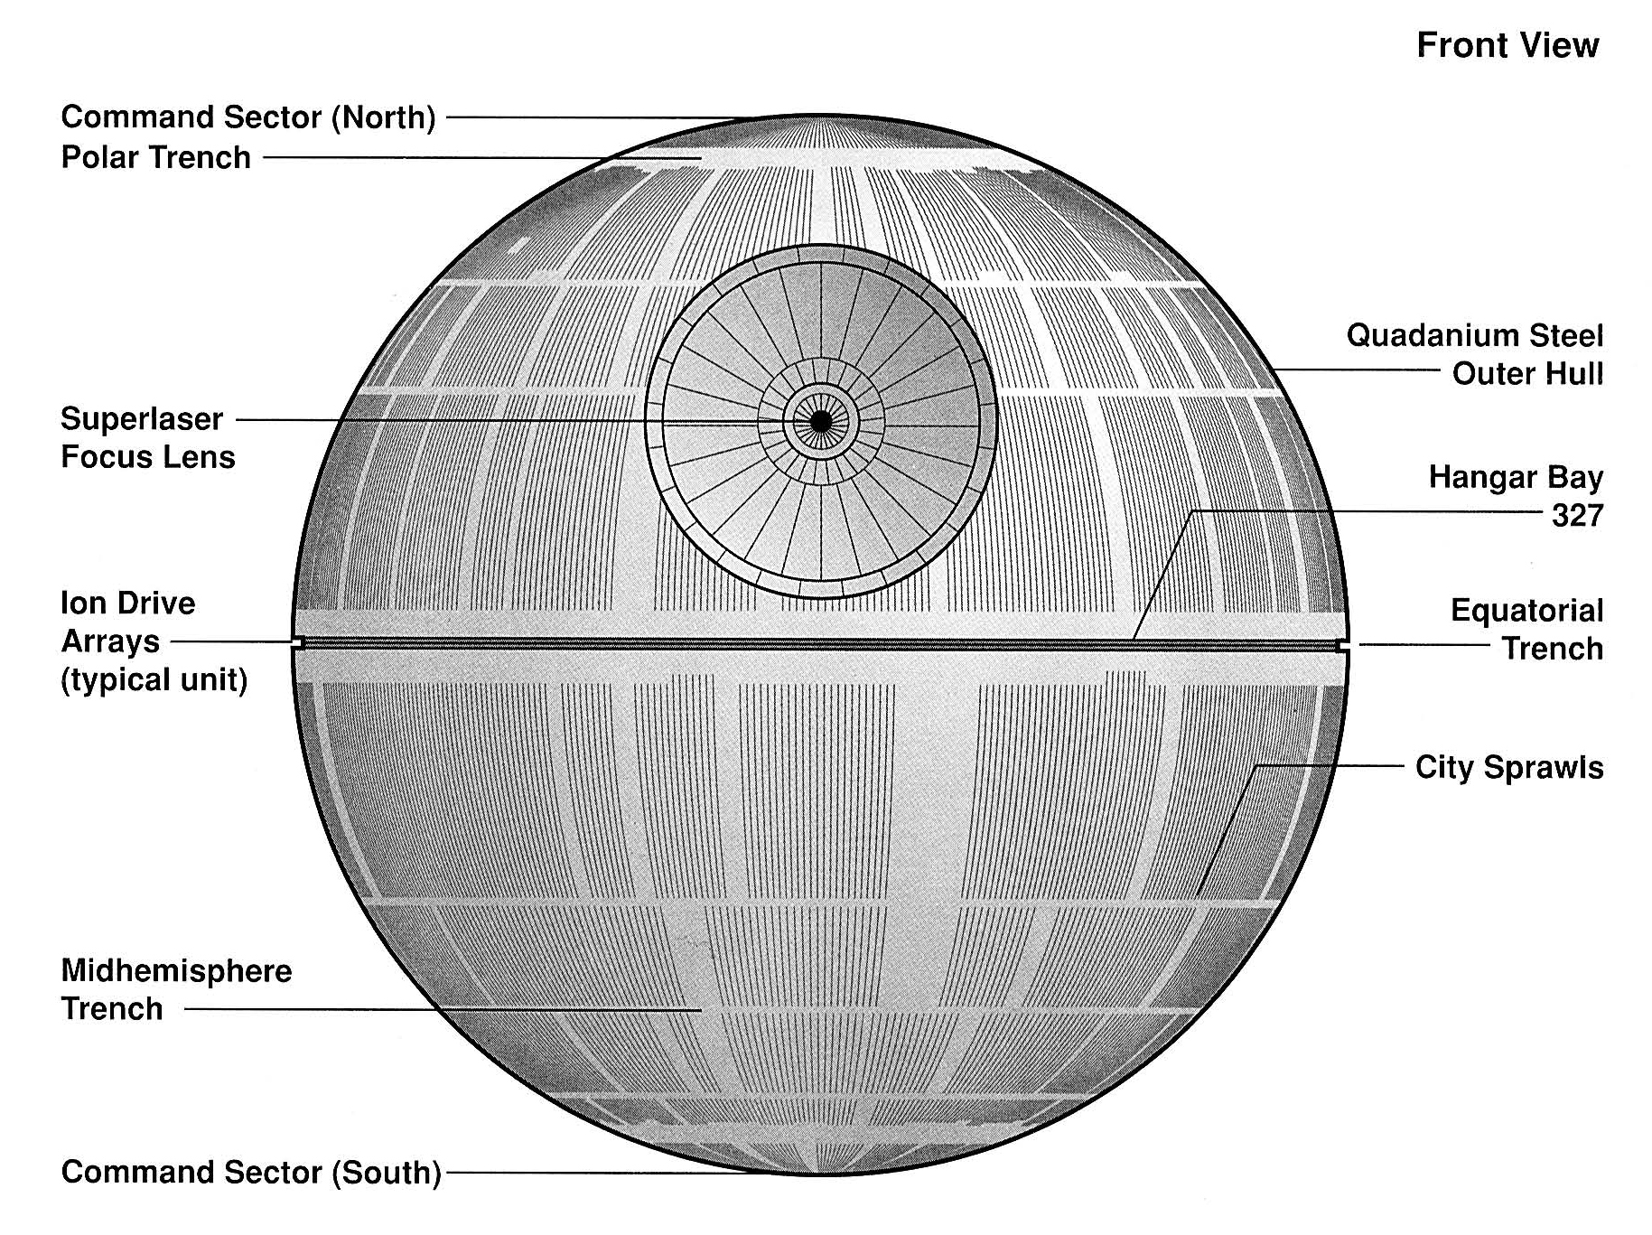
sphere
spherical

Slide 8
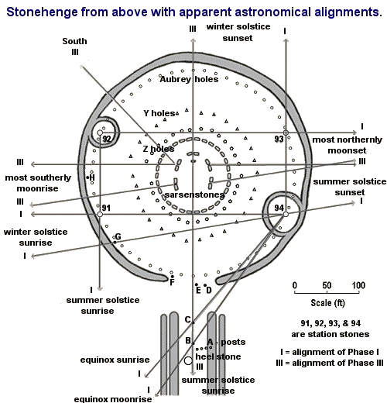
circle
circular

Slide 9
cone
conical

Slide 10
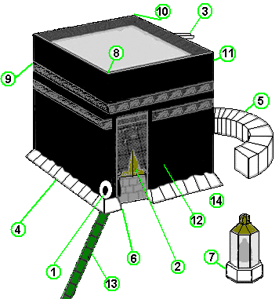
cube
cubic

Slide 11
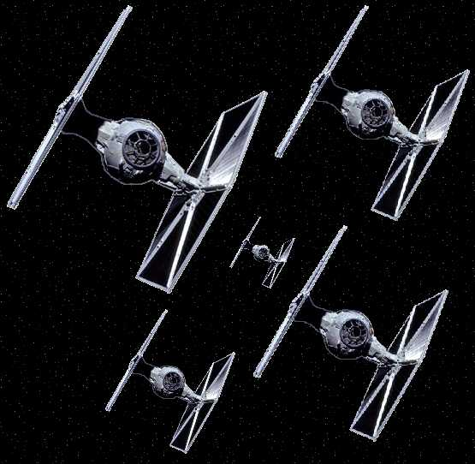
H-shaped

Slide 12
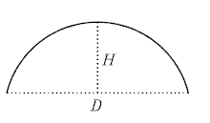
semi-circle
semi-circular

Slide 13
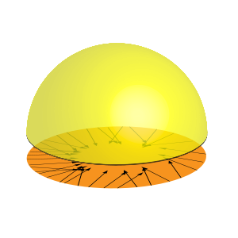
hemisphere
hemispherical

Slide 14
Khalas. Shukran.
Stephen Roney
JIC
May, 2014

