Slide 1
Postcards Gallery
Stephen Roney
JIC
November, 2014

Slide 2
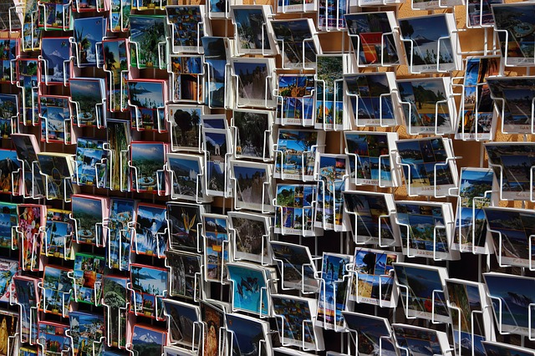
Postcards for sale

Slide 3
Grand Canyon

Slide 4
Reverse

Slide 5
Blackpool

Slide 6
London

Slide 7
Montreal

Slide 8
Shanghai

