Slide 1
Personality adjectives
Stephen Roney JIC 2013

Slide 2
generous

Slide 3
energetic

Slide 4
talkative

Slide 5
ambitious

Slide 6
Easy-going

Slide 7
Hard-working

Slide 8
creative

Slide 9
moody

Slide 10
quiet

Slide 11
Strong-willed

Slide 12
Self-confident

Slide 13
reliable

Slide 14
bossy

Slide 15
assertive

Slide 16
serious

Slide 17
Even-tempered

Slide 18
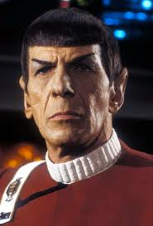
organised

Slide 19
sociable

Slide 20
cautious

