Slide 1
Oil Nouns
Stephen Roney
JIC
April 2014

Slide 2
driller

Slide 3
heat shield

Slide 4
rig

Slide 5
site manager

Slide 6
witness

Slide 7
technologist

Slide 8
supervisor

Slide 9
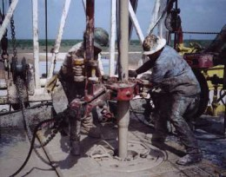
roustabouts

Slide 10
ladder

Slide 11
electrician

Slide 12
blowout preventer

Slide 13
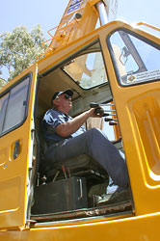
crane operator

Slide 14
emergency escape

Slide 15
oil platform

Slide 16
safety officer

Slide 17
engineer

Slide 18
derrick

Slide 19
The End

