Slide 1
Jobs Vocabulary
Stephen Roney, JIC

Slide 2
Doctor

Slide 3
Fashion buyer

Slide 4
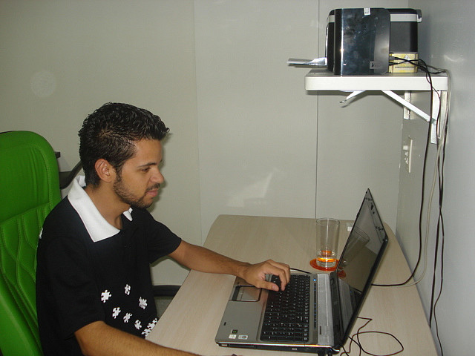
Web designer

Slide 5
Pilot

Slide 6
Lecturer

Slide 7
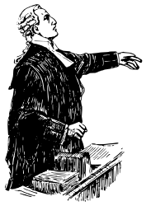
Lawyer

