Slide 1
jobs
Stephen Roney JIC April 2013

Slide 2
presenter

Slide 3
psychologist

Slide 4
photographer

Slide 5
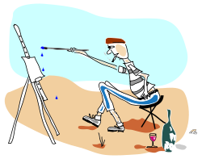
artist

Slide 6
journalist

Slide 7
politician

Slide 8
scientist

