Slide 1
Inventors
Stephen Roney
JIC
February 2013

Slide 2
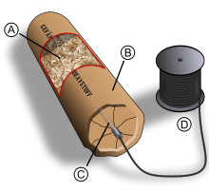
Nobel’s invention

Slide 3

Nobel’s claim to fame

Slide 4
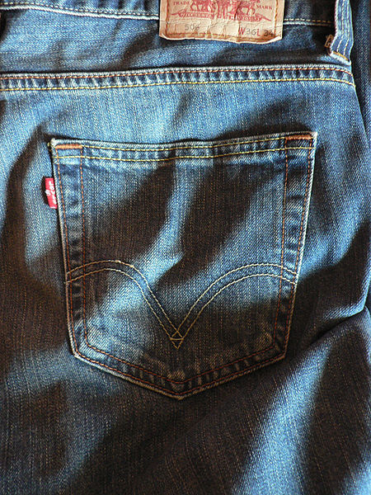
Levi-Strauss’s invention

Slide 5
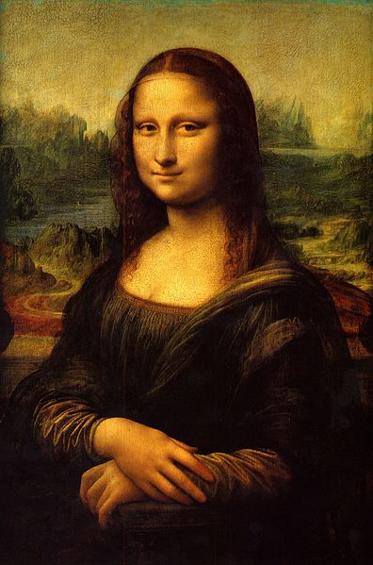
Leonardo's hobby

Slide 6
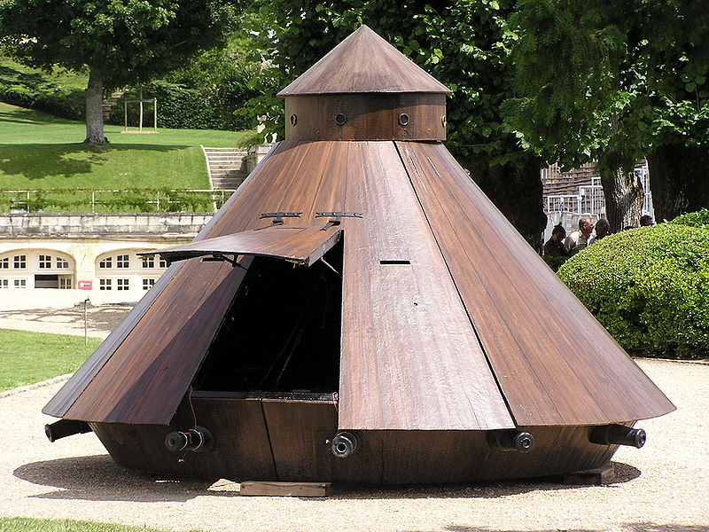
Leonardo's tank

Slide 7
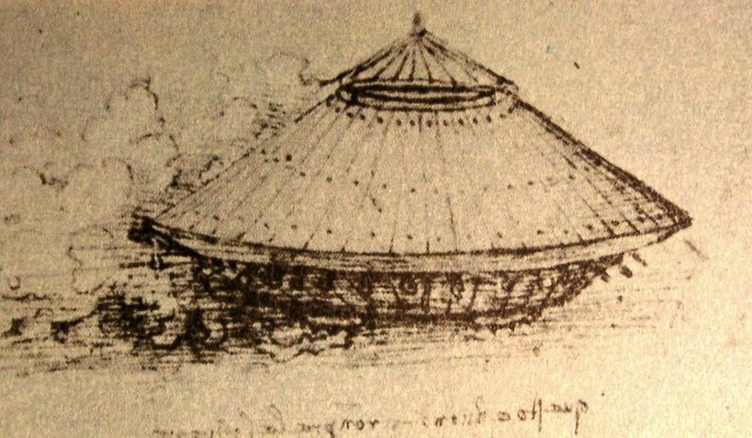
Leonardo's sketch

Slide 8
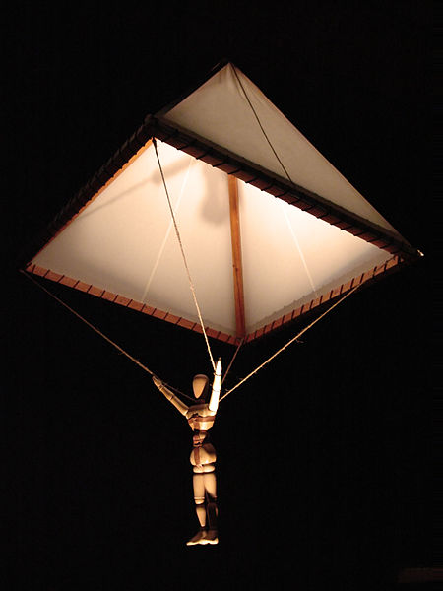
Leonardo's parachute

Slide 9
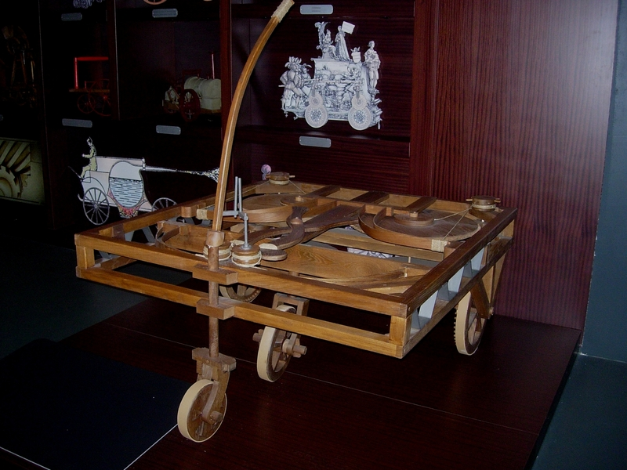
Leonardo's car

Slide 10
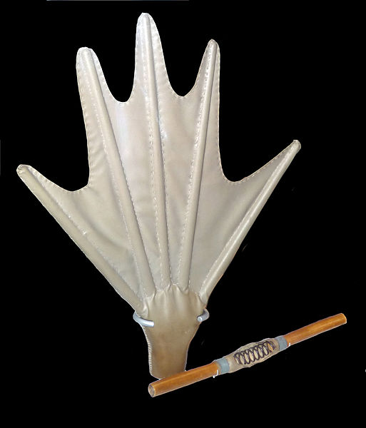
Leonardo's diving glove

Slide 11
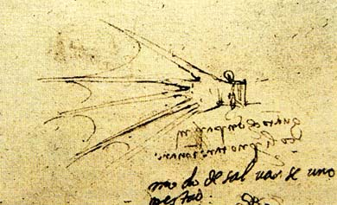
Leonardo's sketch

Slide 12
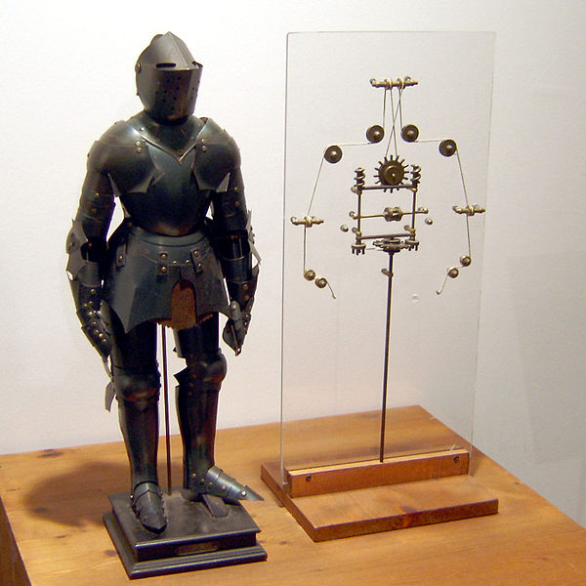
Leonardo's robot

Slide 13
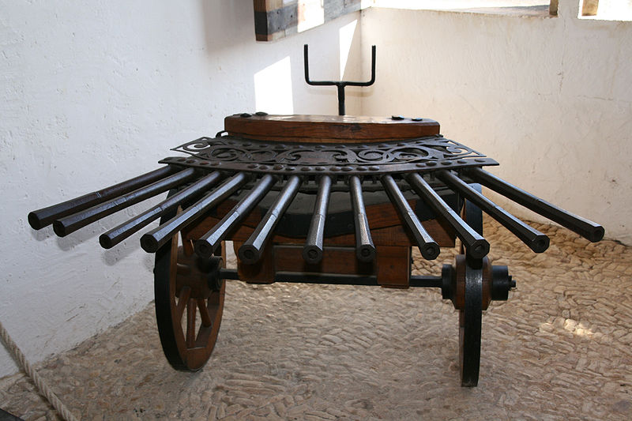
Leonardo's machine gun

Slide 14
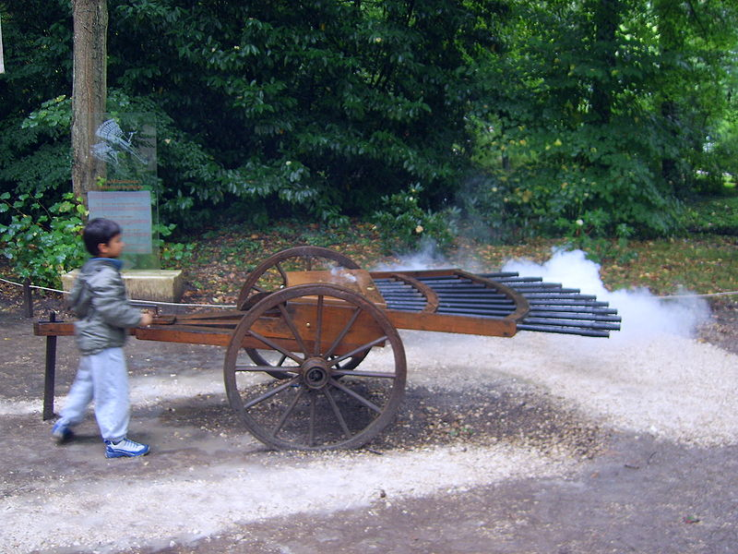
Leonardo's machine gun firing

