Slide 1
Identify the Type of Chart or Graph

Slide 2
What are the TWO types of chart or graph?
Time
Comparison

Slide 3
Which is this?

Slide 4
Which is this?

Slide 5
There are three common types of chart design.

Slide 6
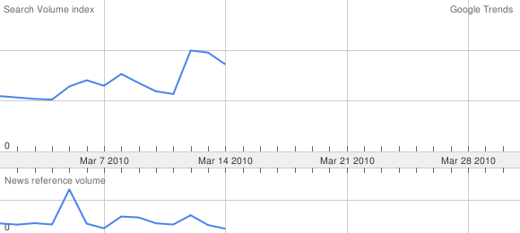
What’s this?

Slide 7
What’s this?

Slide 8
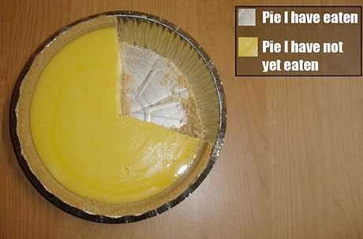
What kind of chart is this?

Slide 9
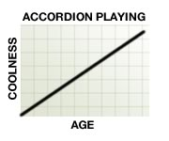
What kind of chart is this?

Slide 10
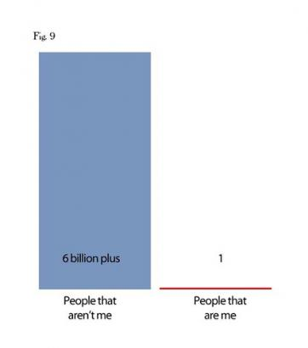
What kind of chart is this?

Slide 11
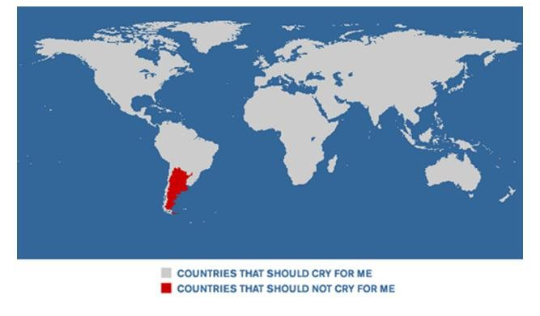
What kind of chart is this?

Slide 12
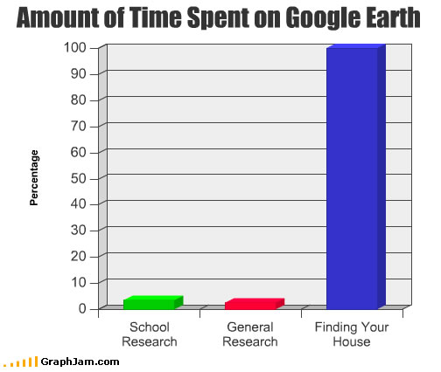
What kind of chart is this?

Slide 13
What kind of chart is this?

Slide 14
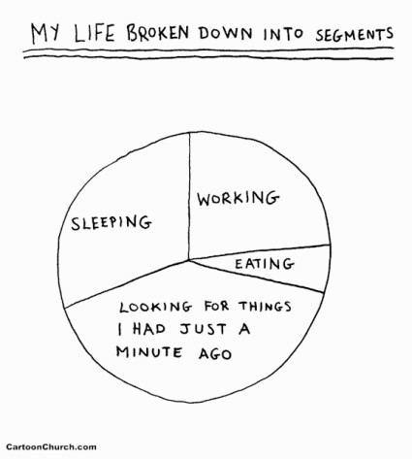
What kind of chart is this?

Slide 15
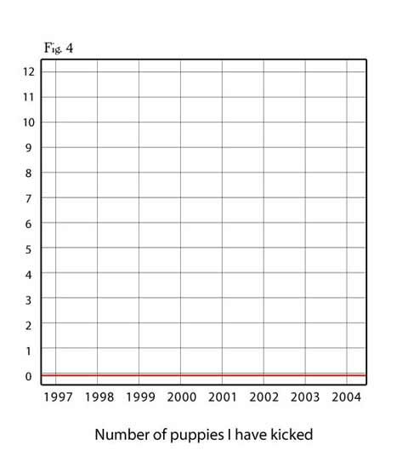
What kind of chart is this?

Slide 16
What kind of chart is this?

Slide 17
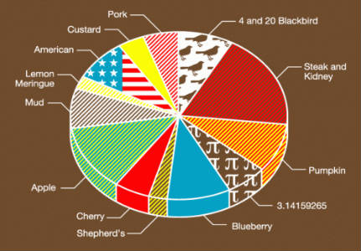
What kind of chart is this?

Slide 18
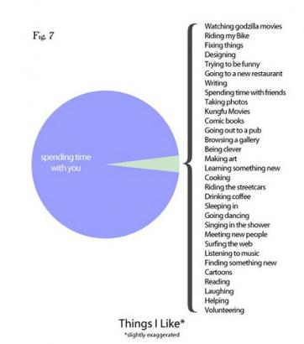
What kind of chart is this?

Slide 19
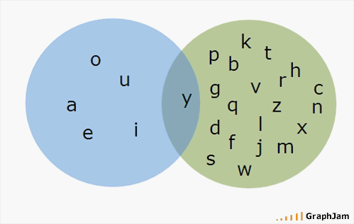
What kind of chart is this?

Slide 20
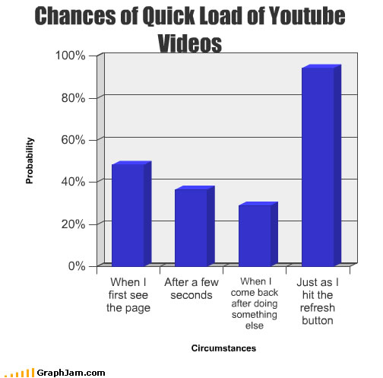
What kind of chart is this?

Slide 21
The End
Stephen Roney CNAQ 2009/2010

