Slide 1
Health Vocabulary
Stephen Roney
JIC
November, 2014

Slide 2
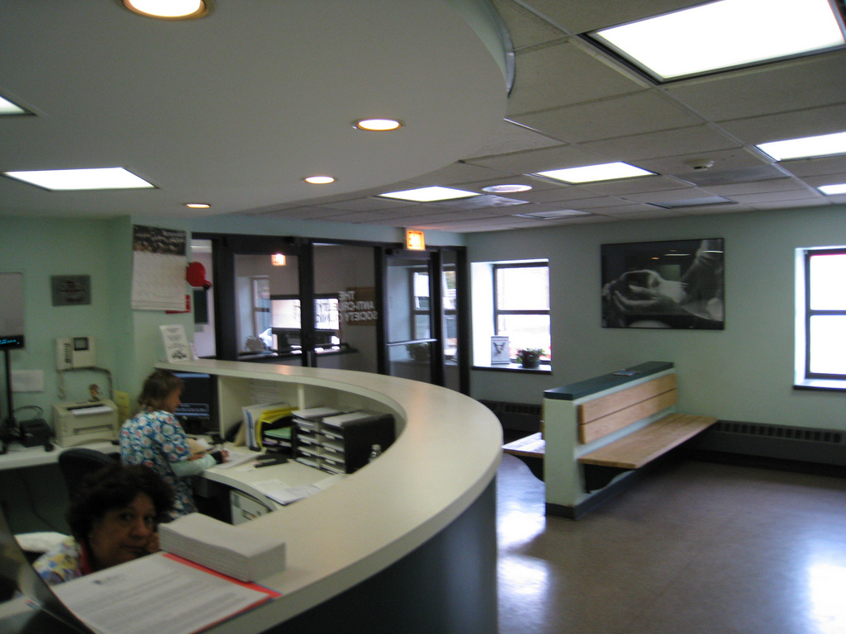
clinic

Slide 3

doctor

Slide 4
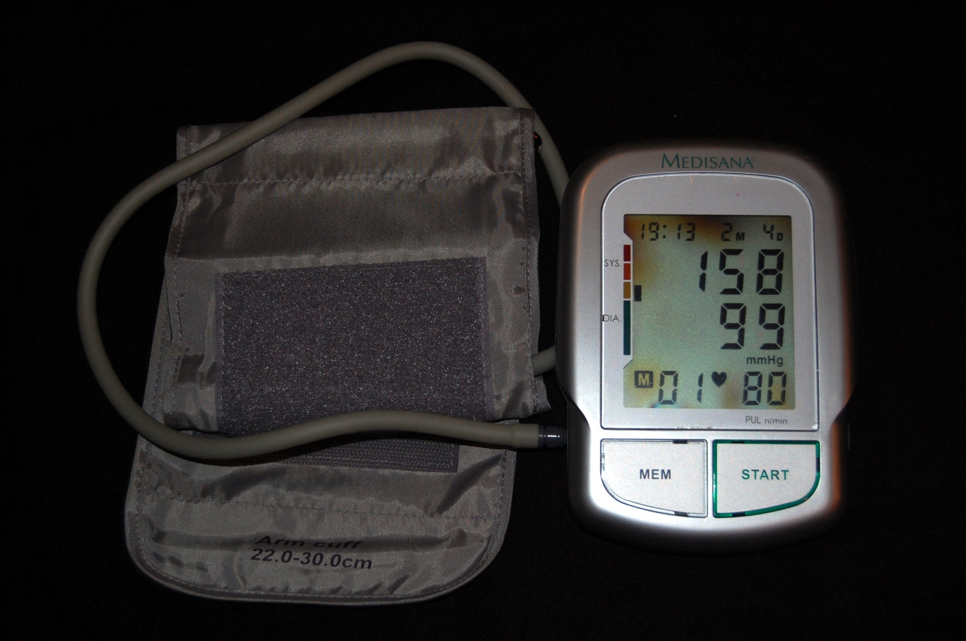
high blood pressure

Slide 5

insomnia

Slide 6
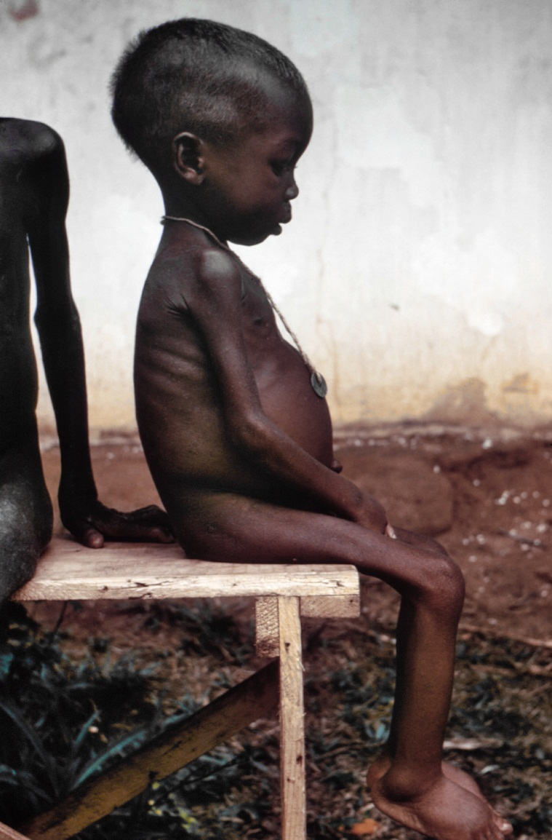
malnutrition

Slide 7
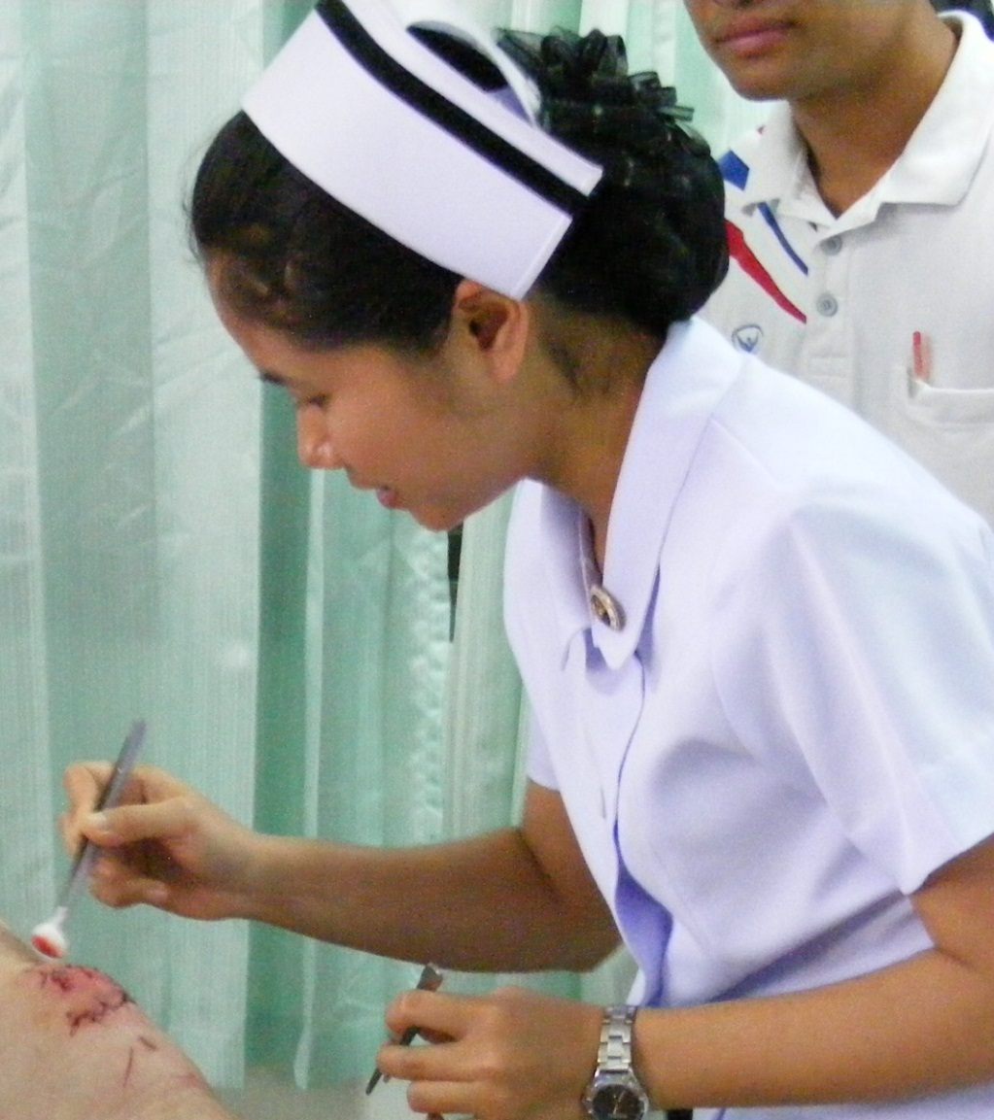
nurse

Slide 8
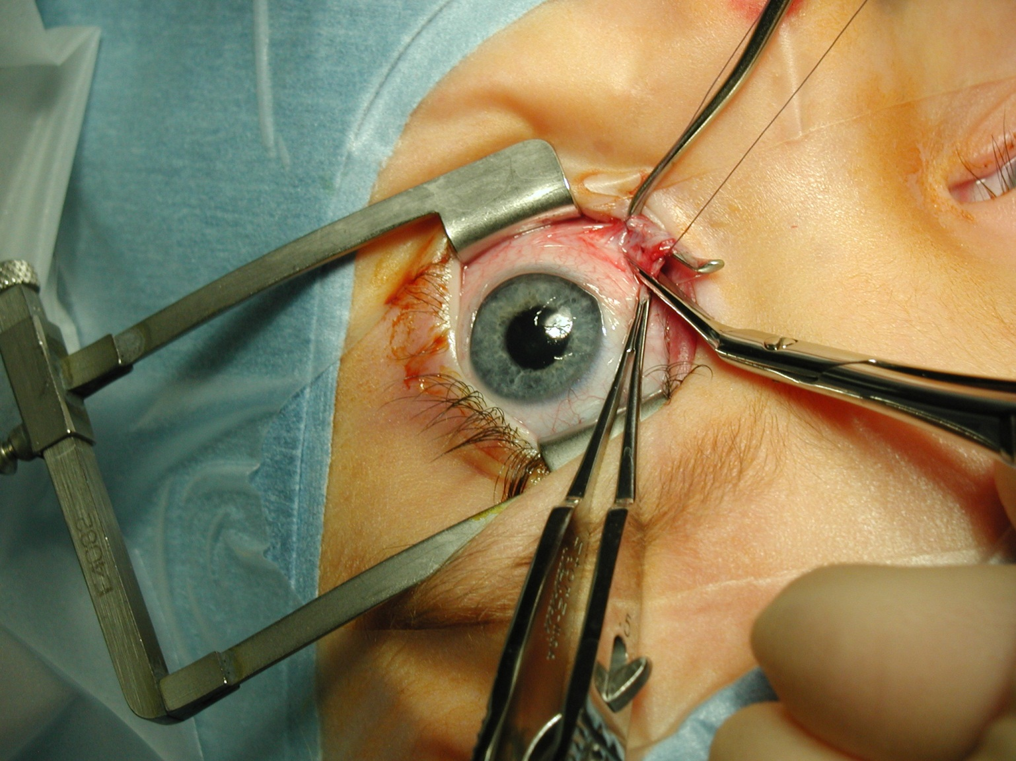
operation, surgery

Slide 9
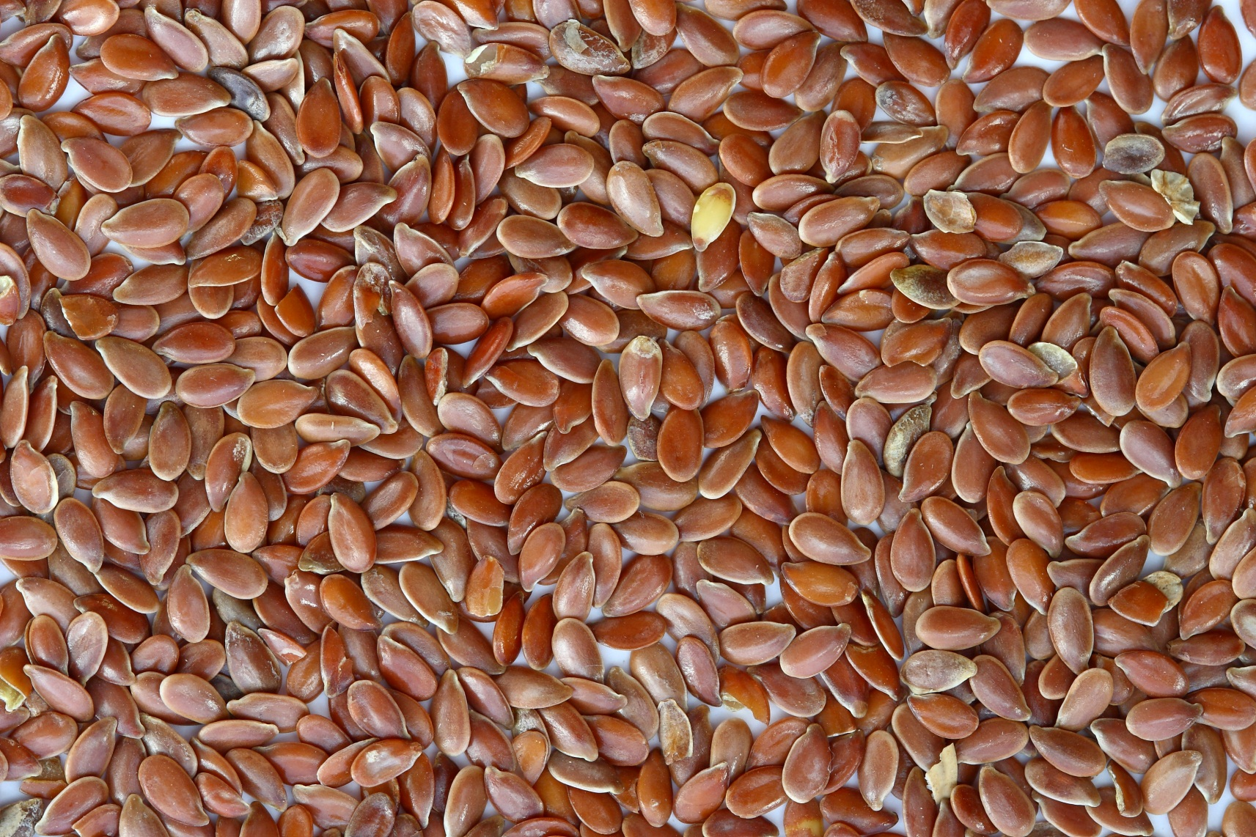
seeds

Slide 10
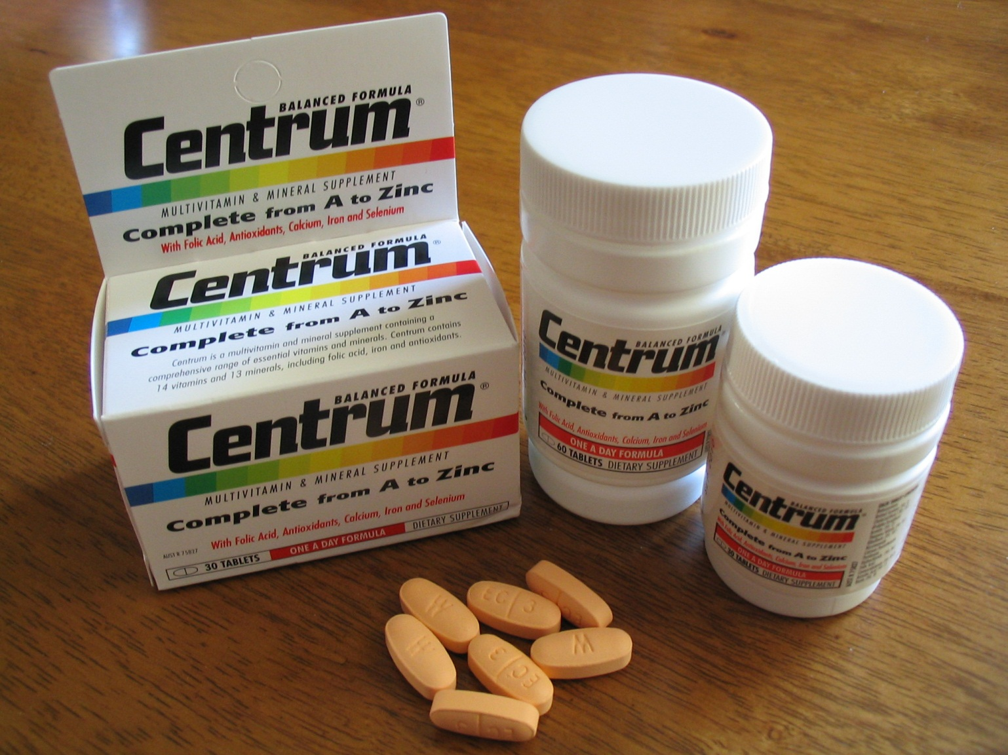
vitamins

Slide 11
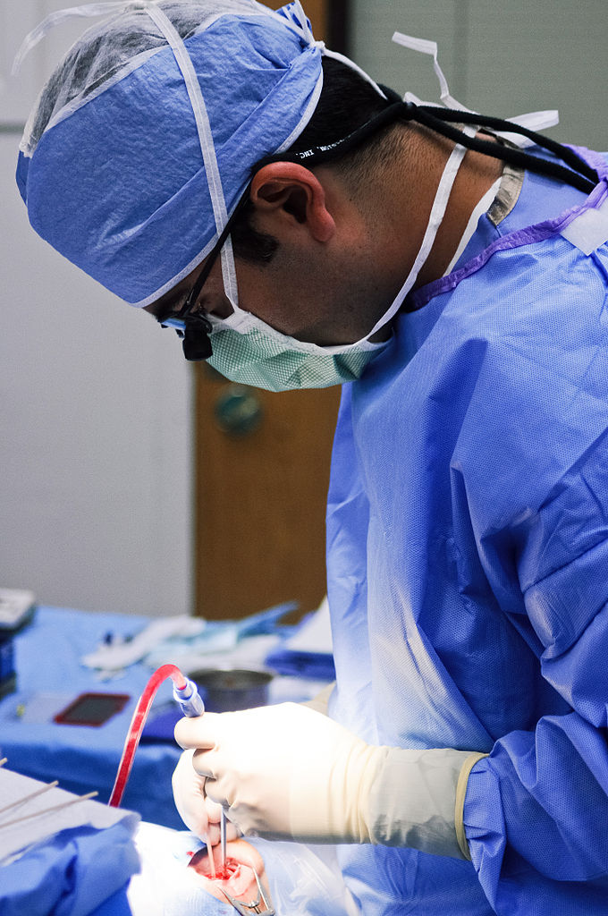
surgeon

Slide 12
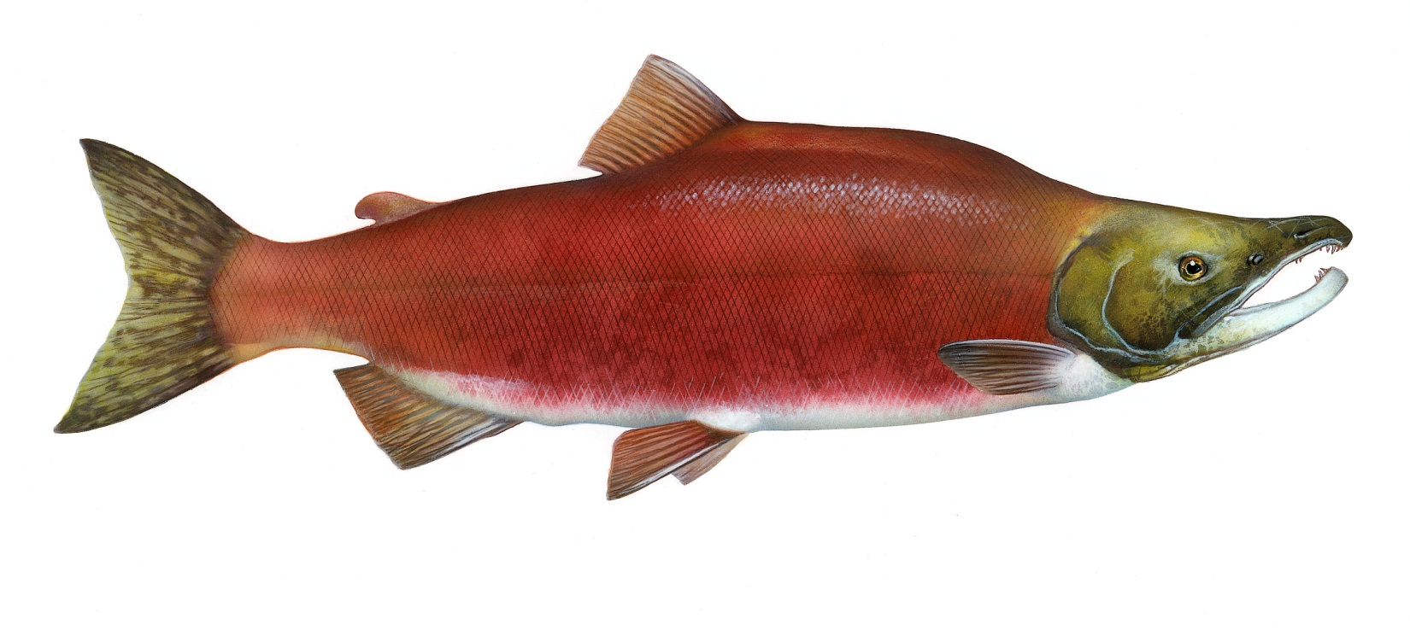
salmon

Slide 13
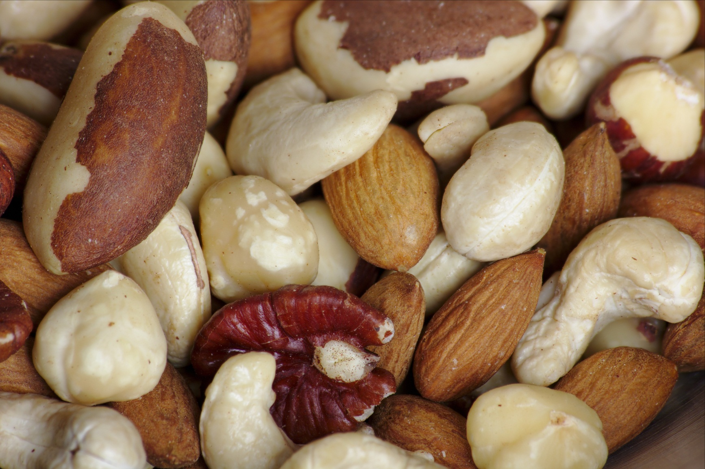
nuts

Slide 14
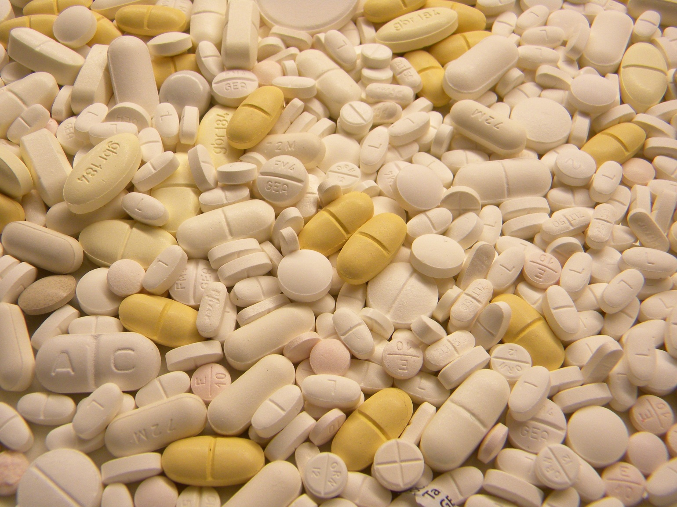
medicine

Slide 15
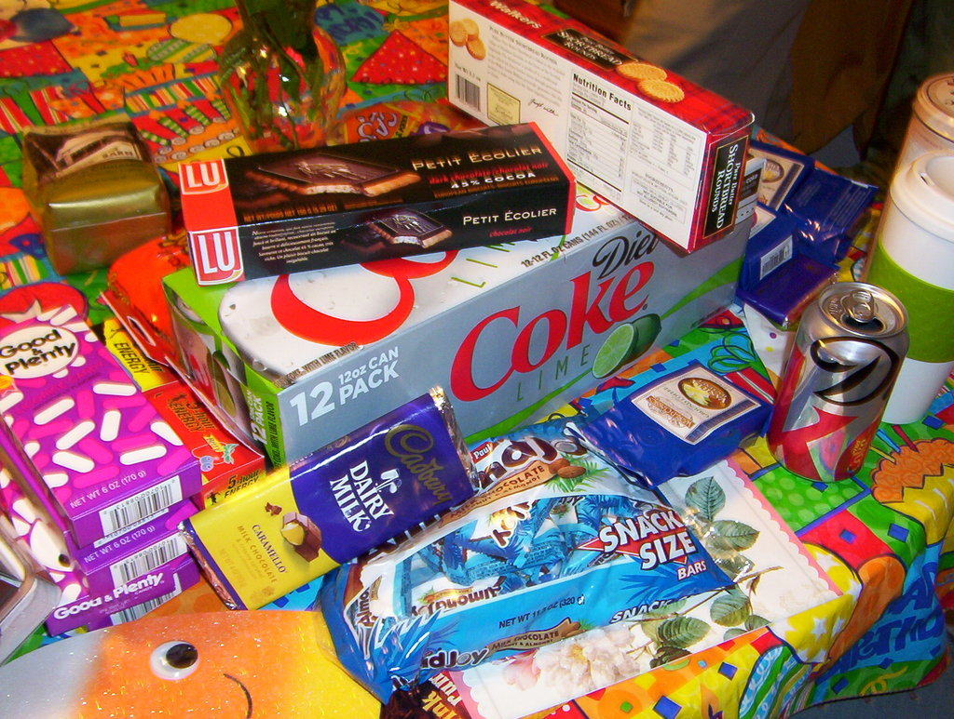
junk food

Slide 16
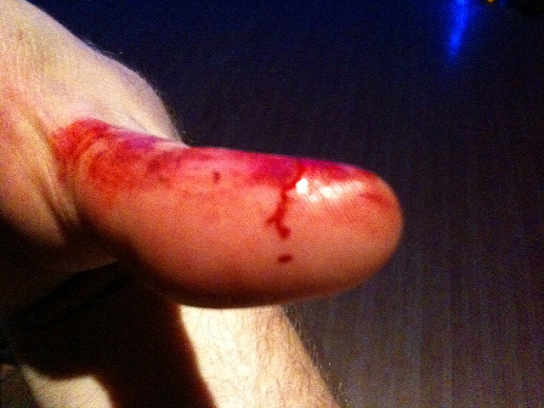
injury

Slide 17
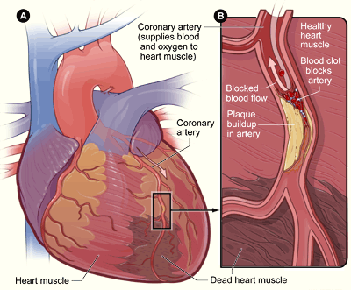
heart disease

Slide 18
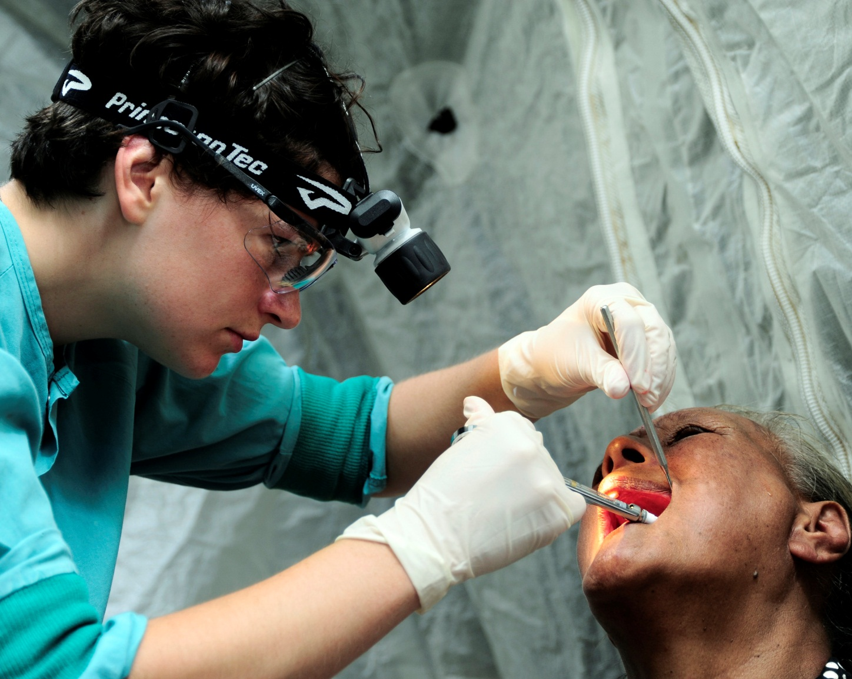
dentist

Slide 19
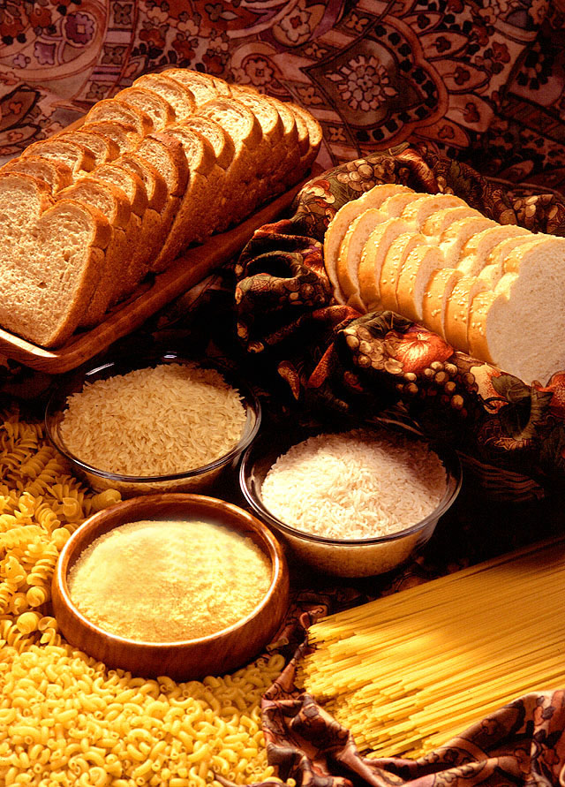
carbohydrates

Slide 20
The End
Stephen Roney
JIC
November, 2014

