Slide 1
Guess the World Record
Painless practice in superlatives

Slide 2
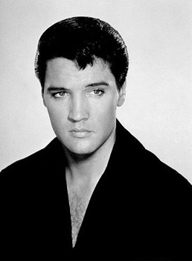
The best-selling singer
Fact, or opinion?

Slide 3
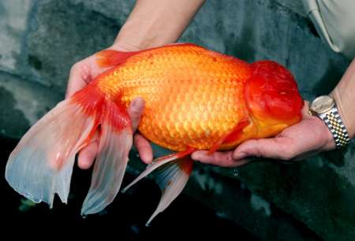
The biggest goldfish
Fact, or opinion?

Slide 4
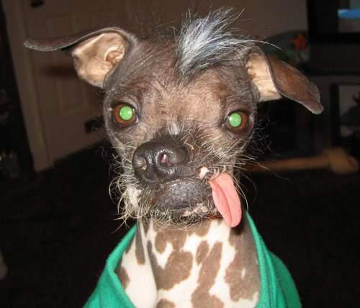
The ugliest dog
Fact, or opinion?

Slide 5

The biggest mosque
Fact, or opinion?

Slide 6
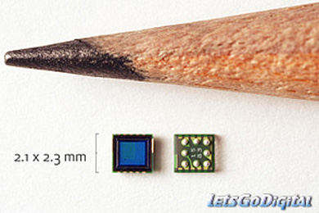
The smallest camera
Fact, or opinion?

Slide 7
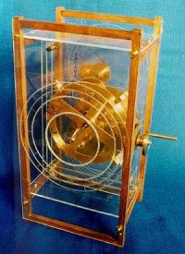
The oldest computer
Fact, or opinion?

Slide 8
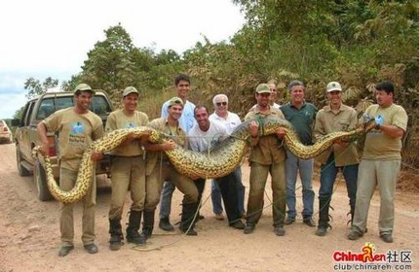
The longest snake
Fact, or opinion?

Slide 9
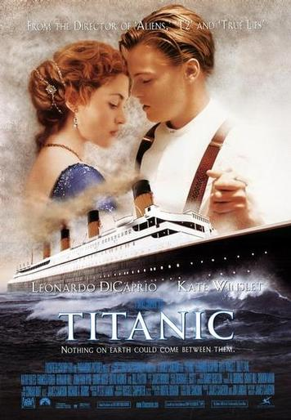
The most popular movie
Fact, or opinion?

Slide 10
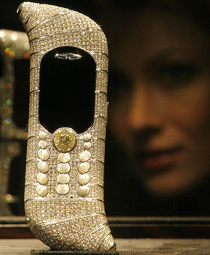
The most expensive mobile phone
Fact, or opinion?

Slide 11
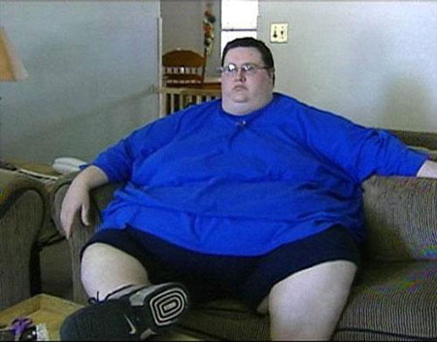
The fattest man
Fact, or opinion?

Slide 12

The most expensive hotel
Fact, or opinion?

Slide 13
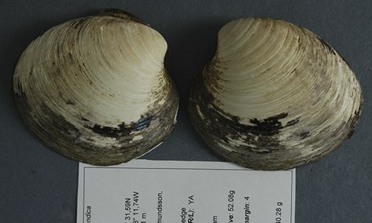
The oldest animal (507 years)

Slide 14
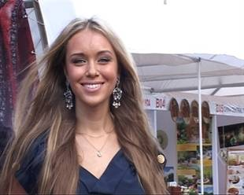
The most beautiful woman
Fact, or opinion?

Slide 15

The most expensive car
Fact, or opinion?

Slide 16

The most dangerous animal
Fact, or opinion?

Slide 17
That’s all, folks!
Stephen Roney, CNAQ, 2009
Images from Creative Commons search, free use

