Slide 1
Famous Logos
Stephen Roney
JIC
September 2014

Slide 2
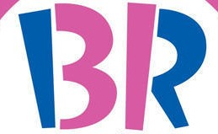
Baskin-Robbins

Slide 3
Hyundai

Slide 4
Red Bull

Slide 5
Twitter

Slide 6
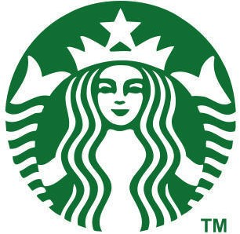
Starbucks

Slide 7
Playstation

Slide 8
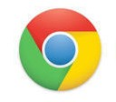
Chrome

Slide 9
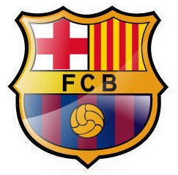
Barcelona

Slide 10
Sony Ericsson

Slide 11
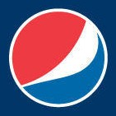
Pepsi

Slide 12
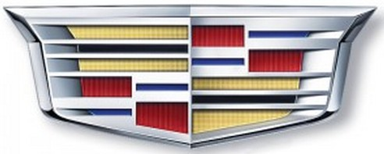
Cadillac

Slide 13
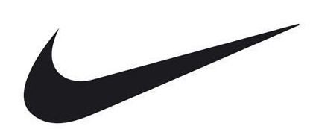
Nike

Slide 14
Skype

Slide 15
Shell

Slide 16
Motorola

Slide 17
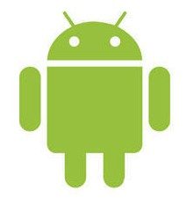
Android

Slide 18
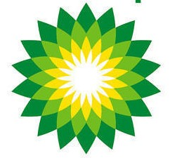
British Petroleum

Slide 19
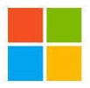
Microsoft

Slide 20
Reddit

Slide 21
Bluetooth

Slide 22
The End
Stephen Roney
Jic
September, 2014

