Slide 1
Everyday Inventions
Stephen Roney
JIC
February 2013

Slide 2
umbrella

Slide 3
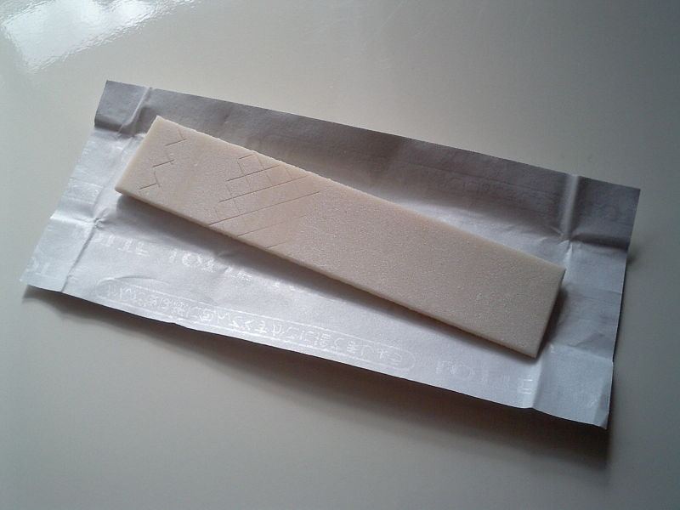
chewing gum

Slide 4
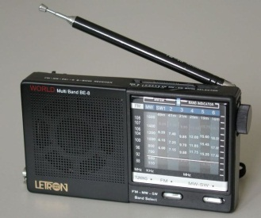
radio

Slide 5
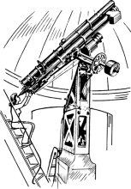
telescope

Slide 6
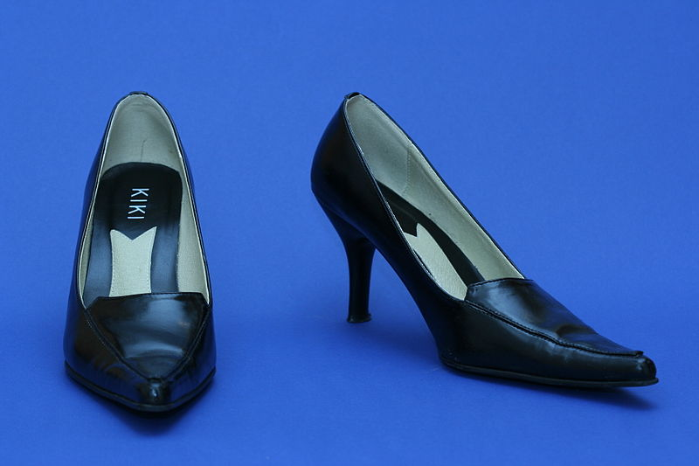
high heels

Slide 7
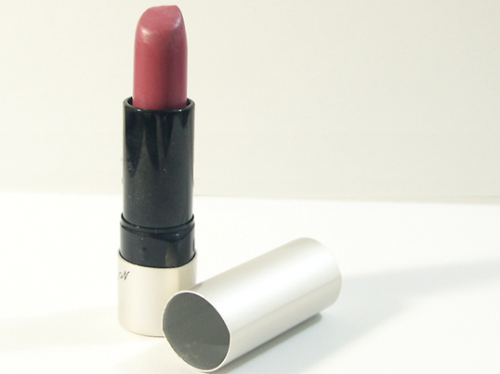
lipstick

Slide 8
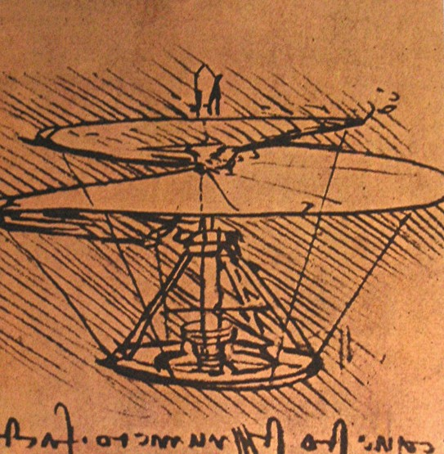
helicopter

Slide 9
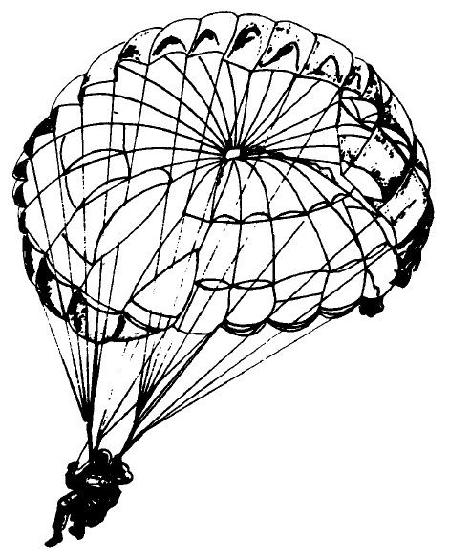
parachute

Slide 10
Post-it® note

Slide 11
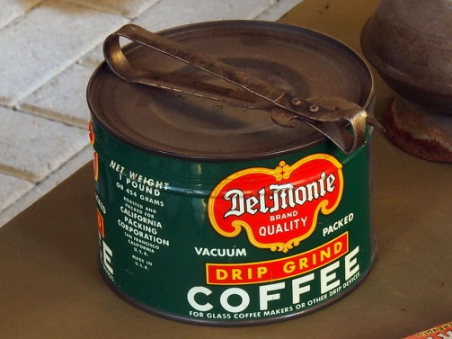
tin can

Slide 12
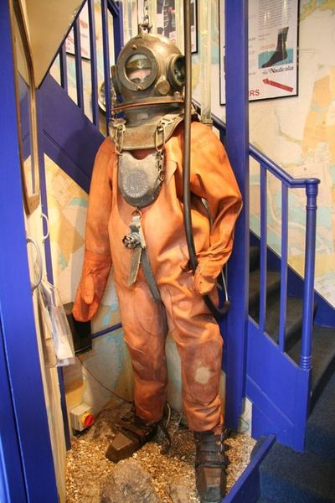
diving suit

Slide 13
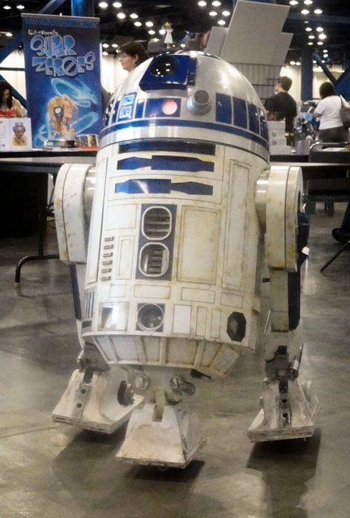
robot

