Slide 1
Crime Vocabulary
Stephen Roney
JIC
April, 2013

Slide 2
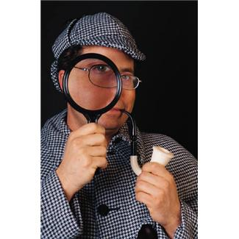
investigator

Slide 3
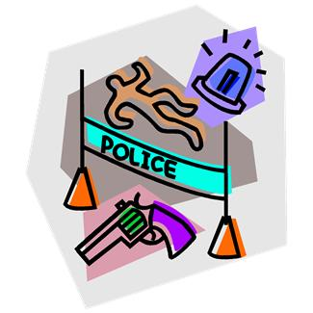
scene

Slide 4
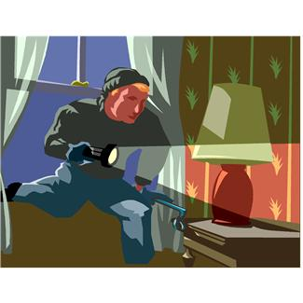
burglary

Slide 5
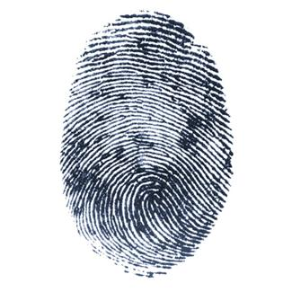
fingerprint

Slide 6
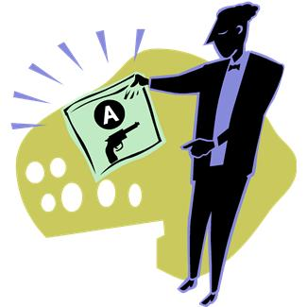
evidence

Slide 7
DNA

