Slide 1
Cities
Stephen Roney JIC Autumn 2012

Slide 2
The following slides show these cities:
Montreal Tokyo New York Vancouver Sao Paolo Toronto London Krakow Manama Dubai
Can you recognize them?

Slide 3
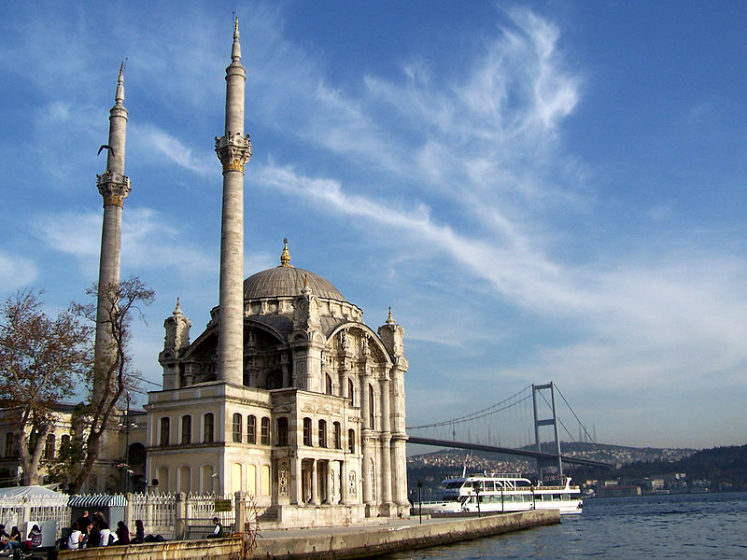

Slide 4
Istanbul

Slide 5
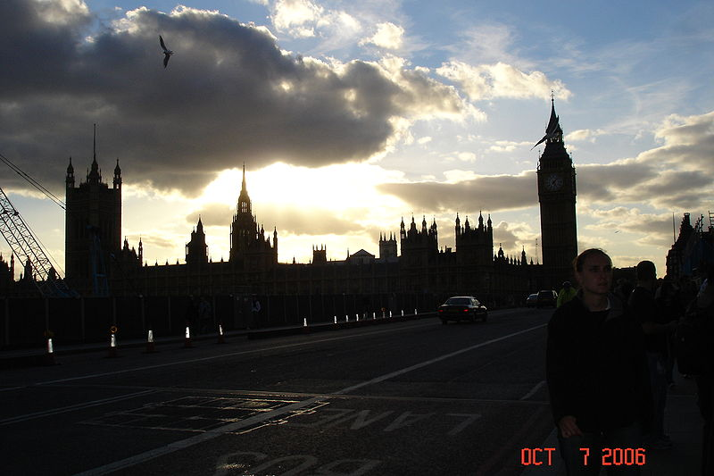

Slide 6
London

Slide 7
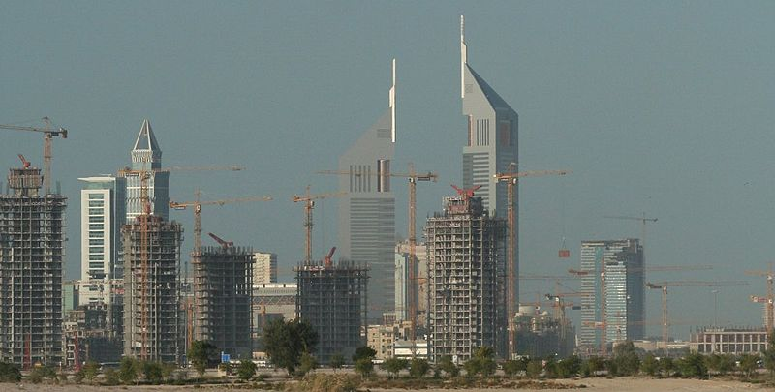

Slide 8
Dubai

Slide 10
Montreal

Slide 11
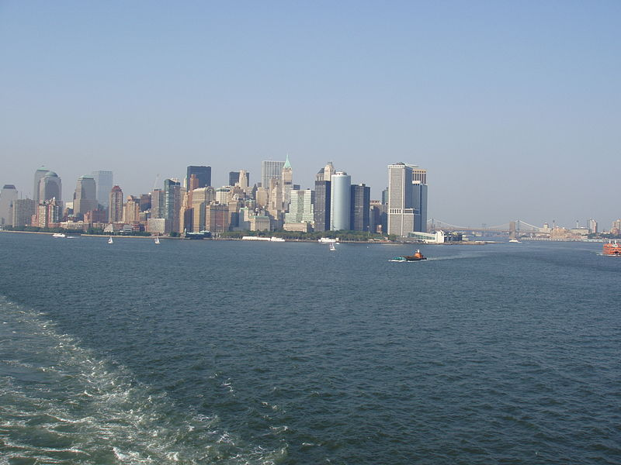

Slide 12
New York

Slide 13
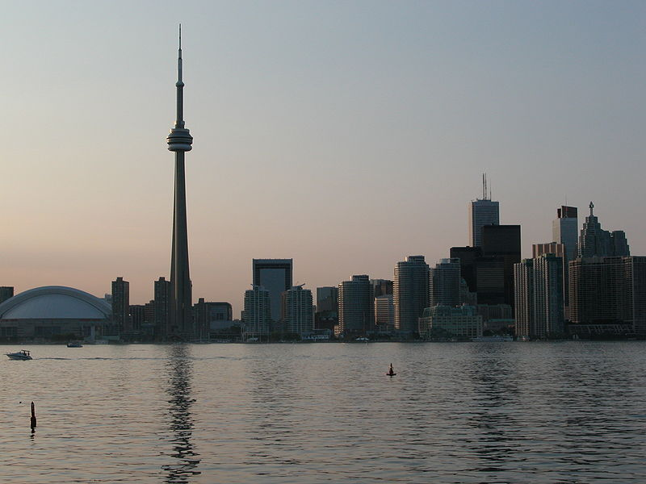

Slide 14
Toronto

Slide 15
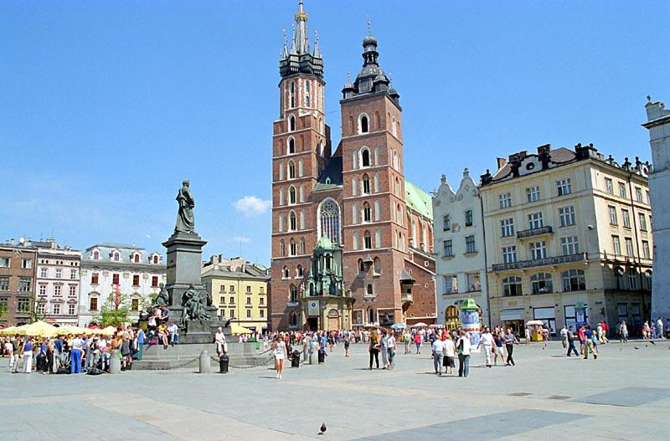

Slide 16
Krakow

Slide 17
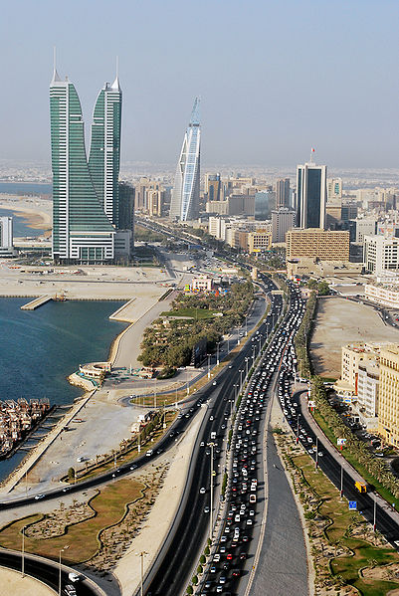

Slide 18
Manama

Slide 19
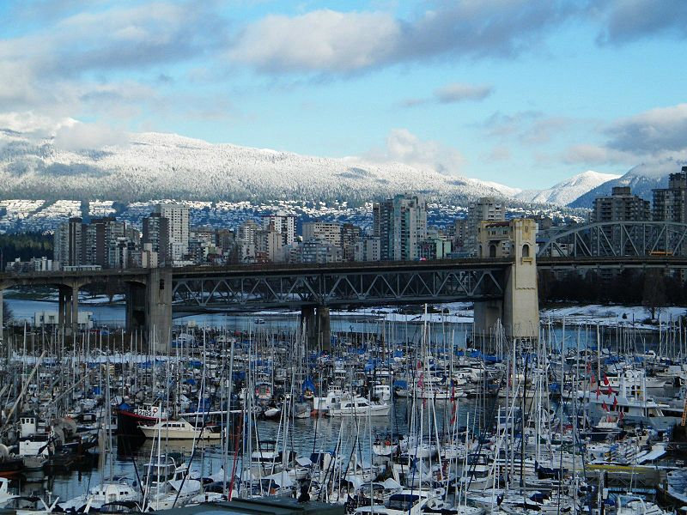

Slide 20
Vancouver

Slide 21
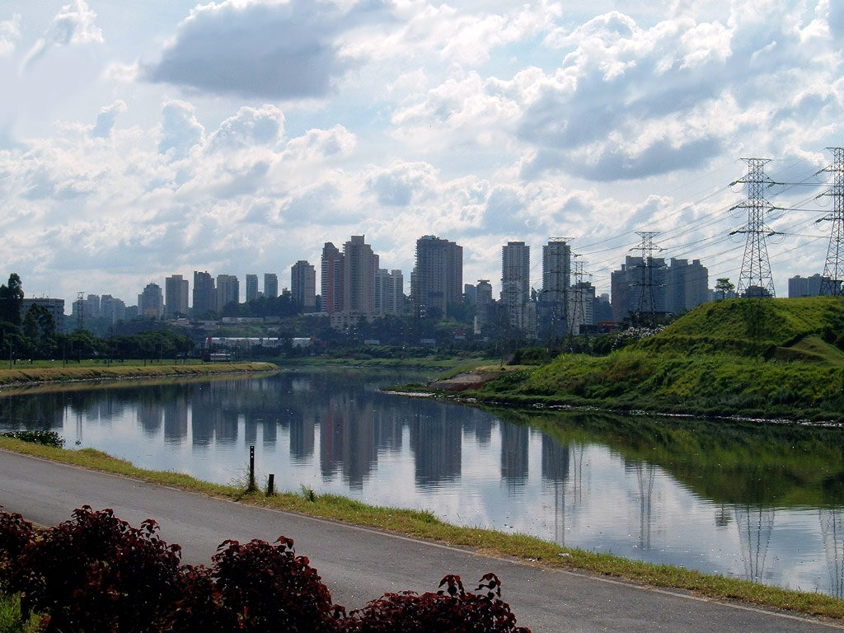

Slide 22
Sao Paolo

Slide 23
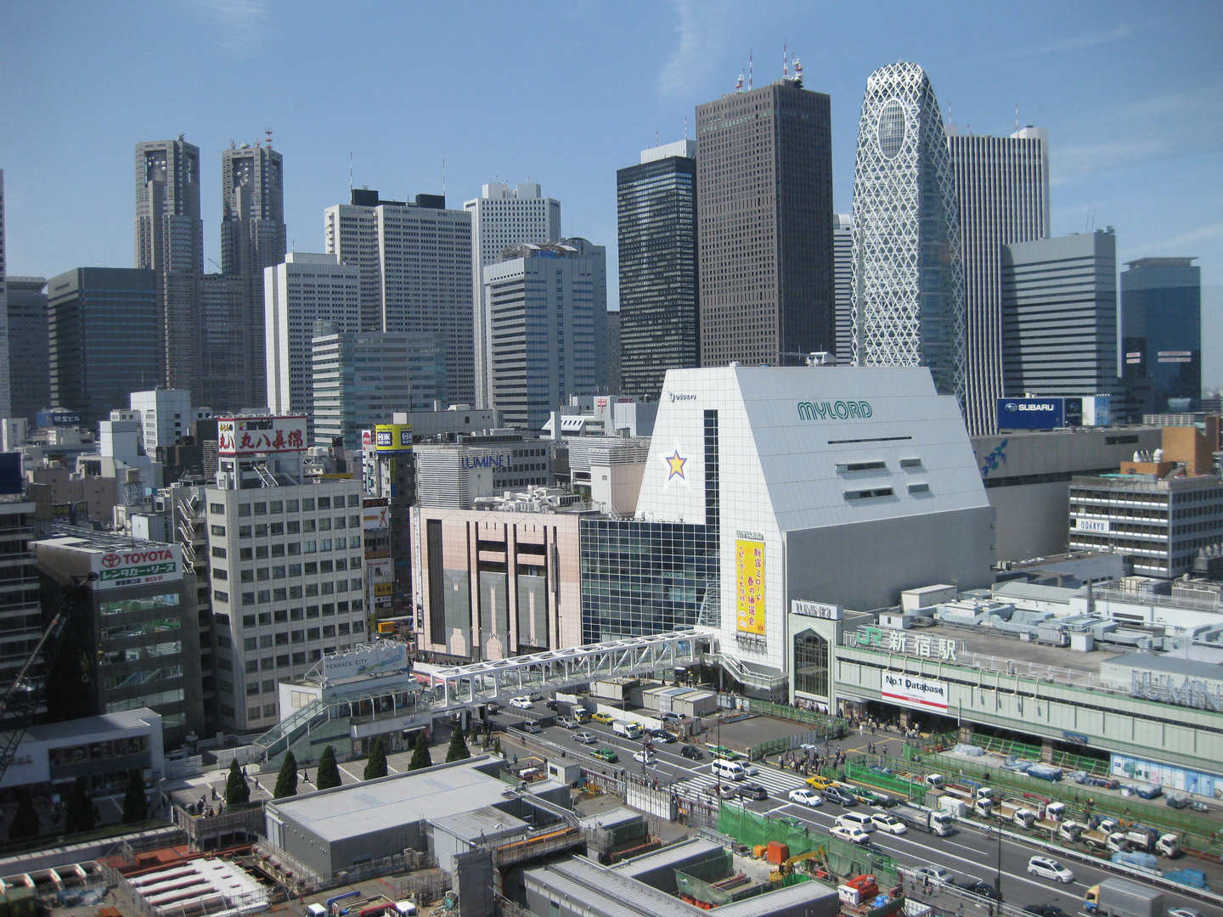

Slide 24
Tokyo

