Slide 1
Canadian Sports & Pastimes
Stephen Roney
JIC
February 2013

Slide 2
baseball

Slide 3
football

Slide 4
curling

Slide 5
skating

Slide 6
snowmobiling

Slide 7
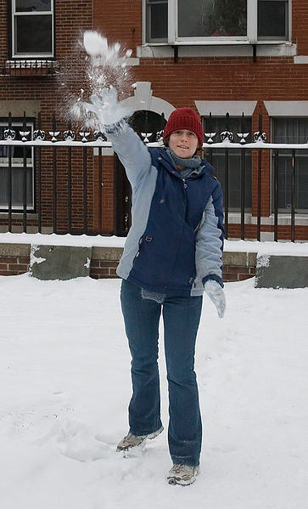
snowball fighting

Slide 8
hockey

Slide 9
tobogganing

