Slide 1
Buildings Vocabulary
Stephen Roney
JIC
September 2012

Slide 2
furniture

Slide 3
garden

Slide 4
door

Slide 5
courtyard

Slide 6
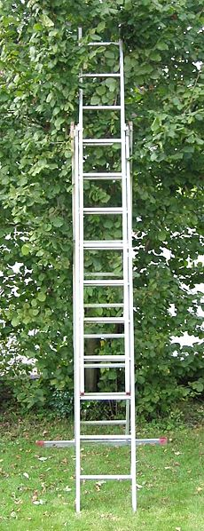
ladder

Slide 7
painting

Slide 8
gate

Slide 9
room

Slide 10
wall

Slide 11
window

Slide 12
roof

